Slide 1

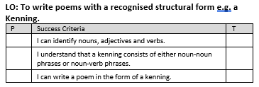

Slide 2
NOUNS
ADJECTIVES
VERBS
WIPEOUT

Slide 3
Nouns, Verbs and Adjectives WIPEOUT
On the boards that follow, all you have to do is pick out the 7 options which belong in the category at the bottom of the screen.
You must avoid wipeouts.
One of these and you’re out!

Slide 4
car
red
school
loud
WIPE
OUT
WIPE
OUT
television
dog
pen
ran
WIPE
OUT
shouted
rock
freezing
exercise book
WIPE
OUT
WIPE
OUT
NOUNS

Slide 5
witch
angry
triangle
circular
WIPE
OUT
WIPE
OUT
blue
cold
cried
sad
WIPE
OUT
painting
neat
writing
beautiful
WIPE
OUT
WIPE
OUT
ADJECTIVES

Slide 6
shouted
ran
said
car
WIPE
OUT
was
yellow
slow
runner
WIPE
OUT
WIPE
OUT
WIPE
OUT
after
tried
jumped
am
WIPE
OUT
VERBS

Slide 7

WIPEOUT !

Slide 8
Thanks for Playing
WIPEOUT

Slide 9
What is it ?
A kenning is a way of describing something using clues rather than just saying what it is.
Each line is two words long.
A heat giver
A light maker

Slide 10
The word kenning comes from a Viking phrase which means:
"to express a thing in terms of
another“
It is like a ‘mini riddle’ used to describe something

Slide 11
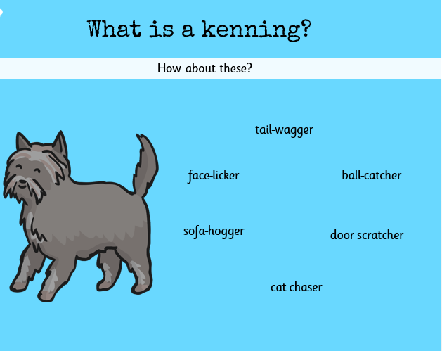
Notes:
What could this kenning be about?

Slide 12
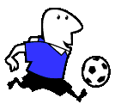
A ball chaser
A crowd pleaser
A fast runner
A sneaky diver
A corner taker
A goal scorer
A mate hugger

Slide 13

How do I write one ?
It is not as hard as it seems.
Remember:
To start each kenning with A ………
A night flyer,
A mouse eater,
A silent swooper

Slide 14
Remember:
To use verbs to describe the object further ………
A night flyer,
A mouse eater,
A silent swooper

Slide 15
And if you want a challenge use alliteration
A night flyer,
A mouse eater,
A silent swooper

Slide 16
Think about what the subject does….
For example a wolf
Comes out at night
Eats meat
Hunts its prey
Lives in the woods
Howls at the moon
This becomes…………

Slide 17
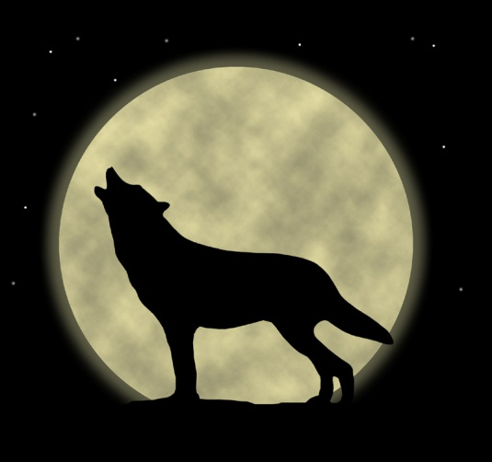
A night mover
A meat eater
A prey hunter
A wood dweller
A moon howler

Slide 18
Notes:
Model writing a class one together.

Slide 19
Plenary:
Lets share some of our Kennings.
Don’t tell us the title, lets guess what they could be about.

