Slide 1
Writing our story

Slide 2
The first part of this lesson we will be finishing our story.
Lets make sure we are writing our very best!

Slide 3
Writing checklist:
Make sure you are reading through your work and checking it makes sense.
Capital letters at the beginning of sentences and for names!
Punctuation . ! ?
Exciting, descriptive language- adjectives, expanded noun phrases.
Conjunctions- but, and, however, because, so.
Adverbs- a word that describes a verb (an action or a doing word).
Prepositions- a word that tells you where or when something is in relation to something else.

Slide 4
LO: To read through and edit my story.
Success Criteria:
I can check my story makes sense.
I can check my writing for capital letters and full stops.
- I can check my writing to improve my word quality.

Slide 5
Do you have any interesting or exciting expanded noun phrases or adverbs, that you have used in your story that you can share with the class?
Lets create a word bank on flipchart.
Could you magpie any good words or phrases off the word bank when editing your story?

Slide 6
Lets edit!
Just like our Exciting Writing editing sessions, we are going to edit our story.
Can we remember our editing stations?

Slide 7
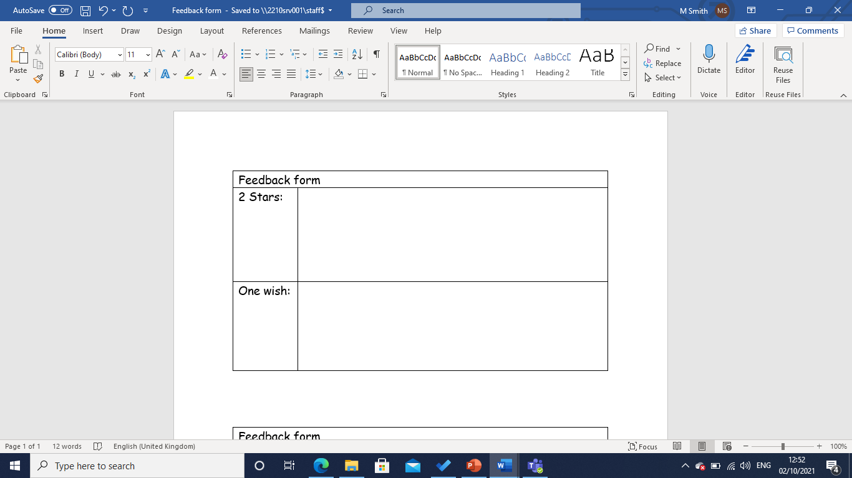
Once you think you have finished and improved your story, swap your book with a partner and complete the 2 stars and a wish form.
Could you improve your story from the wish?

