Slide 2


What Is Poetry?
Poetry is written by a poet.
When a poet writes a poem, they try to get you to use your imagination or feelings, when you are reading it. They do this by thinking about what words mean and how they sound. The poet might change the order of words to make them sound a certain way.
Sometimes, poems have rhyming words in them.
Poetry is meant to be read aloud.
Poet – someone who writes poetry

Slide 3
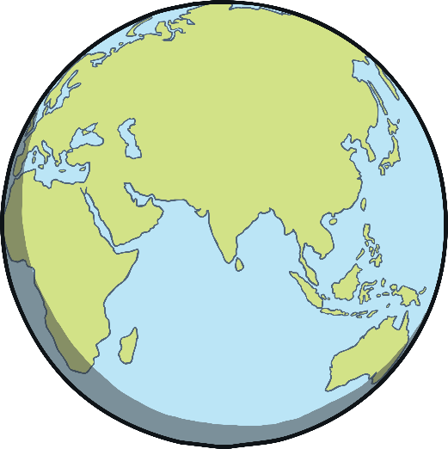

What Is World Poetry Day?
World Poetry Day is 21st March.
It was started by a group called UNESCO. This group celebrates the things that make countries all around the world special.
World Poetry Day celebrates poems in lots of different languages and from lots of different countries.
It encourages people to write poetry and recite poetry.
Recite – say out loud

Slide 4


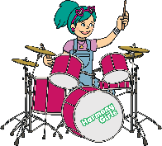
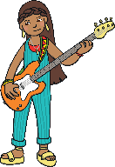
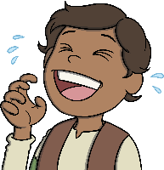



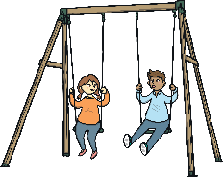
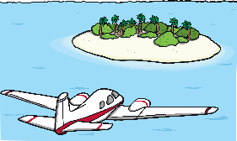
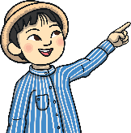


Rhyming Words
Some poetry has rhyming words at the end of lines. When words rhyme, they start with different sounds, but sound the same at the end of the words. So ‘cat’ rhymes with ‘bat’ and ‘hot’ rhymes with ‘lot’.
Can you match up these rhyming words?
sun
band
joke
bit
ring
fun
poke
hit
swing
land

Slide 5
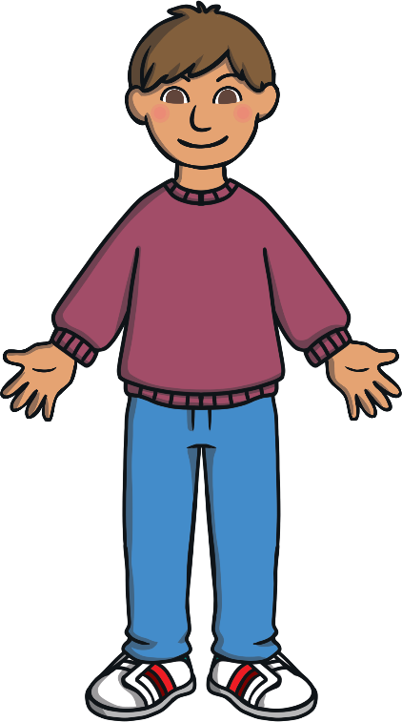

Rhythm
In poetry, rhythm is the pattern that the words make and how they sound, when put together. It can make the poem sound fun to read and can make it easier for you to learn the poem off by heart.
Look at this sentence:
My brother has a jumper and my sister has a skirt.
Try reading the sentence out loud and listen to the pattern the words make.
This is rhythm.

Slide 6
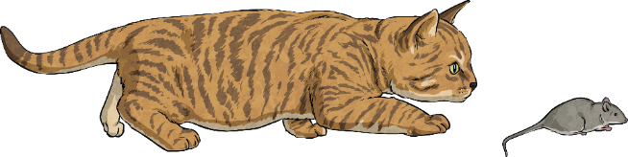
Using Syllables
Poetic Term
A syllable is a unit of written or spoken words. Syllables are broken up sounds that are used to create words.
One syllable = monosyllabic
More than one syllable = polysyllabic
Syllables are used in poetry to create rhythm.
Look at the syllable pattern in this poem:
Cat, (1)
Fluffy, (2)
Catches mice, (3)
My faithful pet. (4)

Slide 7
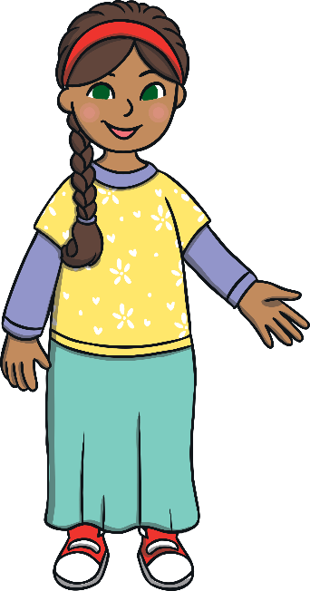
Limericks
There are over 50 types of poem.
This is a limerick.
Limericks are funny and have rhyming words.
There once was a girl from Bombay,
Who always had something to say
Her tongue went too fast,
Her voice didn’t last,
And was quiet the rest of the day.
?
Can you spot the rhyming words at the end of some lines?
?
How does the rhythm of the poem sound?

Slide 8
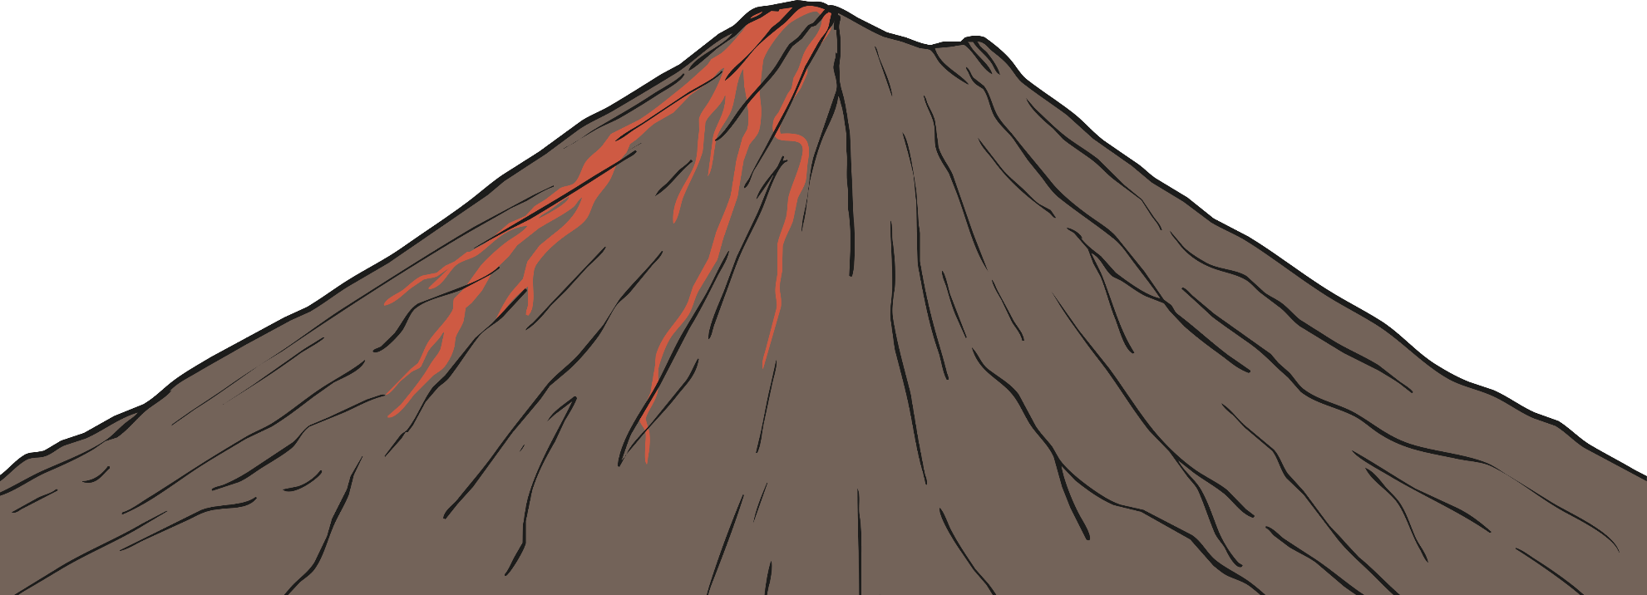
Shape Poetry
Shape poems are written in the shape of the thing the poem is about. Look at this poem.
?
What is the shape of the poem?
?
Does it have rhyming words at the end of lines?
A
huge rock
that rumbles
and roars, wrecking
the ground all around it.
It shoots; sizzling, steaming, scorching lava
like a monster spitting out hot liquid into the air.
Like a smoking dragon, it finally starts to calm down.
The chaos stops and it goes back to being a deadly and dangerous rock.

Slide 9
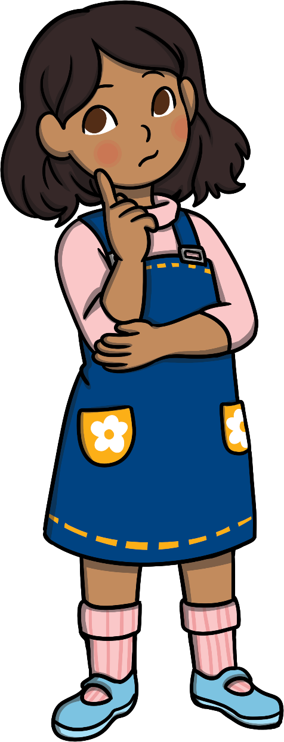
Acrostic Poetry
The first letter of each line spells out what the poem is about.
An acrostic poem
Could be about anything you want
Really.
Of course, you can
Say what you like.
That’s what’s so easy
I might write one right now
Can you guess what it’ll be about?
?
What do the letters in green spell?

Slide 10
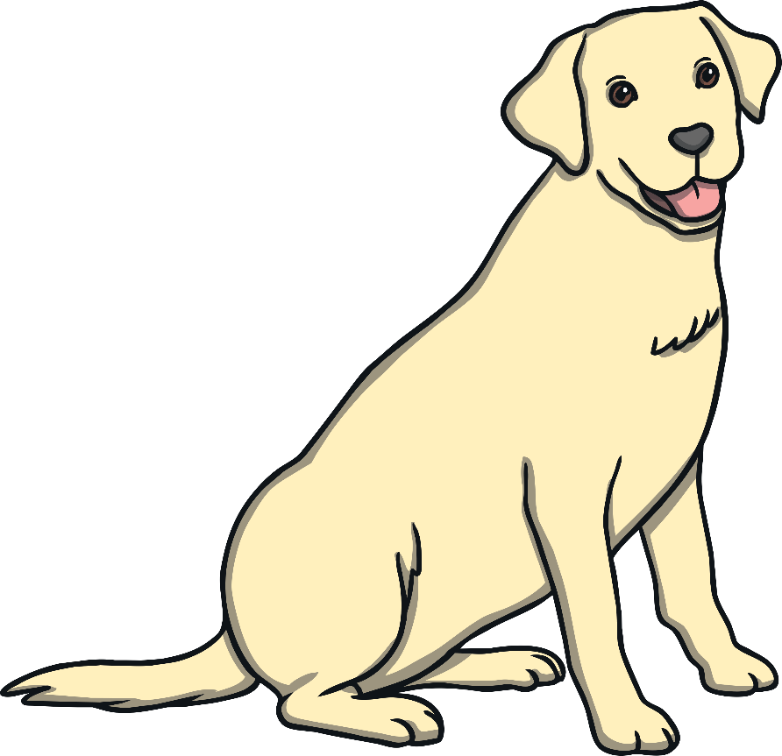
Free Verse
Free verse has no rhyming words. Lines can be full sentences or even just one word.
There’s nothing like a dog
For cheering you up when you’re blue
By licking your face, or
Falling at your feet.
There’s nothing like a dog
For chewing your new shoes
Or running of with your book
Woofing like mad!
There’s nothing like a dog
For always wanting to be with you
Following you everywhere
Being your best friend forever.

Slide 11
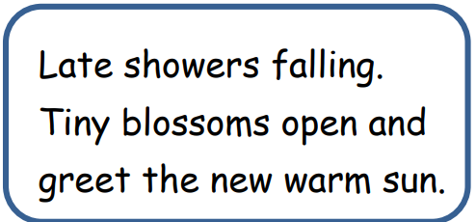
Haiku
Haiku poems are a traditional Japanese art form.
Each haiku has only three lines.
The lines follow a pattern of syllables:
5-7-5
Haiku are often written about nature or the seasons, but they don’t have to be!
My two plum trees are
So gracious. See, they flower.
One now, one later.

Slide 12

Kennings
Kennings describe something using clues rather than just saying what it is. Each line is two words long.
A ball chaser
A crowd pleaser
A fast runner
A sneaky diver
A corner taker
A goal scorer
A mate hugger

Slide 13
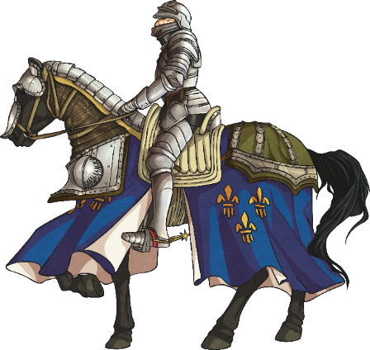
Metaphor
Poetic Term
A metaphor is a figure of speech which describes a place, object or subject as something unlikely and uncommon.
Metaphors are used in poetry to create an image of judgement and comparison in the mind of the reader.
Some examples of metaphor:
Her eyes were glistening jewels.
She is the sunshine which brightens up our day.
The kids at school are all brains.
In Andrew’s eyes, Rebecca is the sun.
He is my knight in shining armour.
The world is a stage.

Slide 14
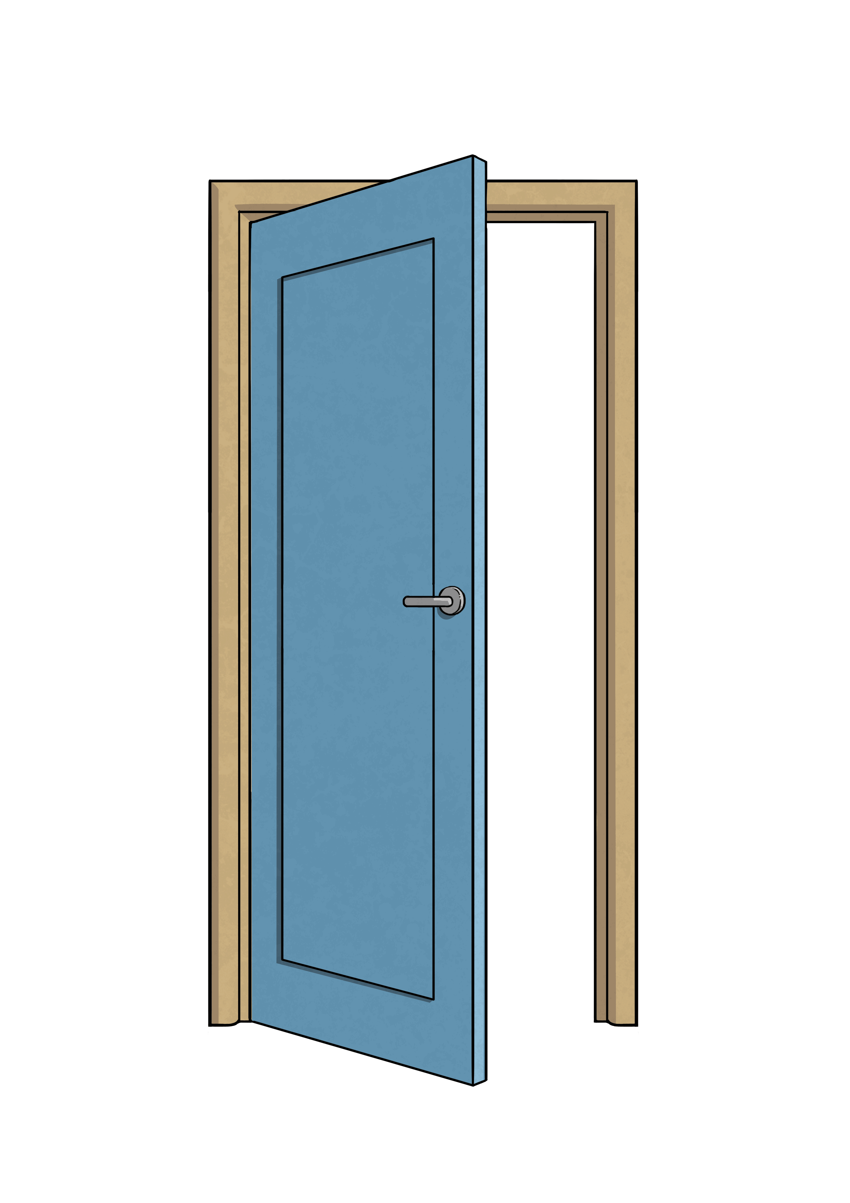
Using Onomatopoeia
Poetic Term
Onomatopoeia is when a word imitates its natural sound, or suggests the sound a certain object makes.
It is used in poetry to create a sound effect to make the description more expressive and interesting.
Some examples of onomatopoeia:
bang
crash
pop
smash
drip
buzz
tick tock
whoosh
wham
pow

Slide 15

Simile
Poetic Term
A simile is a figure of speech. It is when one thing is compared to another using the words ‘like’ or ‘as’. Similes can be as descriptive as the writer chooses.
Similes are used in poetry to give the reader a more descriptive and in-depth understanding about a particular object or person.
Some examples of simile:
As busy as a bee – This is comparing someone’s level of energy to the speed of a bee.
As snug as a bug in a rug – This is comparing someone who is very cosy to how comfortable a bug would be in a rug.
Runs like a cheetah – This is comparing the speed that someone can run to the speed of a cheetah which is quite fast.
As white as a ghost – This is comparing a person’s skin colour to a ghost, usually because they are frightened, sick or scared of something.

Slide 16
Synonym
Poetic Term
A synonym is a word that has the same, or similar, meaning as another word. Synonyms can be found in a thesaurus.
Synonyms are used in poetry to be more graphic and to give a broader description.
Some examples of synonyms:
Beautiful – attractive, pretty, gorgeous, stunning
Funny – hysterical, humorous, amusing, entertaining
Student – pupil, scholar, schoolboy, schoolgirl
Lazy – idle, sluggish, indolent, slothful

Slide 17
Anagrams
Unjumble the letters to find the types of poetry.
Can you explain the features of each type of poem?
shape poetry
ashep treopy
free verse
eefer rrevs
acrostic poetry
rictsoac treopy
limerick
kicermil

