Slide 1
Word Quality
Exciting Writing Edit Lesson 3

Slide 2
LO: To understand how we can improve our writing focusing on word quality.
Success Criteria:
I can understand what a synonym is.
I can use a dictionary correctly and effectively to help with spellings or find definitions.
I can use a thesaurus correctly and effectively to help with the quality of my writing.

Slide 3
Notes:
Write a sentence on the board with bad punctuation and with no conjunctions/adjectives or adverbs. Ask children to rewrite on whiteboard with correct punctuation and grammar. Then if chd have finished, ask chd to label each word for the correct word class.

Slide 4
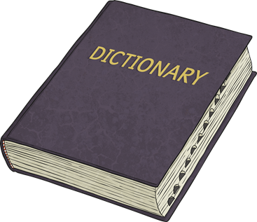

Quick Comparison
A dictionary is a book which lists words and tells you what they mean.
A thesaurus is a book which lists words and gives alternative words which mean the same thing.
If you want to know what a word means, you would check a dictionary.
If you want to find a synonym for a word you already know the meaning of, you would check a thesaurus.

Slide 5
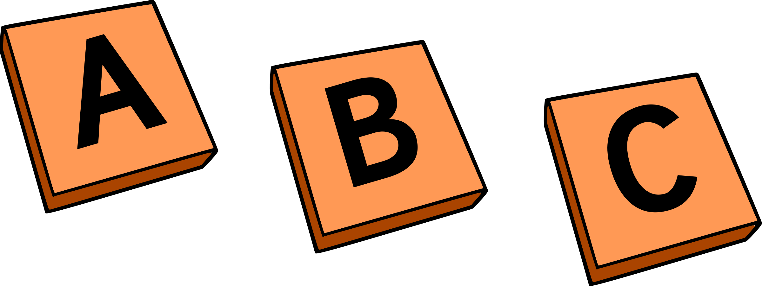
Alphabetical Order
All of the words inside a dictionary are in alphabetical order. This makes it a lot quicker to find the words you need.
Some dictionaries have marks along the edge of the pages. These marks show you where each new letter begins. Does your dictionary have these?

Slide 6
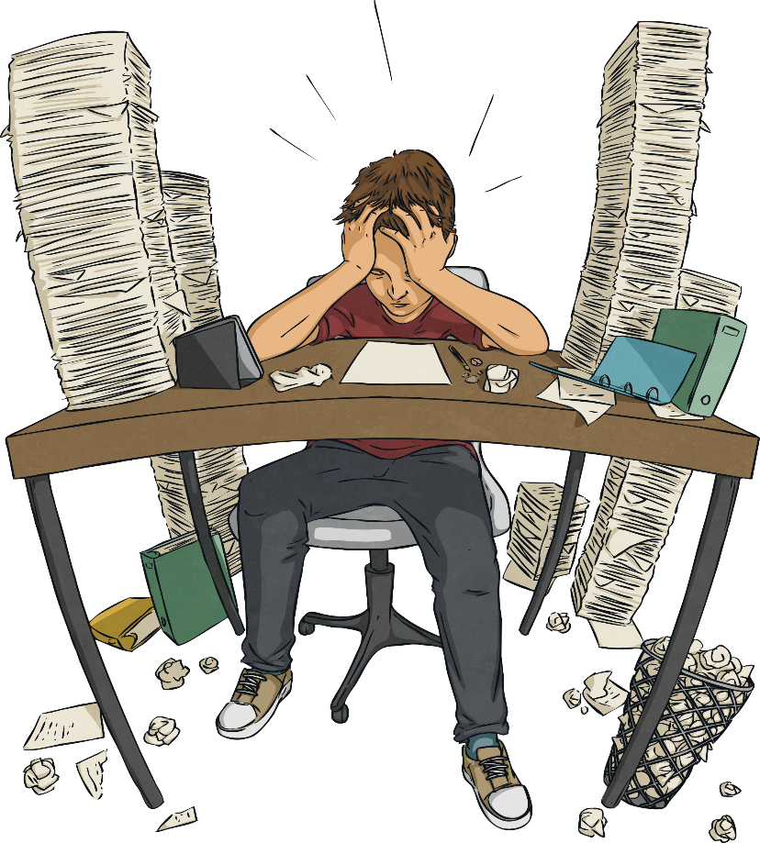
Using a Dictionary
Dictionaries are really useful when you’re trying to find the meaning of a word you’re unsure about, or to check the spelling. However, words may sometimes have more than one meaning. You will need to think carefully in order to choose the correct definition.

Slide 7
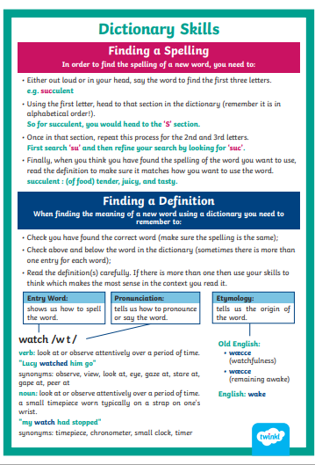

Slide 8
Finding words alphabetically:
2nd letter
AardvarkAbacus
1st letter
Able
Disarm
3rd letter
Director
Dismiss

Slide 9

What comes first?
Dingy or Dinner
Diplomat or Diploma?

Slide 10
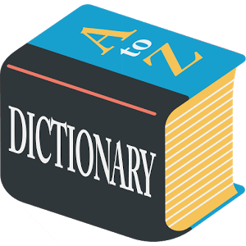
Task One:
Using what we have just discussed, can you use a dictionary to find the definition of these words and write them in your books.
Recycling:
Litter:
Encourage:

Slide 11
Thesaurus
Sometimes you might want to find a different way of saying something. A thesaurus can help you with this.
If you look up a word in a thesaurus it will show you a list of synonyms. These are other words that mean the same thing or something similar.
One of these synonyms might be a better way of saying what you want and you could use it instead.
A thesaurus is a book which lists words and gives alternative words which mean the same thing.
We find words in thesauruses the same as we do in dictionaries, the words are in alphabetical order.

Slide 12
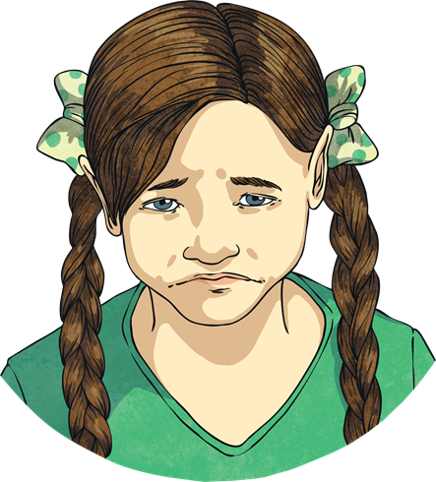
Synonyms List
We are going to practise creating a list of synonyms.
How many synonyms can you jot down for the word sad?
Here are some words that could have been used:
unhappy
miserable
upset
depressed
morose
gloomy
heart-broken

Slide 13
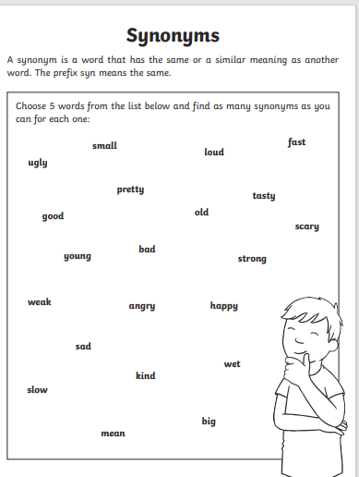
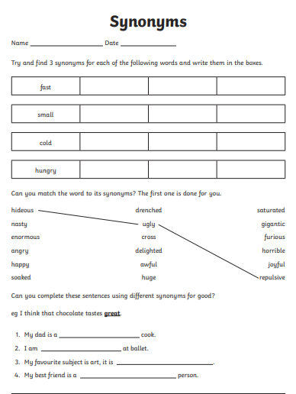
Task Two: Complete the worksheet all about synonyms.
Year 2
Year 3

