Slide 1
Word classes and conjunctions
Exciting Writing Edit Lesson 2

Slide 2
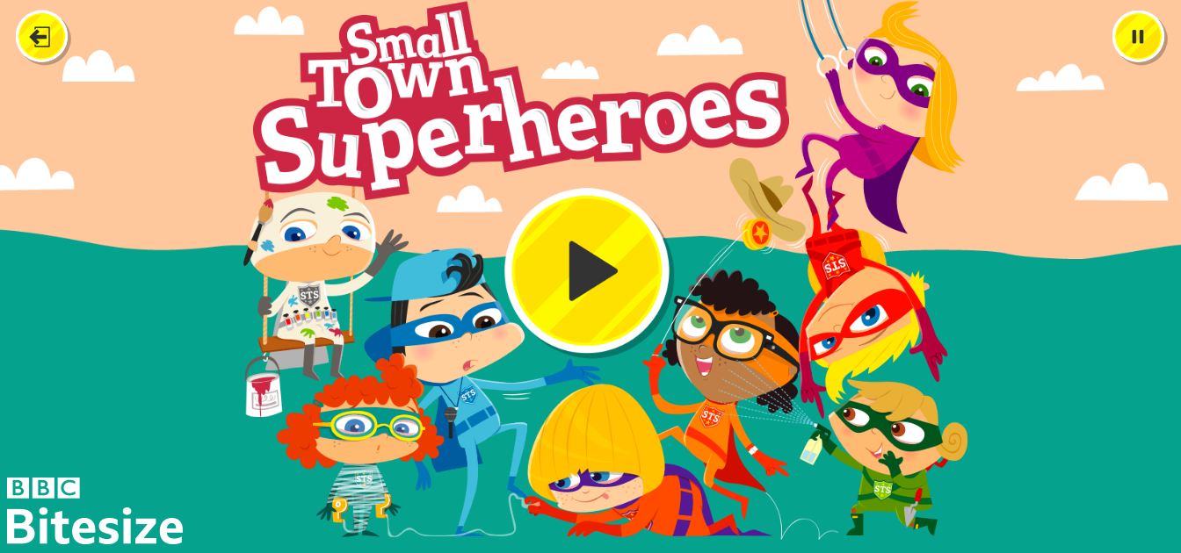
Starter:
Small Town Superheroes (bbc.co.uk)

Slide 3
LO: To understand, identify and use word classes and conjunctions within our writing.
Success Criteria:
I can identify different word classes and conjunctions in a piece of writing.
I can discuss the definitions of different word classes.
I can use different word classes and conjunctions to make my writing more exciting.

Slide 4
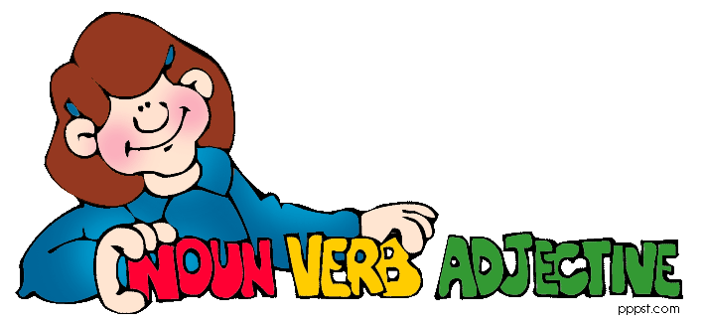
What is a word class?
All words belong to categories called word classes (or parts of speech) according to the part they play in a sentence. The main word classes in English are:
Noun
Verb
Adjective
Adverb
Pronoun
Preposition
Conjunction

Slide 5
Verbs
A word that describes what a person or thing does, such as: run, hit, rain, be, seem, become, grow
Although he was tired, the young boy ran quickly into his bedroom to read a book.

Slide 6
Nouns
A word that identifies a person, place thing idea or quality, such as: woman, dog, building, London, truth, birth
Although he was tired, the young boy ran quickly into his bedroom to read a book.

Slide 7
Adjectives
A word that describes a noun, such as:
red, bad, giant, hairy, shy
Although he was tired, the young boy ran quickly into his bedroom to read a book.

Slide 8
Adverbs
A word that gives more information about a verb adjective or another adverb, such as: lazily, easily, abroad, very
Although he was tired, the young boy ran quickly into his bedroom to read a book.

Slide 9

Task One:
In pairs, you need to complete the activity. You need to organise the words into the correct word classes.
Noun
Verb
Adjective
Adverb

Slide 10
Conjunction
A word that connects, phrases or sentences,
such as:
and because but for, if, or
Although he was tired, the young boy ran quickly into his bedroom to read a book.

Slide 11

Conjunctions
Let me remind myself what conjunctions are……
Connect ideas
within a sentence
They make one short sentence into a two clause sentence
Although he was tired, the young boy ran quickly into his bedroom to read a book.

Slide 12
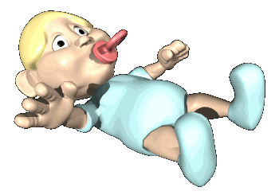
The baby cried and cried until he was given his favourite dummy!

Slide 13

The green car caused a crash because he was too close to the red car.

Slide 14

The torch will shine brightly as it has had new batteries.

Slide 15

Until because as
Can you use one of the conjunctions above to make these two short sentences into one sentence with two clauses?
I really like a cup of hot chocolate. It makes me feel cosy and warm.

Slide 16
Task Two:
Using the example piece of writing, can you improve it by adding in what we have learnt today?
Think about adjectives, different word classes, adverbs and expanded noun phrases.
Extension:
Using what we have learnt today, can you write your own sentences?

Slide 17
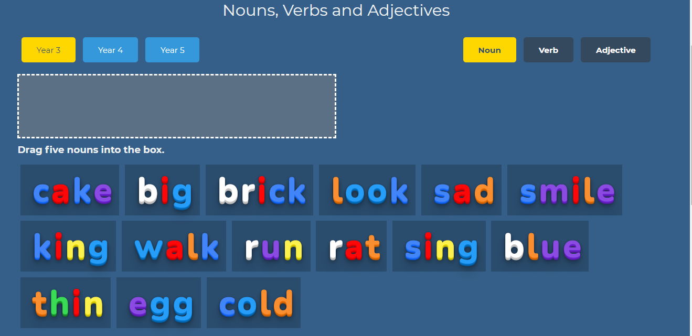
Plenary:
Word types (bigbrownbear.co.uk)

