Slide 1
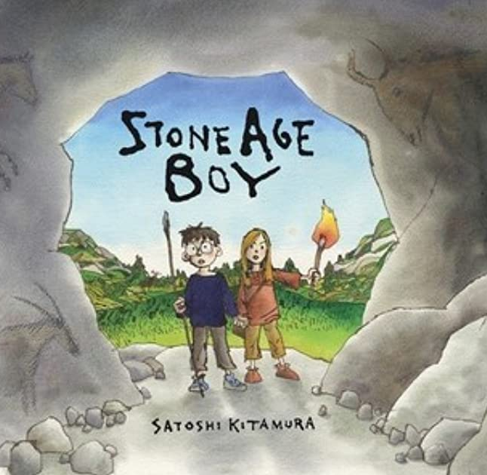
Stone Age Boy
Lesson 3

Slide 2
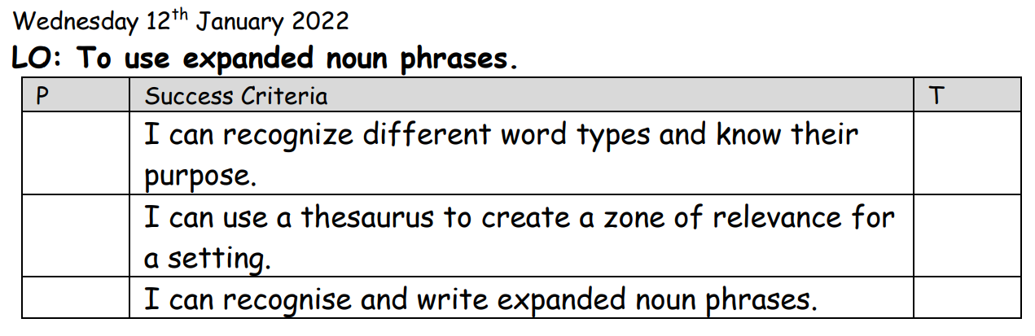

Slide 3
Starter:
What are the different word types?
How can we describe them? e.g. a noun is a person place or thing.
Can you think of a sentence that includes all of the word types that we know so far.
Notes:
Adjectives, nouns, verbs, adverbs

Slide 4
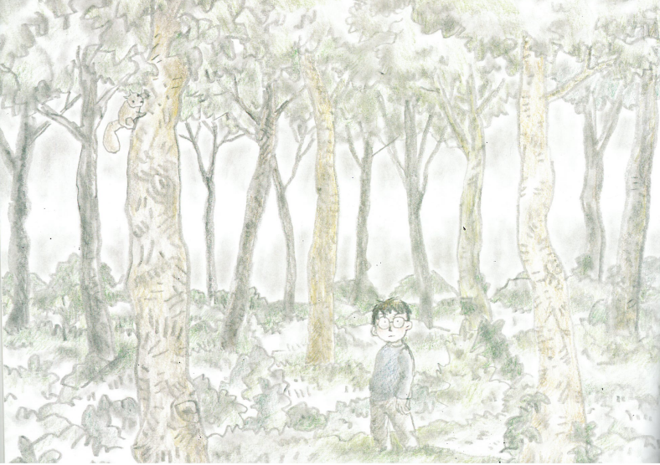
Notes:
Annotate as a class what has happened? Where is he? Who is he? What might happen next?

Slide 5
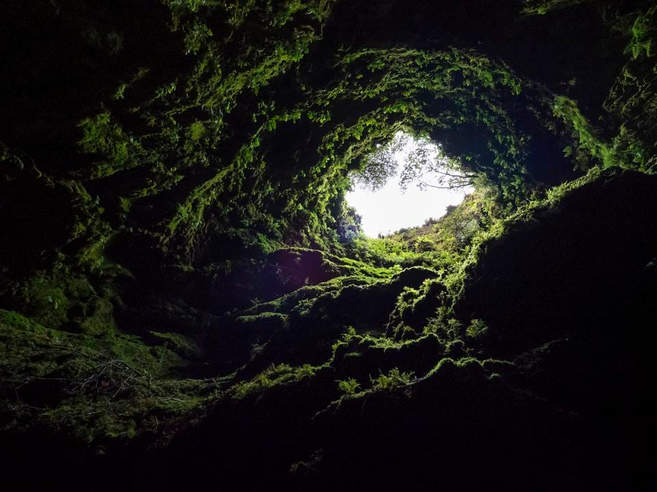
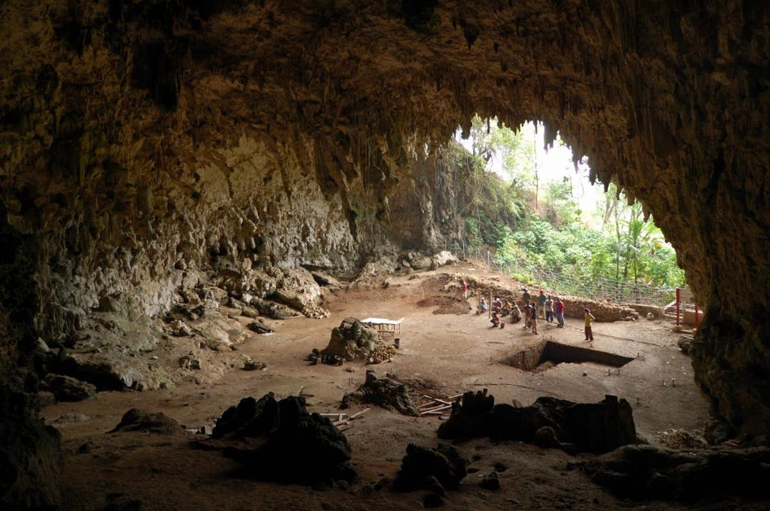
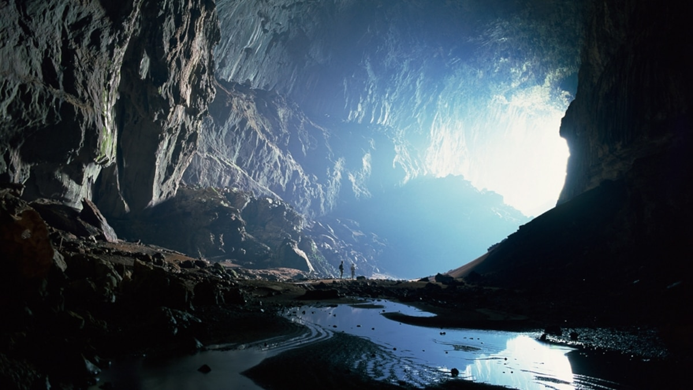
Notes:
Look at a range of pictures of caves. Which part of our story does this link to? Do the caves look different or similar?

Slide 6
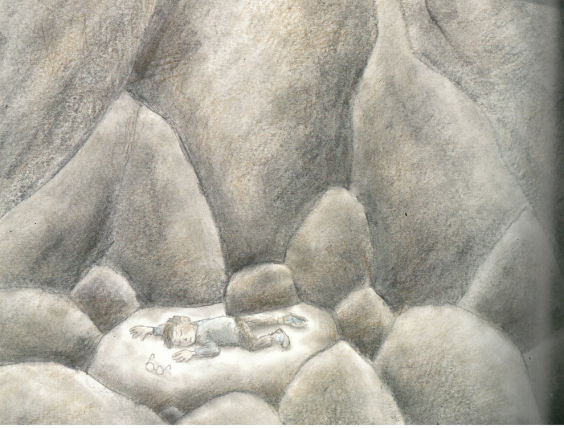
Notes:
This is the image that we are going to create a zone of relevance for.

Slide 7
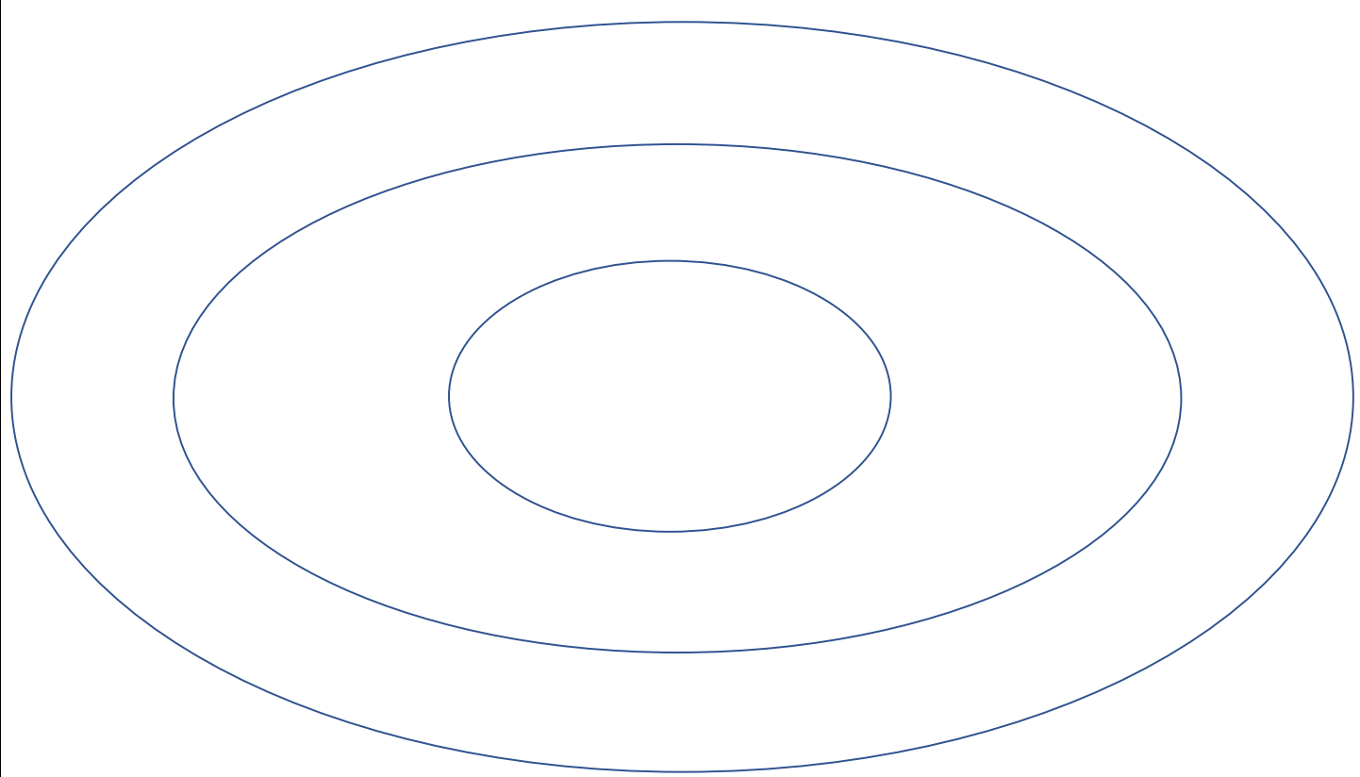
Notes:
Demonstrate how to create a zone of relevance on an image of the cave or forest - Most exciting words in the middle and less exciting outside highlight appropriate word choices.
Model writing expanded noun phrases – emphasis on extra detail and exciting vocabulary.

Slide 8
Task 1:
Using either the picture of the cave or the forest, create a zone of relevance.
Less exciting words go in the outside circle e.g dark, cold, rocks
More exciting words go in the middle circle e.g. pitch black, freezing.
Most exciting words go in the middle circle – use a thesaurus to find these.
Notes:
Choose your boring words first, then use a thesaurus to find interesting synonyms.

Slide 9
Task 2:
Choose some of the most interesting adjectives and create expanded noun phrases about your setting. Try to describe different parts of the setting.
E.g. Swaying, evergreen trees.
Adjective, adjective noun.
Year 3, write sentences including adjective, adjective noun and include some prepositions e.g. next to, under, above.
EXT: Can you write a sentence for each of the five senses about your chosen setting?

