Slide 1

Stone Age Boy
Lesson 1

Slide 2
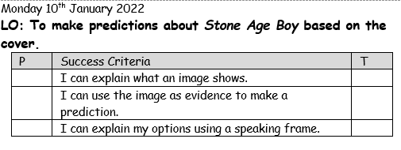

Slide 3

Let’s look at the example front cover which should be familiar to us. With your partner, can you predict what this book might be about.
Remember to say:
I predict that…. I think this because.

Slide 4
Notes:
Main:
Use cropped picture of SAB to ask children to make predictions about what they think this tale might be about on carpet before revealing the title. Annotate picture on whiteboard with key words that the children use e.g. adventure, cave, scared. What do you notice about the differences in the two children? Where do you think they are and why? Look at their face – what have they just seen? Feedback ideas as a class.

Slide 5
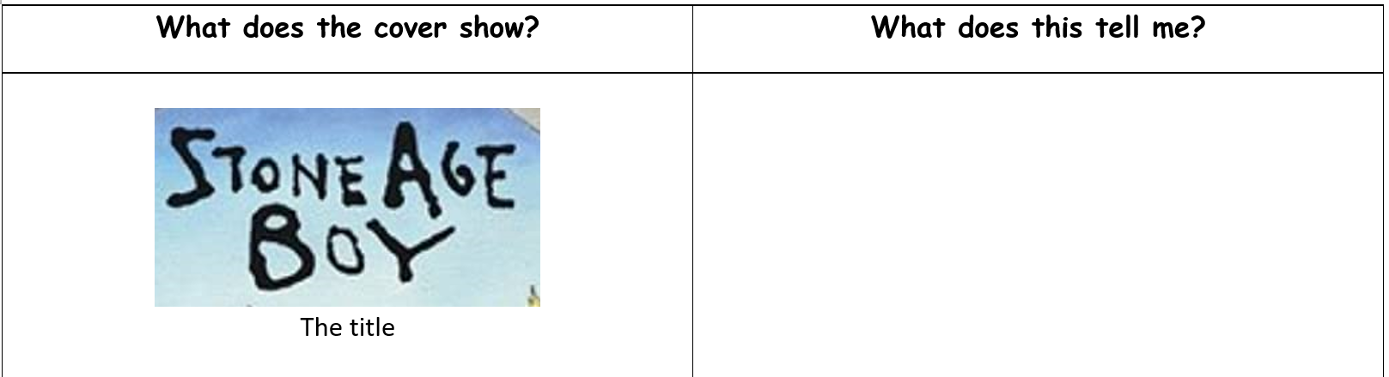
This tells me that the story will be set in the Stone Age. I can guess that it might be about a boy who lived in the Stone Age.
Notes:
Model using a table to help create predictions. One side evidence from cover, the other what we can predict from it.

Slide 6
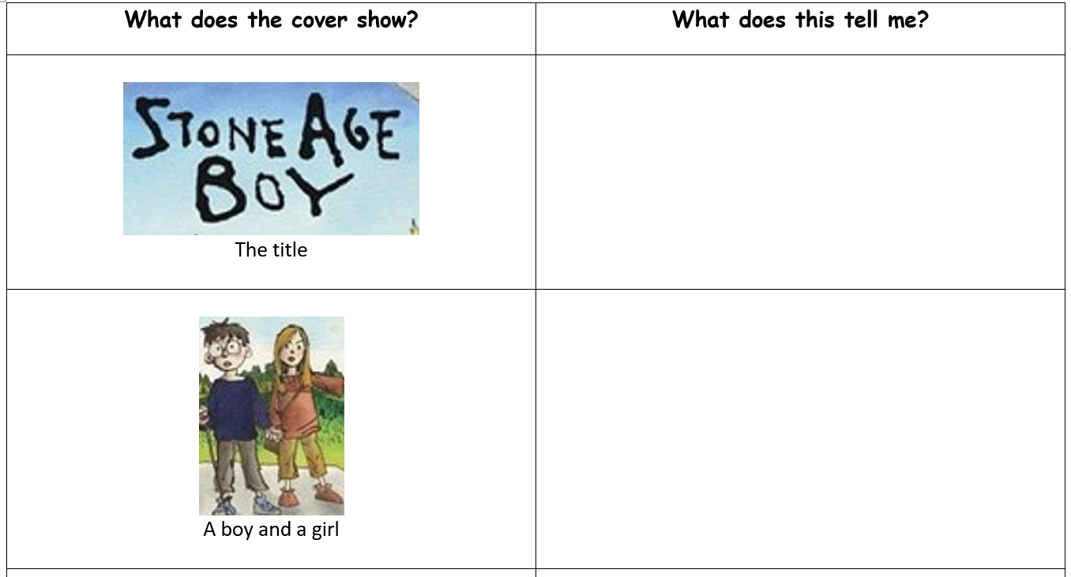
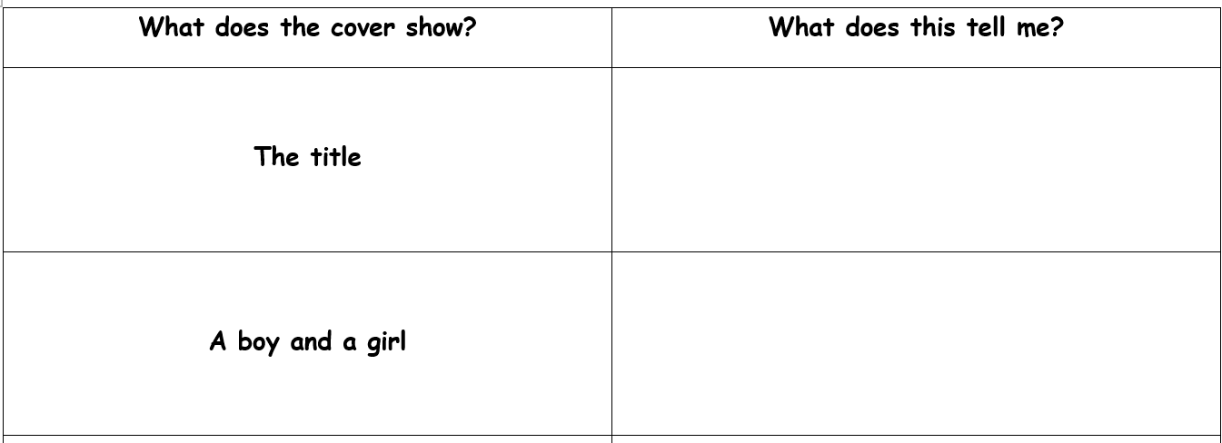
Your task:
Using the front cover of Stone Age Boy, complete your table. Some children will have pictures to help you, some children will have words to help you, and some will have a blank grid to fill in.

Slide 7

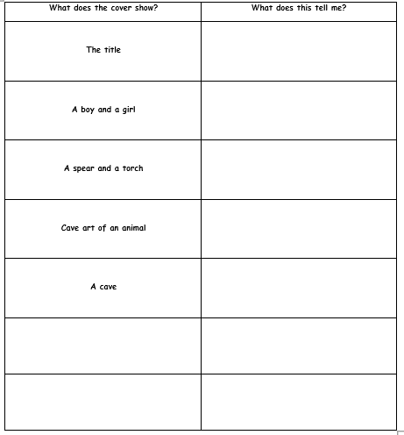
LO: To make predictions.
Notes:
Layout

Slide 8
Plenary:
To finish, write a few sentences to write a complete prediction using the information you have gathered. E.g.
‘I predict that this story is about two friends who go back in time. I think they become cavemen because I can see some Stone Age cave art on the walls. I also think they will go back in time through the cave because they look like they are going to walk into it.’

