Slide 1

Poetry
Lesson 1

Slide 2
LO: To explore poems with rhyme schemes.
I understand what a rhyme scheme is.
I can identify the rhyme scheme used in the poem.
I can annotate a poem to show the rhyme scheme and rhyming words.

Slide 3
Rhyme hunt
How many rhymes can you think of for these words:
paws
feet
hot
tree
cute
Notes:
Use IWB to brainstorm ideas.

Slide 4
What is a poem?
A poem is made up of words and some words rhyme. Some poems have a fast rhythm, while others are slow. Someone who writes poetry is called a poet.
Notes:
What is a poem? Who writes a poem – are they an author or do they have a different name? give chn time to discuss.

Slide 5
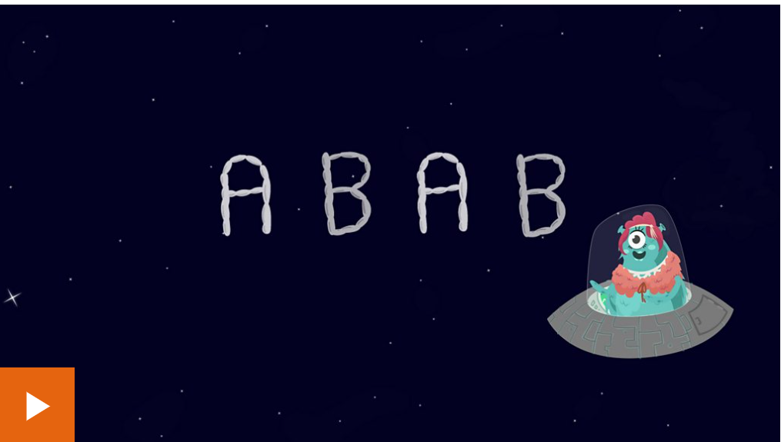
What is a rhyme scheme or patten?
Notes:
What is a rhyme? What is a rhyme scheme? Do all poems have to have a rhyme scheme? Give chn time to discuss.
What is a rhyme scheme? - BBC Bitesize

Slide 6
What rhyme scheme does this poem have?
Dear Santa,
Christmas is coming and I know I should be glad,
But to tell the real truth, I am really, really sad.
You see, I have lost something so precious to me,
And there is no way you could put it back under my tree.
Notes:
Source: https://www.familyfriendpoems.com/poem/my--christmas-wish
Chn should be able to identify AABB and write on whiteboards the rhyming words.

Slide 7

What rhyme scheme does this poem have?
Carnival
Skipping through the cool grass
with eyes shining bright,
heart beating fast,
awaiting a magical night.
The lights color her skin
with purples, reds, and greens
and reflect off of her grin,
showing pure innocent glee.
Notes:
Chn should be able to identify ABAB and write on whiteboards the rhyming words.

Slide 8
Your task:
With a partner, work through the poems that you have been given. Try to work out what the rhyme scheme is and label it like we did on the board.
After that, use a colouring pencil to highlight the rhyming words in each stanza.
Notes:
YR2 LA/MA – AABB rhyme scheme
YR2 HA/YR3 LA/MA - ABAB rhyme scheme
YR3 HA – ABCB rhyme scheme

