Slide 1


Oak & Jupiter Editing
WB 15.11.21

Slide 2

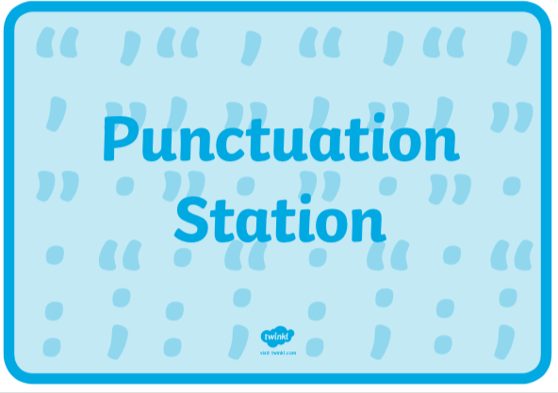



Year 2 – capital letters, full stops, exclamation marks, question marks. Year 3 – as above and commas for a list, apostrophes for contracted words and possession.

Slide 3
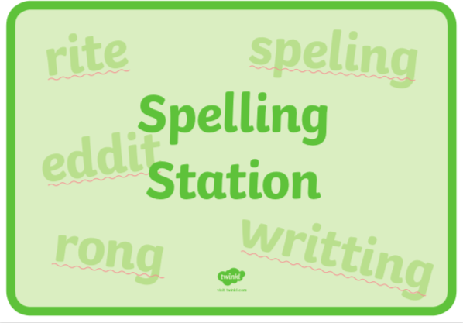
Make sure that all of the high frequency words you know are spelt correctly. What about the words specific to your Jeremy Strong book? Have you spelt all of your common exception words correctly and all of the words on your word mat?

Slide 4
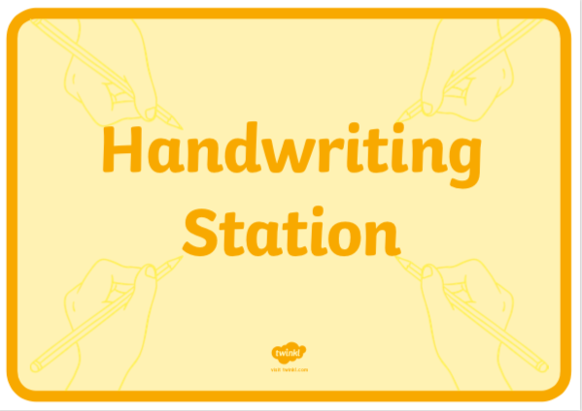
Take a few minutes to check your handwriting. If you are joining your handwriting, is it neat? Are all your letters formed correctly? Are they sitting in the right place on or under the line?

Slide 5

Think about some of the words you have used – could you improve any? If you have used an adjective in a phrase, could you change it to be a more powerful one – eg: big cage could be an enormous, metal cage. You could check whether you could improve the quality of some of your words using a dictionary or thesaurus.

Slide 6
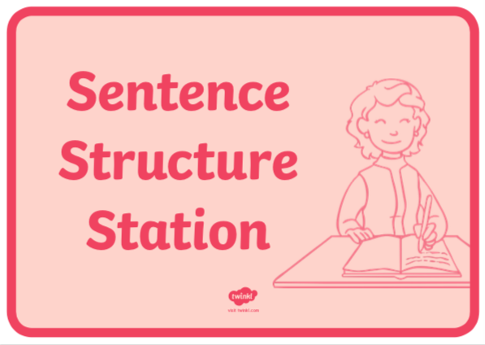
Have you included some statements, questions, commands and exclamations in your story? Have you remembered to use conjunctions to show time and place – eg: when, before, because, during, until, soon, therefore Could you add an attention-grabbing exclamation?

Slide 7
Well done! Please send your edited work back to your teacher so they can see your improved draft.

