Slide 1

Newspaper Reports
LO: To be able to structure and write a newspaper report.
I can use the layout of a newspaper successfully.
I can include the 5 W’s.
I can recall information accurately.
I can write in the correct tense. (Y2)
I can use speech marks correctly. (Y3)

Slide 2
Lets remind ourselves of the key features of a newspaper report.
What do we need to include in our writing today?

Slide 3
Who?
What?
When?
Where?
Why?

Slide 4
Features of a newspaper report:
Headline and by-line
5 W’s
Quotes
Photographs and captions
Paragraphs
Writing in the third person and past tense

Slide 5
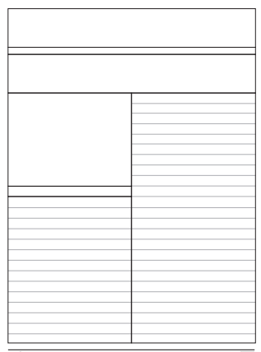
Notes:
Create article together with children, making sure chn know where different features go.

Slide 6
Your task
You are going to report on the discovery of Skara Brae.
Using the planning sheet, think about the key events that you need to talk about in your newspaper article.
You might need to be creative with some of the information if it was not given to us in our research.

