Slide 1
Newspaper Reports
LO: To be able to identify features of a newspaper report.
I can identify key features.
I can annotate key features.
I can create my own key features checklist.

Slide 2
A newspaper report needs to:
Present factual information.
Catch the readers attention.
Be about an interesting event.
It is important that newspaper reports have the most important information coming first.
This is called front-loading. This allows the reader to decide if they wish to read more.
Be interesting and to the point.

Slide 3
Features of a newspaper report:
Headline and by-line
5 W’s
Quotes
Photographs and captions
Paragraphs
Writing in the third person and past tense

Slide 4
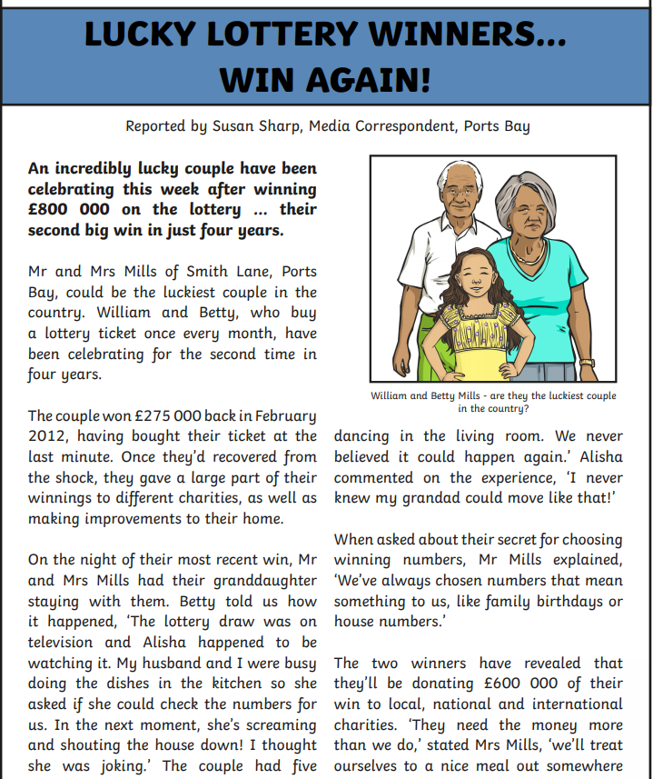
Headlines and By- lines.
Newspapers use the headline to try to grab the readers’ attention. It might even use a pun, rhyme or alliteration.
Headlines try to tell the story in as few words as possible.
Use powerful and interesting language.
A by- line is a line in the newspaper naming the writer.

Slide 5
5 Ws
A newspaper report begins with an introductory paragraph that includes the five Ws.
What
happened?
When did
it happen?
Where did
it happen?
Who was involved?
Why did
it happen?

Slide 6
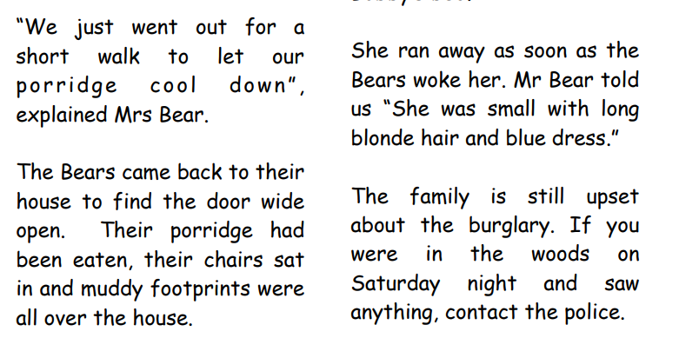
Quotes
Quotations tell us what has been said and who has said it. They can help to make the story credible by giving the reader the opinions of the people involved. Remember to use inverted commas!
For example, Class teacher for Year 3 and 4, Mrs Jones said “They are a lovely class of children and I really like teaching them.”

Slide 7
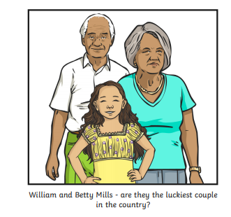
Photographs and Captions
Photos and captions help to tell the story by giving readers a snapshot of what happened, where it happened or who it happened to.
Photos also need a caption underneath them. A caption is a short sentence explaining what is happening in the photograph.

Slide 8
Paragraphs
Paragraphs help the reader clearly understand the information on the story.
The newspaper body includes all the details of the news story and should be split in paragraphs to help the reader digest the information. Each paragraph tells one part of the story.
A newspaper must give information that is factually correct about the events.
Make sure your writing is chronological (in order).
The last paragraph should sum up the story and bring it up to date.

Slide 9
Third person and past tense.
Third Person
Write about what happened to others (e.g. he, she, they, them, it), not from your own perspective.
Past Tense
Newspaper articles are normally an example of a recount text. They are written in the past tense as the event has already taken place.

Slide 10
Structure:
Headline and by-line
Lead
Body
Tail

Slide 11
Task one:
Walk around the room and have a look at the newspaper reports.
Can you spot the key features we have discussed? Are there any reports that have a key feature missing?

Slide 12
Task two:
Choose your favourite newspaper report you have read so far.
Using coloured pencils or labelling, highlight the key features within the diary entry.

Slide 13
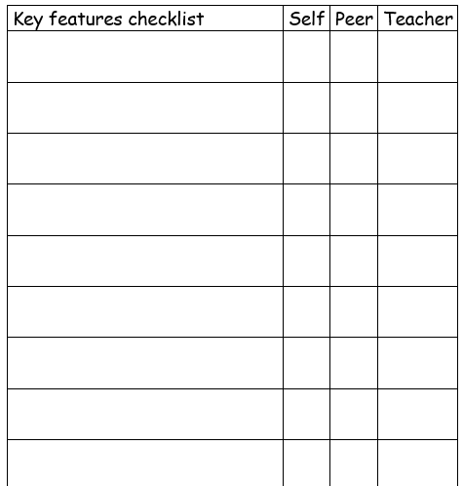
Task three:
Using the sheet, you need to create your own tick sheet for when you write your own newspaper report next week. Think about the key features we have learnt today.

Slide 14
