Slide 1
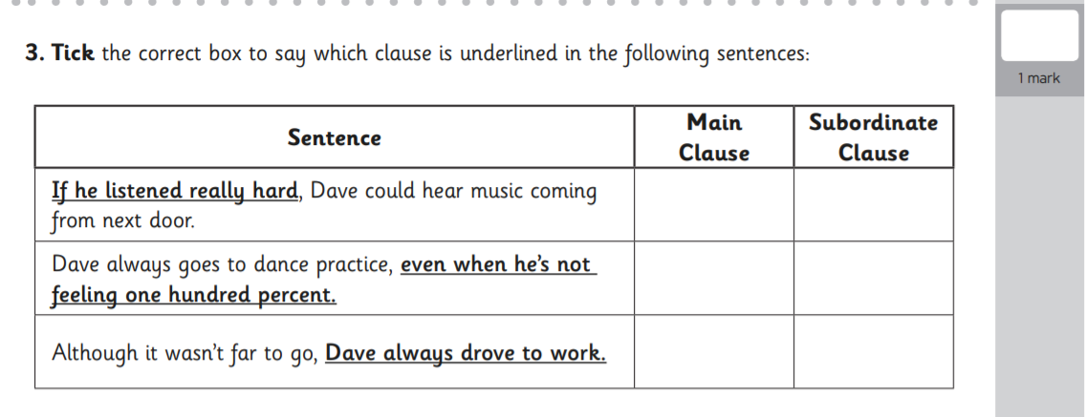
L.O: To identify, evaluate and write similes. 14.12.21
P | Success Criteria | T
 | Must: I can identify and discuss different types of poetic language used in the poem.
 | Should: I can evaluate the effectiveness of similes.
 | Could: I can write lines of poetry that include similes about the sea.
 | Even better if… In partners discuss and rank the similes written.

Slide 2
Waves are like silver birds, Flying over water, Waves are like blue ferns curling, Like bright crystals….
What do you notice about these lines?
What poetic technique has the poet used?

Slide 3
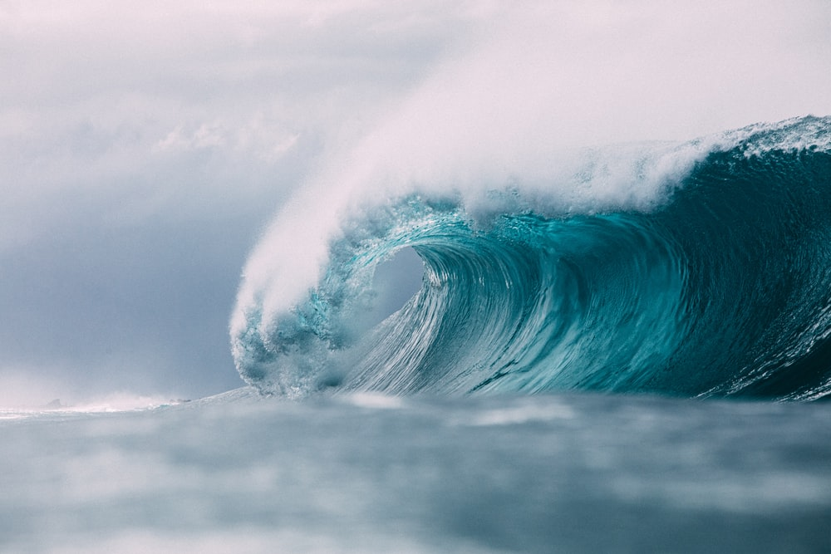
Here is another line-
‘treacherous smiler with teeth white as milk’
What do you think this one might be about?
How would you describe the way it is personified?

Slide 4
Task- In pairs, use your word bank from last session to write some descriptive similes.
Then, rank them in order of preference. Explain which you think are more effective, and why you think so.
Challenge- Try playing simile consequences where one person starts eg. The swirling sea was like …..’ and the other finishes eg.. ‘a giant cauldron bubbling’.

Slide 5
Plenary
Volunteers will give their best simile, and the rest of the class will help suggest improvements.
We will collect these into a class simile bank to use next lesson.

