Slide 1
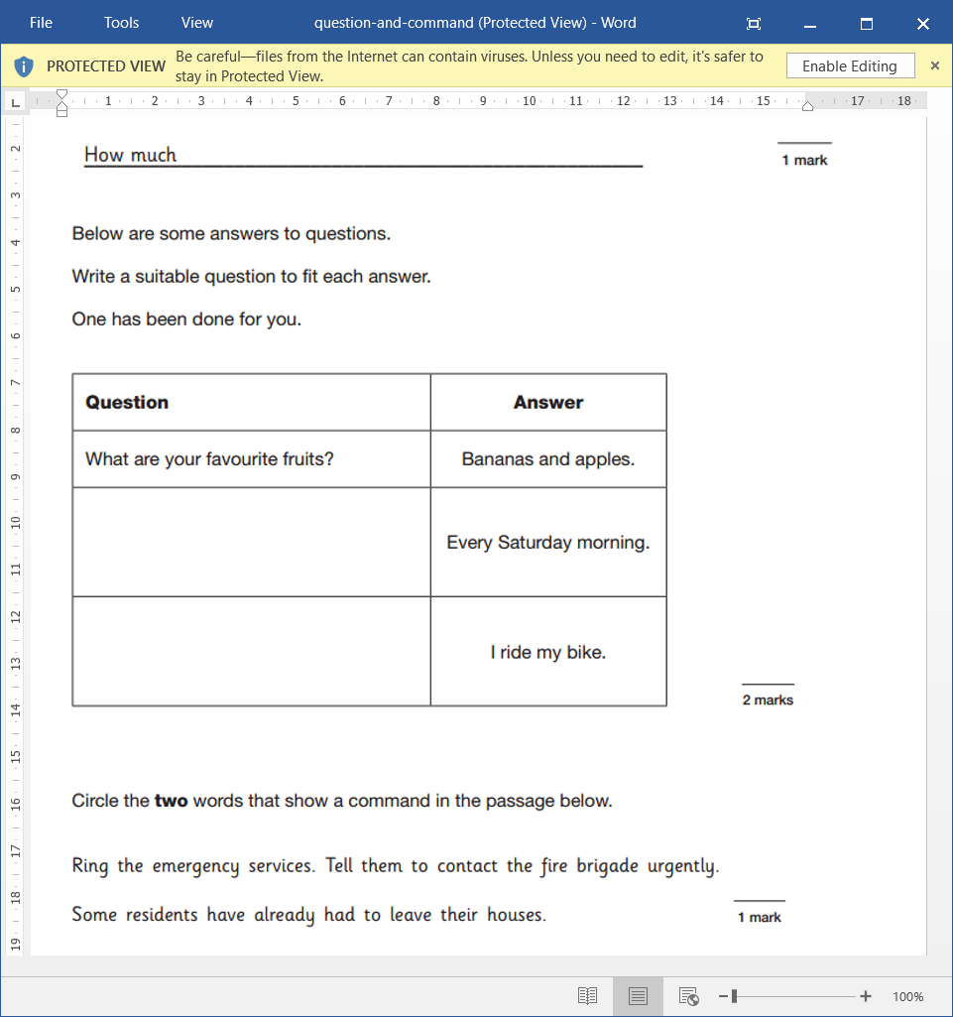
L.O: To justify inferences made about character’s thoughts and feelings. 13.01.22
P | Success Criteria | T
 | Must: I can make inferences about characters in the book.
 | Should: I can give a justification for my opinion using evidence.
 | Could: I can compare characters at different stages of the story.
 | Even better if… I can evaluate how the language and illustrations contribute to meaning.

Slide 2
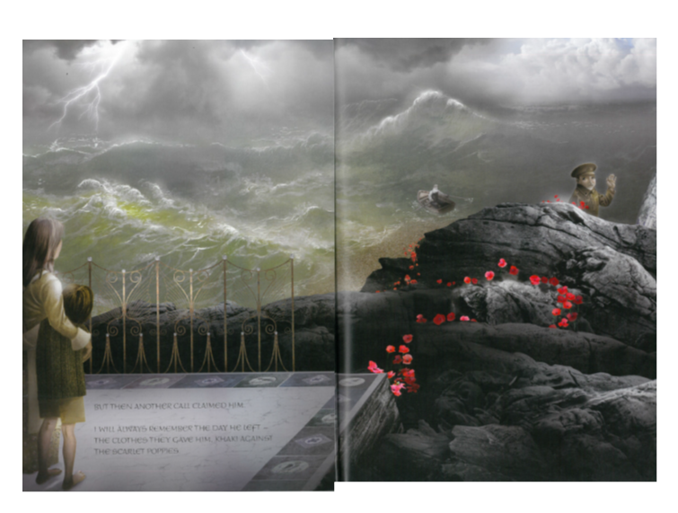

Slide 3
We can examine this image on two levels- a literal level, or a figurative level.
Literal level : you explain what you can see in the picture, e.g. ‘there are stormy waves and lightning’.
Figurative level: you can explain what the author is trying to convey through the text and images, e.g. ‘I think the stormy waves and lightning mean the father will be heading into danger. I know this because rough seas can be dangerous to travelling in a boat’.
Don’t forget to P.E.E.
Point
Evidence
Explanation.

Slide 4
Task 1: In mixed year group partners, annotate the image with both literal observations and inferences.
Literal observations explain what can you see in the picture?
Inferences will explain What does it mean? What is the writer trying to convey?
Don’t forget to back up your opinion using P.E.E.
Task 2: We will now be exploring how the characters must be feeling by using hot-seating.
Your task is to write questions for each of the characters to find out more about what each character will be feeling at this time.
Try to think of open-ended questions that need full sentences to answer.
You could ask them about their fears, hopes, regrets etc.

Slide 5

Plenary

