Slide 1
L.O: To make a prediction based on evidence from the text. 11.01.22
P | Success Criteria | T
 | Must: I can make a prediction of what I think will happen.
 | Should: I can give a justified reason for my opinion.
 | Could: I can explain how my evidence supports my point using my prior knowledge.
 | Even better if… I can evaluate how effectively the text and images create meaning.
Revision of word types.
What categories of words do you remember?
I am in a hurry.
I hurried home.
What do you notice about the words in red? What word categories do they fit into?

Slide 2
Many words can be a noun or a verb depending on how you use them in a sentence.
Noun phrases
Noun phrases contain a noun and words that describe or modify the noun.
e.g. a goat; a hungry goat; the hungry goat called Nanny.
Tip: You can tell it’s a noun phrase because it can be replaced by a pronoun e.g. The hungry goat ate the flowers in the garden. It ate the flowers in the garden.
Come up with a noun phrase about:
A balloon. A flower.

Slide 3
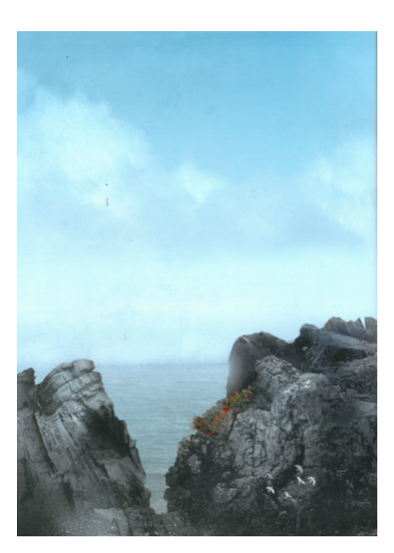
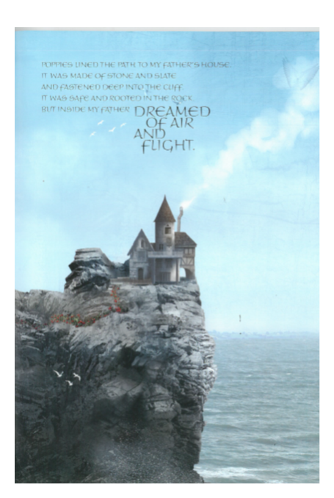

Slide 4
What do you predict this story might be about? What do the first pages remind you of?
Task 1- to write descriptive sentences to describe the setting of the house on the cliffs. Use descriptive noun phrases to create a picture in the mind of your reader.

Slide 5
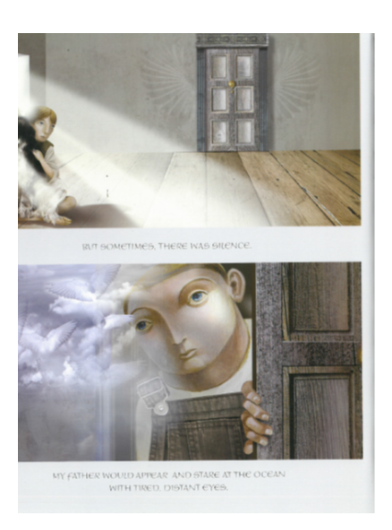
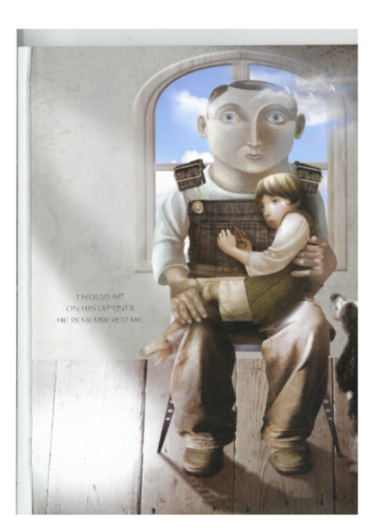

Slide 6
Can you back up your ideas with evidence?
Task 2 – Make predictions about what you think will happen in this story. Has your opinion changed from earlier?
To fully explain your thinking, use P.E.E. (point, evidence, explanation).
Point: What you think, such as ‘I think the father wants to build a flying machine.’
Evidence: What in the text or images makes you think this, e.g. ‘The text says that he dreams of flight and air, and the images showed him building mechanical wings’.
Explanation: Justify how your evidence supports your point. ‘I know that wings are used to for flight, and that the father dreams of flight’.

