Slide 1
LO: To predict what may happen from details within the book.
Success Criteria:
I can use the text to make a prediction.
I can justify my prediction.

Slide 2
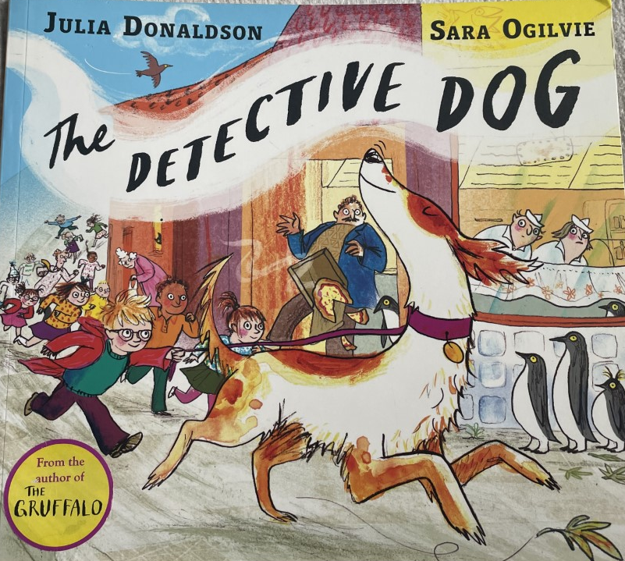
Lets read
Notes:
Stop at ‘Nell sniffed the air and she smelled the wrong smell’.

Slide 3
We need to predict what we think is going to happen next.
Remember to use the text and images to help you.
I predict that…
I think this because…

Slide 4
Was our predication right?
Were we surprised?
Notes:
Read the next page after the stopping point to see if our predictions were correct. Were you surprised?

Slide 5
LO: To be able to give an opinion based on a text.
Success Criteria:
I can give my opinion as why the thief stole the books.
I can give reasons why I think this.
I can use my opinion to help the thief.

Slide 6
Lets read
Notes:
Now we’re going to carry on reading up until “Those are OUR books! Give them back!”

Slide 7
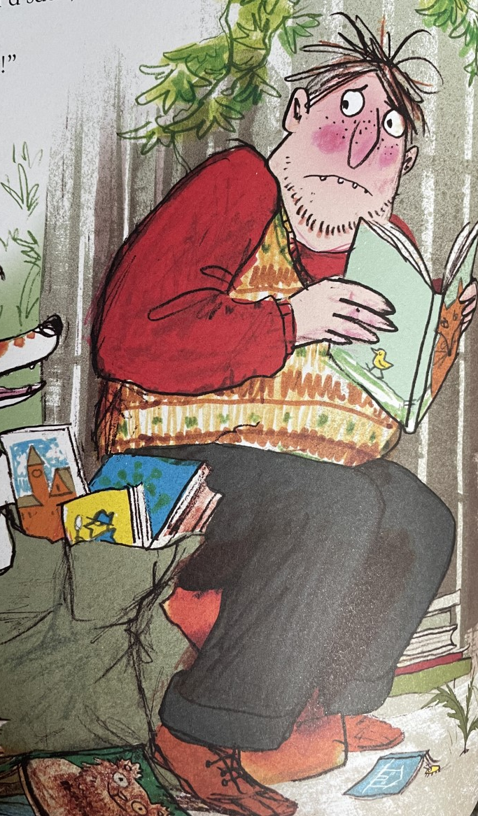
We’re going to use our opinion to discuss why we think the thief stole the books.
Why do you think he stole the books?
What could detective dog and Peter do to help the thief?
What is the thief feeling? How do you know?
Notes:
Get chd into pairs and explain task

Slide 8
Lets read
Notes:
Finish book

