Slide 1
Year 2 LO:
To understand what an action verb is.
Success Criteria:
I can understand what an action verb is.
I can identify action verbs in the text.
I can include action verbs in my writing.
Year 3 LO:
To understand what a preposition is.
Success Criteria:
I can understand what a preposition is.
I can identify prepositions within text.
I can include prepositions in my writing.

Slide 2
Organise into the correct word class:
Crashed flung pig bounding shout gleaming swerved poked tree cautiously
Squeal palm forest hastily friendly violently wooden boar hunted destroyed
scratch delicately miserable sun clouds turquoise boys stormy flung creepers
tower coldly frighten excited desperately proud beast disgusting scary
hideous giant loud piercingly bloody grass squeeze tread wounded.
Notes:
Have chd choose words and put into correct word class on white board- verb, noun, adjective and adverb

Slide 3
What is an action verb?
An action verb is a verb that describes an action or something that is being done.
For example:
Bark
Jump
Kick
Can you think of anymore?

Slide 4
Lets share them:

Slide 5
Can you write a sentence including an action verb?

Slide 6
Year 2:
Using the copies of the book, can you highlight any action verbs you find.
Once you have done this, Write at least two sentences including action verbs.
For a challenge, can you include conjunctions and adjectives in your sentences?

Slide 7
What is a preposition?
It is a word that tells you where or when something is in relation to something else.
Prepositions are words / phrases used to describe a place, time or cause.
The dog is on the table.
The iguana is next to the teacher.

Slide 8
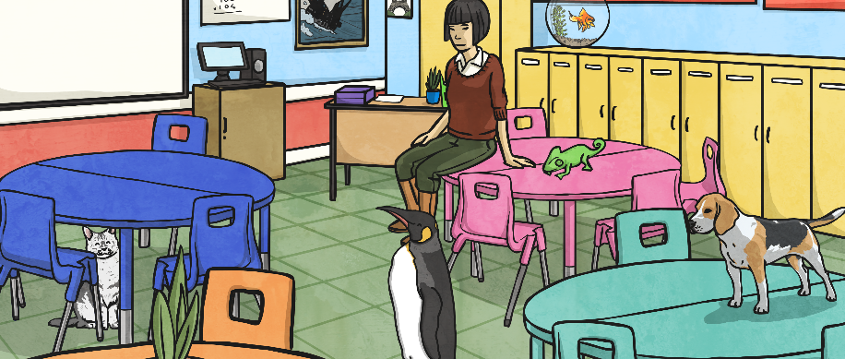
Prepositions can also tell us about time.
At 6 o’clock the dog was on the floor.
During the lesson, the cat was under the table.
Other prepositions tell us about how something is caused by something else.
Due to the barking, she put her hands over her ears.

Slide 9
Can we think of any prepositions?

Slide 10
Can we write a sentence including a preposition?

Slide 11
Year 3:
Using the copies of the book, can you highlight any prepositions you find.
Once you have done this, Write at least three sentences including prepositions.
For a challenge, can you include conjunctions, adjectives and action verbs in your sentences?

