Slide 1
Newspaper Reports
LO: To be able to plan my newspaper report.
I can use my research to help plan my newspaper report.
I can structure my ideas.
I can think about the key features when planning.

Slide 2
Starter:
Year 2: Complete the past tense worksheet and stick in your SPAG book.
Year 3: Complete the speech marks activity in your SPAG book.

Slide 3
Features of a newspaper report:
Headline and by-line
5 W’s
Quotes
Photographs and captions
Paragraphs
Writing in the third person and past tense

Slide 4
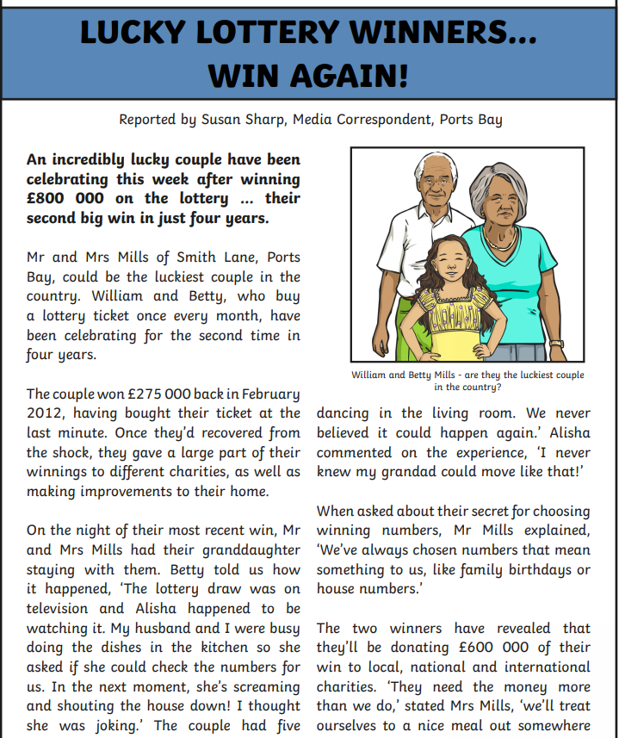
Headlines and By- lines.
Newspapers use the headline to try to grab the readers’ attention. It might even use a pun, rhyme or alliteration.
Headlines try to tell the story in as few words as possible.
Use powerful and interesting language.
A by- line is a line in the newspaper naming the writer.

Slide 5
5 Ws
A newspaper report begins with an introductory paragraph that includes the five Ws.
What
happened?
When did
it happen?
Where did
it happen?
Who was involved?
Why did
it happen?

Slide 6
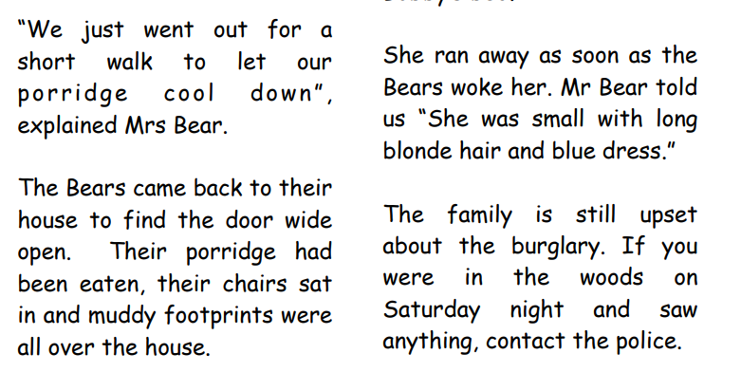
Quotes
Quotations tell us what has been said and who has said it. They can help to make the story credible by giving the reader the opinions of the people involved. Remember to use inverted commas!
For example, Class teacher for Year 3 and 4, Mrs Jones said “They are a lovely class of children and I really like teaching them.”

Slide 7
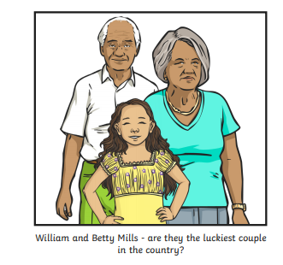
Photographs and Captions
Photos and captions help to tell the story by giving readers a snapshot of what happened, where it happened or who it happened to.
Photos also need a caption underneath them. A caption is a short sentence explaining what is happening in the photograph.

Slide 8
Paragraphs
Paragraphs help the reader clearly understand the information on the story.
The newspaper body includes all the details of the news story and should be split in paragraphs to help the reader digest the information. Each paragraph tells one part of the story.
A newspaper must give information that is factually correct about the events.
Make sure your writing is chronological (in order).
The last paragraph should sum up the story and bring it up to date.

Slide 9
Third person and past tense.
Third Person
Write about what happened to others (e.g. he, she, they, them, it), not from your own perspective.
Past Tense
Newspaper articles are normally an example of a recount text. They are written in the past tense as the event has already taken place.

Slide 10
Structure:
Headline and by-line
Lead
Body
Tail

Slide 11
A newspaper report needs to:
Present factual information.
Catch the readers attention.
Be about an interesting event.
It is important that newspaper reports have the most important information coming first.
This is called front-loading. This allows the reader to decide if they wish to read more.
Be interesting and to the point.

Slide 12
Who can share what they have learnt about Skara Brae?
Which information would be useful and purposeful for our newspaper report?

Slide 13
As I write the newspaper report, see if you can spot the key features that have been included.
Notes:
Model writing a newspaper report on paper, for the working wall.

Slide 14
Your task
You are going to plan your newspaper report.
Make sure you are using your research to help you plan your newspaper report.

