Slide 1
L.O: To write using the features of a news article. 25.11.21
P | Success Criteria | T
 | Must: I can use the inverted pyramid of journalism to complete my report.
 | Should: I can ensure I have used formal language.
 | Could: I can improve my punctuation and sentence structure.
 | Even better if… I can correctly use a semicolon in my report. .
Use a semicolon, full stop or coordinating conjunction to complete the sentences below.
Sandip spent three hours in the library he couldn’t find the book he wanted
Imogen missed the bus she had to walk to town.
Rohan had been saving his pocket money he was hoping to buy a new bike
It was a warm, sunny day we spent the afternoon in the park

Slide 2
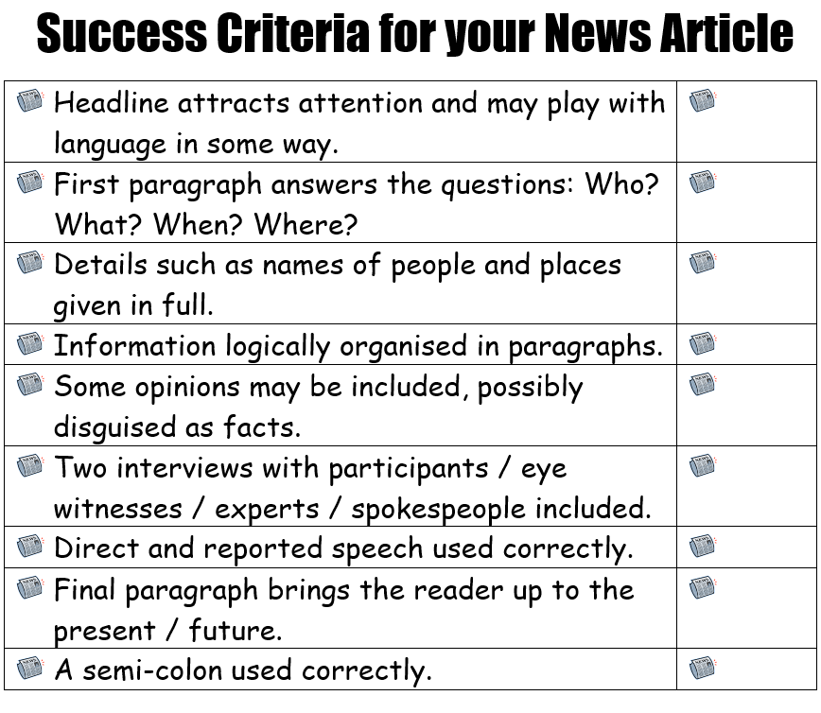
This lesson we will be completing our reports.
What are the key features of journalistic writing we will need to include?
Try to make absolutely sure you are using the passive voice most of the time.
e.g. pigs were seen soaring over the church steeple by Reverend Jones.
Not
Father Jones saw…

Slide 3
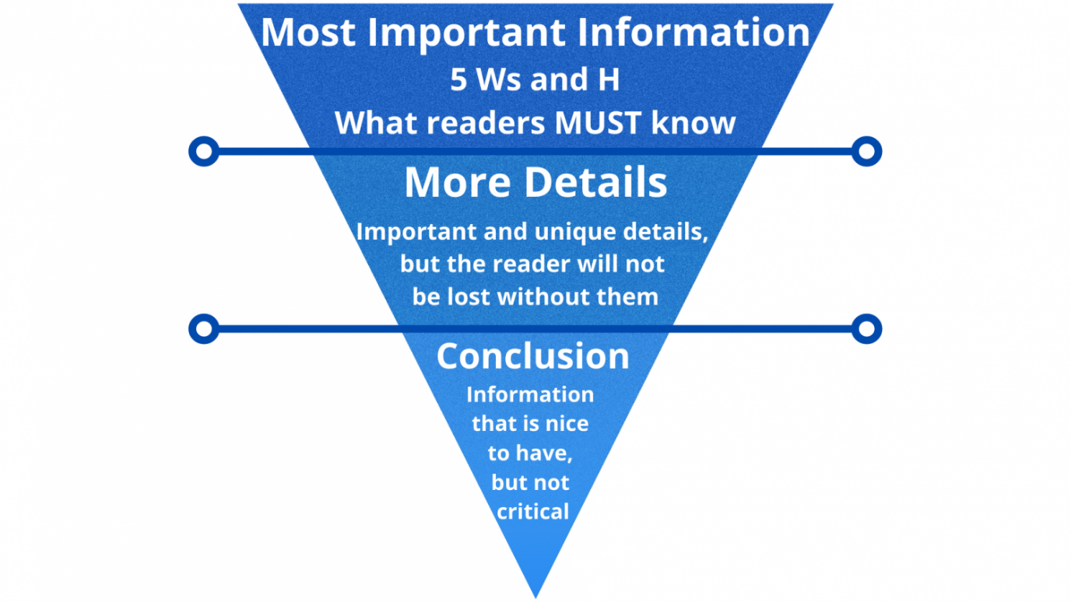
Ensure you have included your most important information in your opening paragraph.
Then fill in more of the ‘nice to know’ details in the rest of the story.
Include details of the witnesses, and explain what they saw using reported speech.

Slide 4
In the concluding paragraph, bring the story up to the present day.
What happened next?
What are the authorities doing now?

