Slide 1
L.O: To write using the features of a news article. 24.11.21
P | Success Criteria | T
 | Must: I can write the first paragraph of a news article.
 | Should: I can include the key information: who, what, where and when.
 | Could: I can use reported speech in my article.
 | Even better if… I can choose passive voice in my writing.
These sentences should be written in the passive voice by you.
The dog chased the squirrel.
Melvin left the packed lunches on the bus.
Ruby painted a beautiful portrait of the Queen.

Slide 2
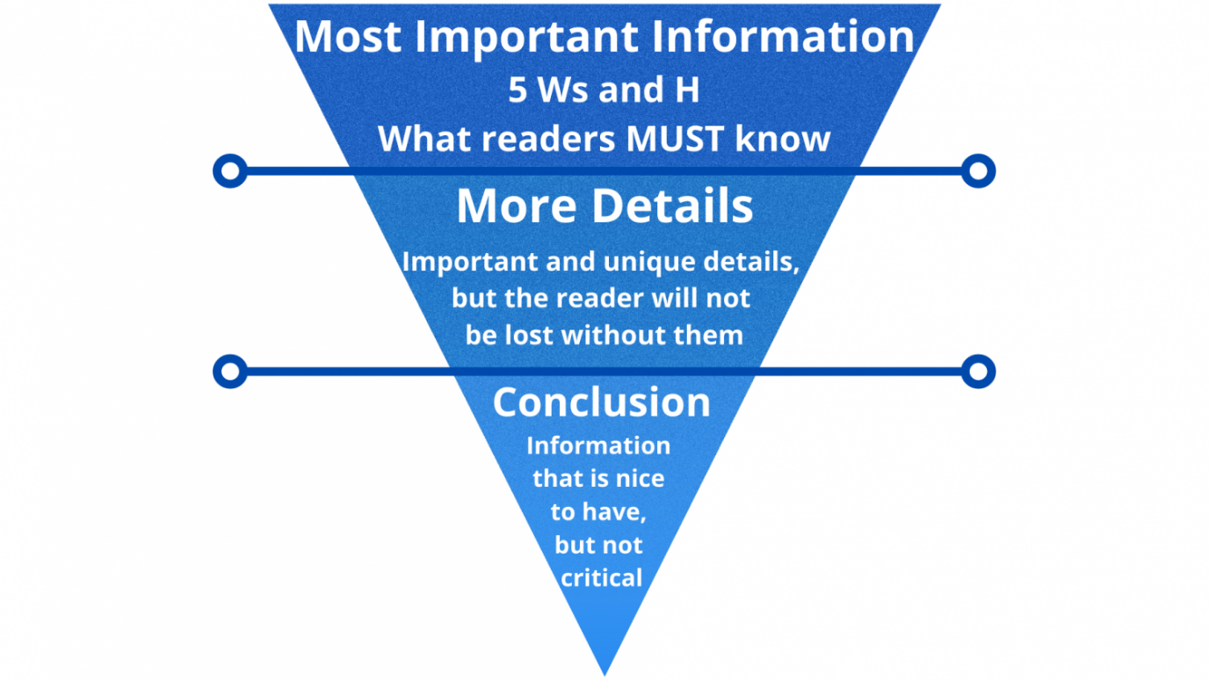
Your task is to write the beginning of your report, using your plan to help you.
The first paragraph of a news article is the most important part of the entire story. It should be informative enough to give your reader the basic idea of what is going on, but interesting enough they will want to keep reading.
First let’s examine a few of the opening paragraphs of the articles we read last week. How much can we understand of the story after reading only the headline and the first paragraph?

Slide 3
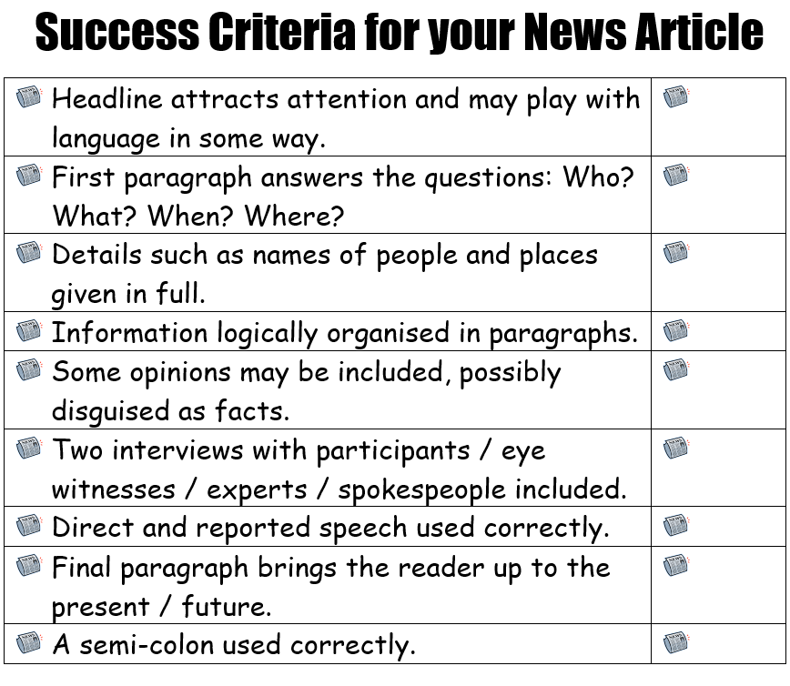
Work in your pairs to write a headline and first paragraph for your reports.
Remember to answer the key questions!
Try to use the passive voice where possible.
A commotion was caused by….
Pigs were seen by…
Challenge yourselves to use a semicolon correctly.

Slide 4

Self-assess your work using the self- assessment criteria.
Have you been successful in using them all?
What will be your target for next time?
Let’s read through a couple of volunteer pieces of work and evaluate the strengths and weaknesses of each one.

