Slide 1

Jeremy Strong
Lesson 4

Slide 2
LO: To use The Hundred-Mile-an-Hour Dog to focus on sentence types.
I can understand the different types of sentences.
I can identify which sentence types Jeremy Strong uses in his writing.
I can write a variety of sentence types about the story.

Slide 3
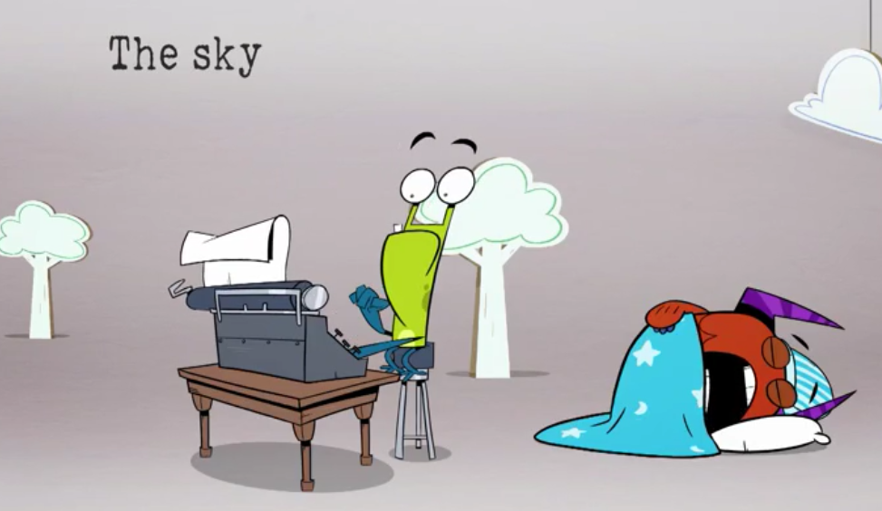
Statement sentences
Statements are the most common type of sentence. They tell the reader a fact or idea about a single topic. These sentences usually end with a full stop. For example: The cat walked over to the house.
Notes:
Types of sentences - Year 1 - P2 - English - Home Learning with BBC Bitesize - BBC Bitesize

Slide 4
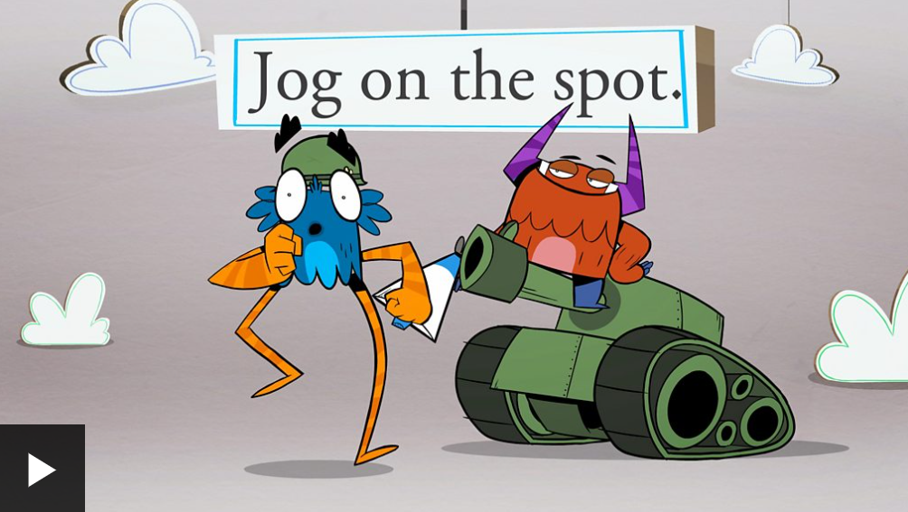
Command sentences
Command sentences are used when you are telling someone to do something. Because they are telling someone to do something, they usually start with a bossy verb. For example: Fetch me some biscuits.

Slide 5
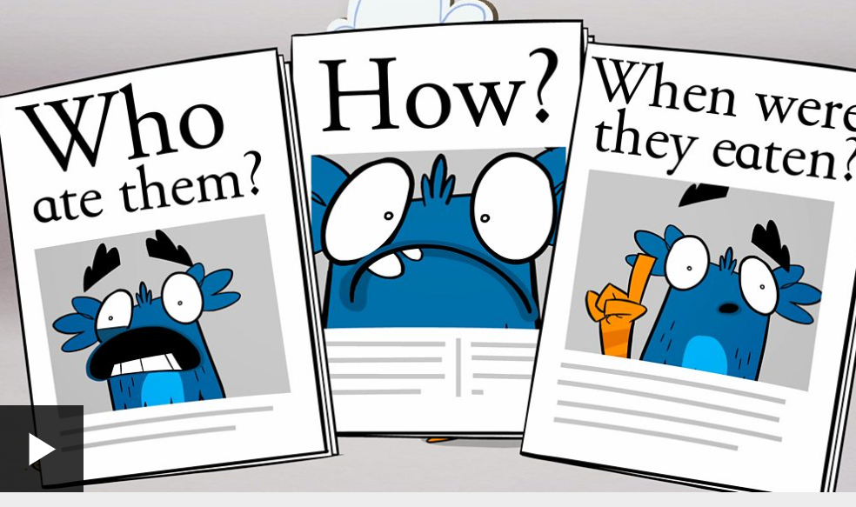
Question sentences
These sentences always end with a question mark. They might start with who, what, where, when, why or how.

Slide 6
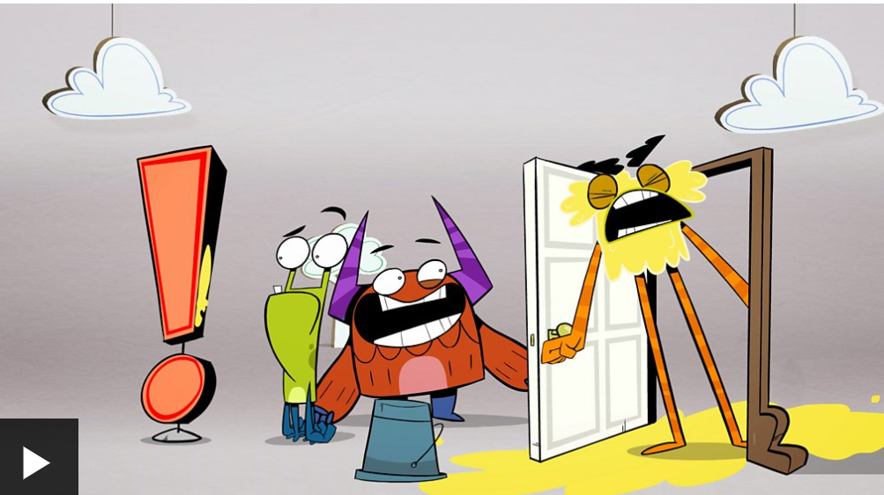
Exclamation sentences
These sentences always end with an exclamation mark. They also always start with the words 'how' or 'what'. For example: What a wonderful day!

Slide 7
Activity 1:
Read through Chapter 4 of The Hundred-Mile-An-Hour Dog with 1 copy in each pair.
In your pair, you need 2 different coloured highlighters. Every time we see a question or exclamation sentence, highlight it.
Questions in one colour, exclamations in another colour.

Slide 8
Activity 2:
Can you write 2 of each different types of sentences about the Chapter that we have just read.
e.g.
Statement – Trevor might lose a bet with Charlie.
Command – Sit down streaker.
Question – What will Trevor have to do if he loses the bet?
Exclamation – Streaker is so fast!

