Slide 1
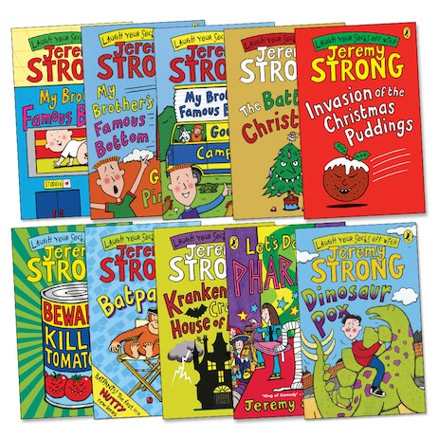
Jeremy Strong
Lesson 3

Slide 2
LO:To use drama to explore a text.
I can create a freeze frame to reflect the plot.
I can imagine what a character might say in the freeze frame.
I can use speech marks correctly to record my ideas.

Slide 3
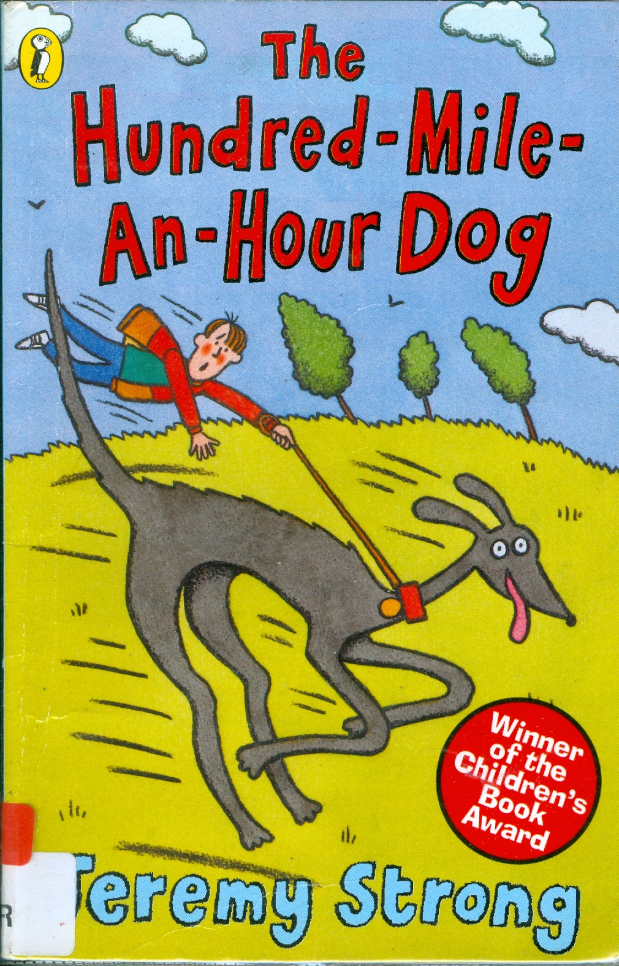
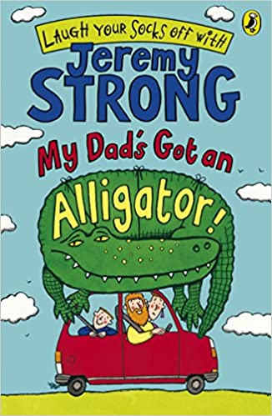
Starter:
We have listened to/read chapters 1 to 3 of both books so far. What has happened so far in each story? Talk to a partner.

Slide 4
The Hundred-Mile-an-Hour Dog
My Dad’s Got an Alligator
Dog called Streaker who is super fast.
Mum bets Trevor that he can’t walk her every day over the Easter holidays. If he does, he will get £30.
Trevor has a great idea to wear his roller skates when walking Streaker and accidentally grabs a woman's bag as they zoom past the market.
He is taken to the police station but is let go.
Trevor goes to his friend Tina and asks her to help train Streaker.
Dad brings home an alligator from work as a pet.
Mum is not happy!
The alligator is ruining the house – he has eaten the remote and is making a mess.
Dad builds a cage that looks like a T-Rex to keep the alligator safe.
Mr and Mrs Tugg (the neighbours) are not happy about the alligator either.
Mr Tugg is very grumpy and comes over to complain about Dad’s loud singing. What a grump!

Slide 5
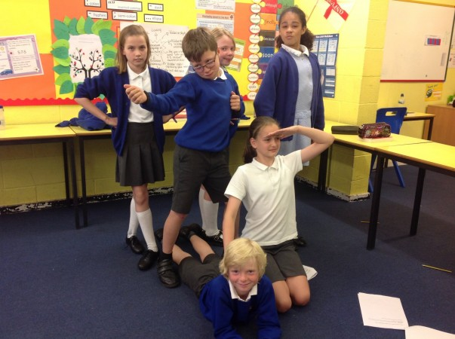
What is a freeze frame?
What is a freeze frame? When might we use a freeze frame? What can a freeze frame show us?
Notes:
Remind chn that in a freeze frame, they should be completely still and should all have a character or be a prop.

Slide 6
Today, we are going to be looking at Chapter 4 of My Dad’s Got an Alligator and focus on some key lines that we can act out using freeze frames.
Let’s read through it together.

Slide 7
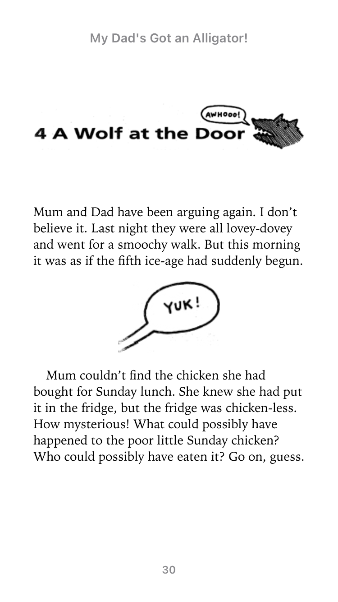
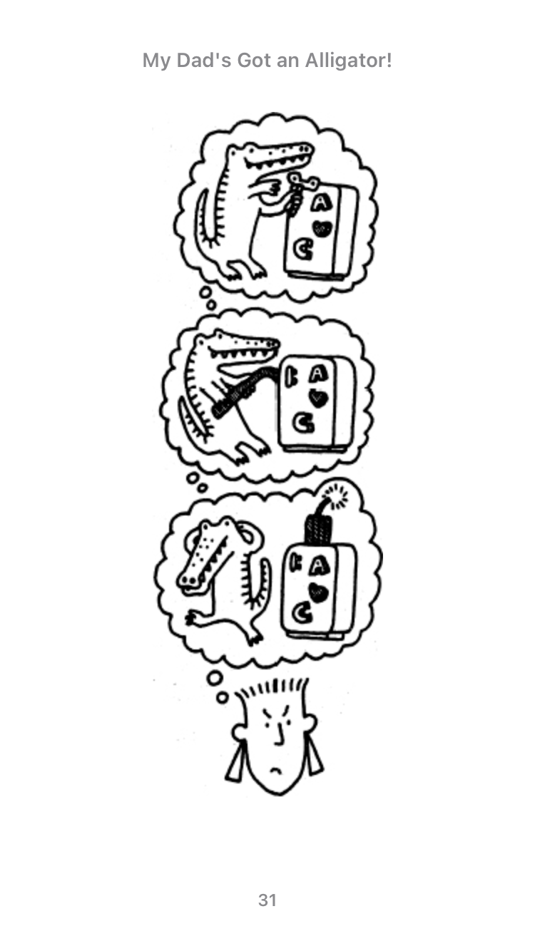

Slide 8
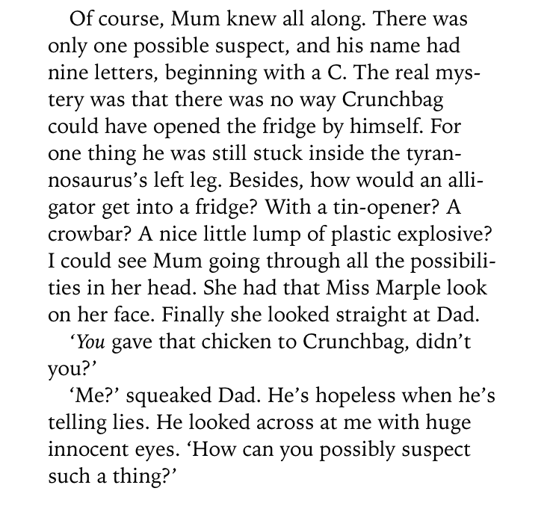

Slide 9
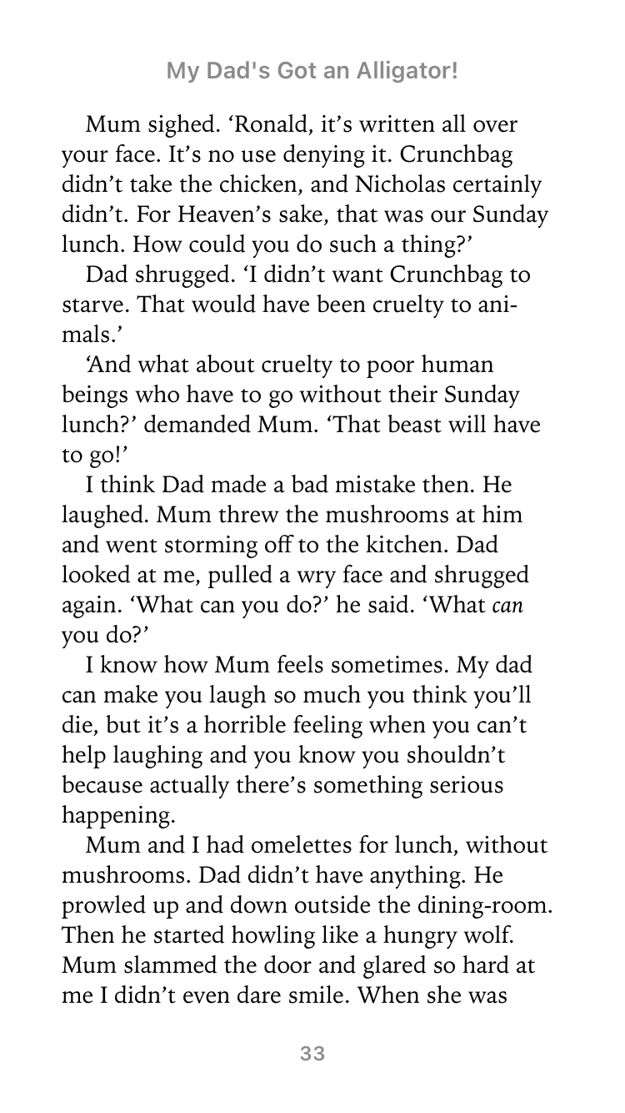

Slide 10
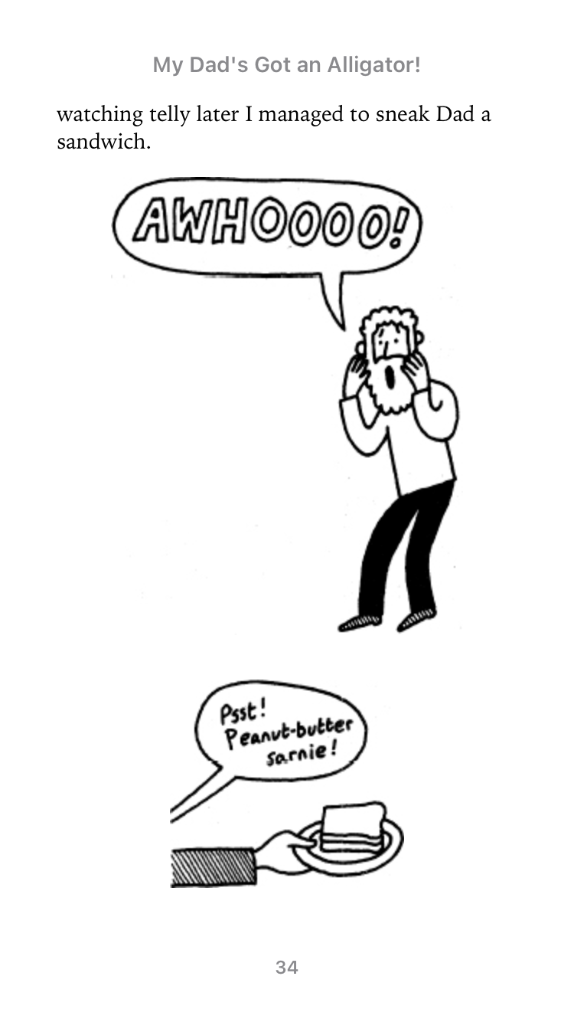

Slide 11
Activity 1:
In mixed groups, we are going to create freeze frames for key sentences in chapter 4.
The three sentences are:
Mum and Dad have been arguing again.
Mum couldn’t find the chicken she had bought for Sunday lunch.
I think Dad made a bad mistake then. He laughed. Mum threw the mushrooms at him and went storming off to the kitchen.

Slide 12
Activity 2:
Using same freeze frames, you need to think about what your character might say or be thinking. When you are tapped on the shoulder, you need to come alive and say what your character would say. If you are Crunchbag, you can still speak.
The three sentences are:
Mum and Dad have been arguing again.
Mum couldn’t find the chicken she had bought for Sunday lunch.
I think Dad made a bad mistake then. He laughed. Mum threw the mushrooms at him and went storming off to the kitchen.

Slide 13
We are going to link our drama to using speech marks.
We use speech marks to show when someone is talking.
We are going to write down some sentences to show what our characters might say in each freeze frame.
Demonstrate using whiteboard how to use speech marks. Remind chn that speech starts with capital letter and punctuation needs to go inside speech marks e.g.
“Hello,” said Bob. Remind YR3 chn that we usually start a new line for a new speaker.

Slide 14


Inverted Commas
There are two places where inverted commas are needed when writing direct speech:
“What’s the matter, Dina?” said Sid.
Inverted Commas
Inverted Commas
You need to open your inverted commas with a “ (66) before the first word which is
being spoken.
You need to close your inverted commas with a ” (99) after the last word which is being spoken.
Imagine that inverted commas are like hands;
They hold within them only the words which are being spoken.
“What’s the matter, Dina?” said Sid.
Back

Slide 15
Punctuation
There are two places where other forms of punctuation are needed when writing direct speech:
“What’s the matter, Dina?” said Sid.
You need to end the speaking with:
a comma
a question mark, if it is a question.
an exclamation mark, if it is an exclamation.
You will need to finish your sentence with a full stop after the reporting clause.
Examples of other punctuation in direct speech are:
“How exciting it is!” exclaimed Sarah.
“I don’t know what to do,” said Sayeed.
Back

Slide 16
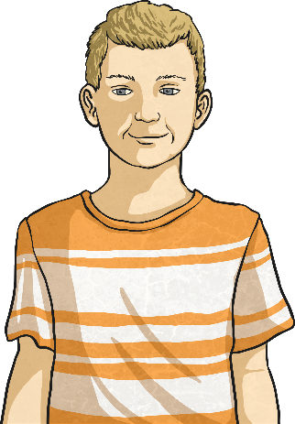
Reporting Clauses
After the speech itself, a reporting clause gives a little bit of information about who is speaking and how it was said.
“What’s the matter, Dina?” said Sid.
Reporting Clauses
In this case, Sid is speaking.
If Sid said it in a different way, you could change ‘said’ to...
“What’s the matter, Dina?” asked Sid.
“What’s the matter, Dina?” whispered Sid.
“What’s the matter, Dina?” uttered Sid.
“What’s the matter, Dina?” shouted Sid.
Back

Slide 17
Activity 3:
With your group, can you children write some sentences from your characters using speech marks.
The three sentences are:
Mum and Dad have been arguing again.
Mum couldn’t find the chicken she had bought for Sunday lunch.
I think Dad made a bad mistake then. He laughed. Mum threw the mushrooms at him and went storming off to the kitchen.

