Slide 1
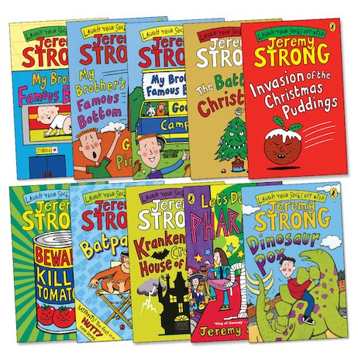
Jeremy Strong
Lesson 2

Slide 2
LO: To explore a text further through comprehension questions.
I can answer retrieval questions about a text.
I can answer inference questions about a text.
I can create my own questions using different reading skills.

Slide 4

Vocabulary Questions with Vocabulary Victor
Vocabulary Victor will help you to look at how authors and poets have chosen to use certain words and sentences.

Slide 5
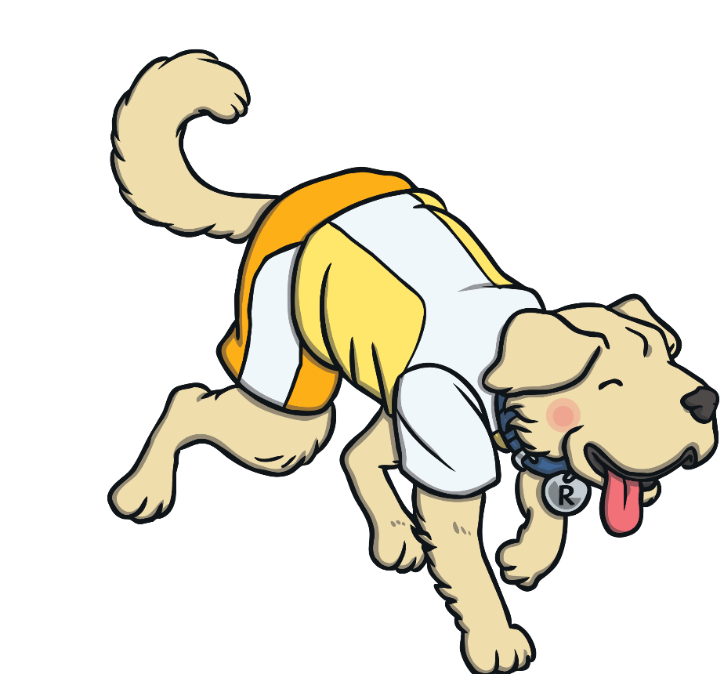
Retrieval Questions with Rex Retriever
Rex Retriever will help you to go into a text and retrieve the facts.

Slide 6
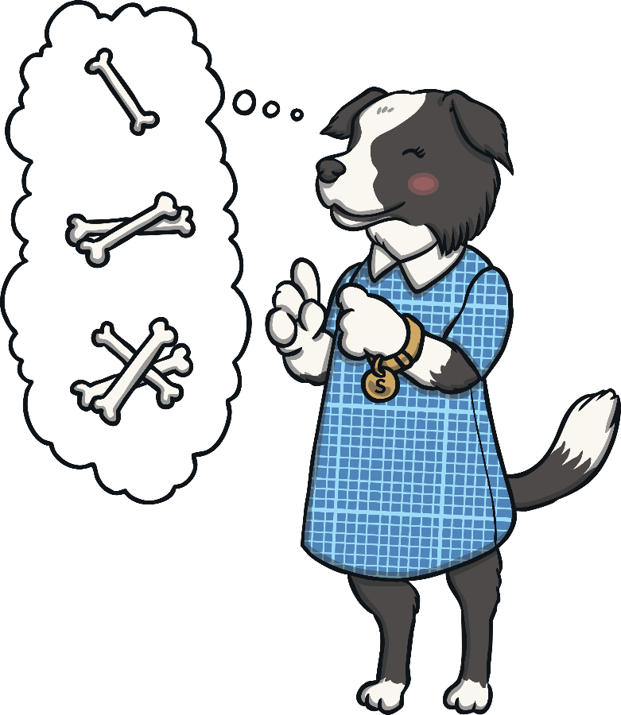
Sequence Questions with Sequencing Suki
Sequencing Suki likes everything in order! She will help you to sequence the events in a text.

Slide 7

Inference Questions with Inference Iggy
Inference Iggy will help you to hunt for clues in a text, about how someone might be feeling or why something is happening.

Slide 8
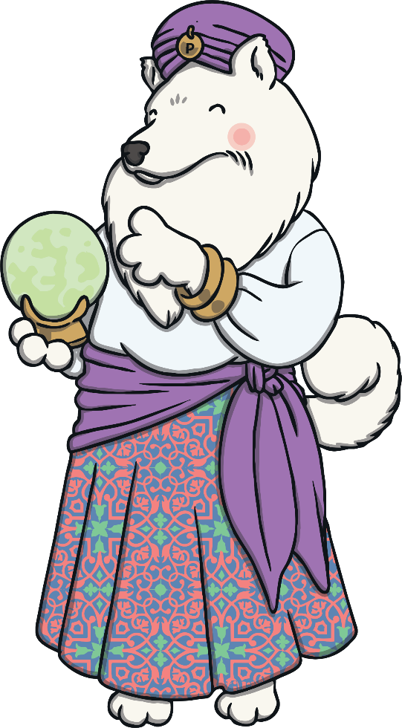
Prediction Questions with Predicting Pip
Predicting Pip tries to see the future and she will help you to work out what might happen next.

Slide 9






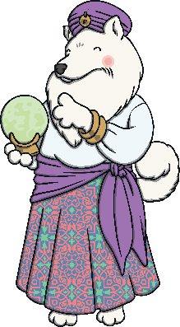

Listen to Chapter 2
To listen to Jeremy Strong read the second chapter of
‘The Hundred-Mile-An-Hour Dog’, click here.
Chapter 2 starts at 4:02 minutes into the video.
When you’ve listened to Chapter 2, pause the video.
On the next slides, the Totally Pawsome Gang are going
to ask you some questions about a picture from Chapter 2.

Slide 10
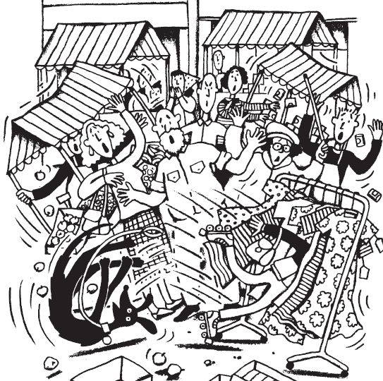


Vocabulary Victor wants to know…
Which two adjectives could you use to describe how the people at the market might feel?
The two adjectives that
I could use to describe how the people at the market might feel are angry and startled.
Reveal Answer
Notes:
Write answers on whiteboards.

Slide 11
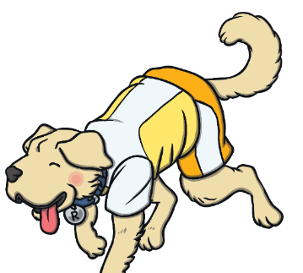
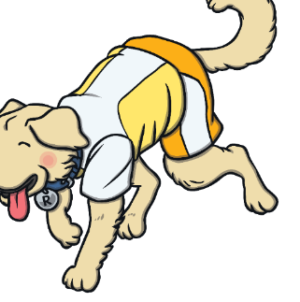
Rex Retriever wants to know…
People from the market were chasing Trevor because they thought that he had stolen the old lady’s bag which was caught on his arm.
Why were the people from the market chasing
after Trevor?
Reveal Answer

Slide 12
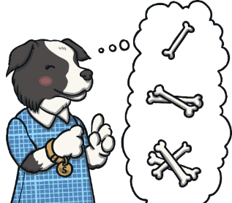
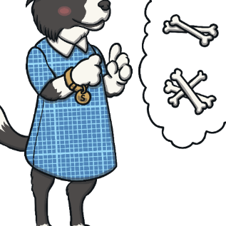
Sequencing Suki wants to know…
How could you use 20 words or fewer to sum up what you can see in this picture?
In the picture, I can see Trevor letting go of Streaker’s lead and falling into a rack of dresses.
Reveal Answer

Slide 13


Inference Iggy wants to know…
What do you think the owner of the dress stall might be thinking?
The owner of the dress stall might be wondering why a boy has fallen into their stall and wondering where he came from.
Reveal Answer

Slide 14
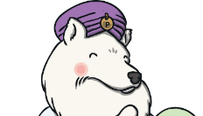
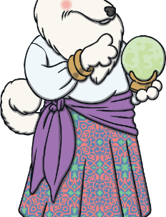
Predicting Pip wants to know…
What do you think will happen at the market after Trevor and Streaker have left?
I think that the people who were following Trevor and Streaker through the market might stay and help all of the stallholders to tidy up the mess.
Reveal Answer

Slide 15
Your task:
In your groups, read through Chapter 2 of My Dad’s Got an Alligator. Then answer the comprehension questions about the chapter.
Once you have finished that, can you think of your own questions to ask about the book using one of the 5 reading skills we have looked at.

Slide 16
Plenary:
Let’s read Chapter 3 of ‘My Dad’s Got an Alligator’ together.

