Slide 1
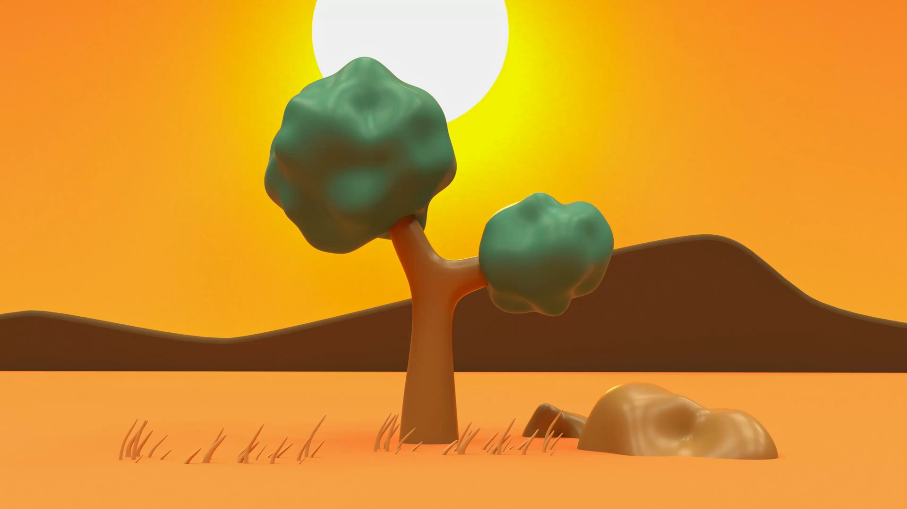
Aesop’s Fables
Lesson 7

Slide 2
YR2 LO: To write my own Aesop inspired fable.
I can include a moral for my reader to learn.
I can include phrases to show my characters personality.
I can follow the structure of my plan.

Slide 3
YR3 LO: To write my own Aesop inspired fable.
I can include a moral in my writing
I can include phrases to show my characters personality.
I can include speech marks.
I can follow the structure of my plan.

Slide 4
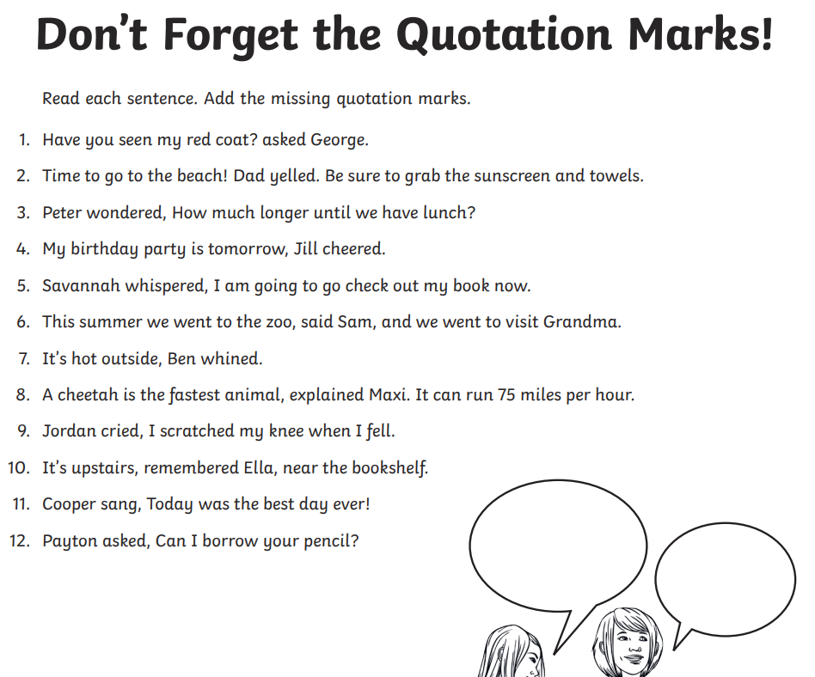
Starter:
Notes:
Give chn a sheet in their pair and ask them to add speech marks.

Slide 5
Writing expectations:
A fable is a short story. Your story will be in between 1 and 1 ½ pages long.
Your story will have a clear start where you introduce the characters, a clear ending where the character learns a lesson.
Your story will have one problem or competition.
Let’s create a whole class word bank of language we might need. These words should not be spelt wrong.

Slide 6
Word bank:

Slide 7
Your task:
Verbally scaffolded independent writing.
Give chn time to complete each section making sure they don’t move on from each section too quickly.
Chn to start by introducing characters:
e.g. Once there lived two animals who lived in a forest. One was a mouse and one was a lion. The lion was very rude and all the other animals were scared of him.
Chn then to explain problem or competition.
Chn to explain solution.
Chn to end the story with the lesson the ‘bad’ character learns.

