Slide 1

Aesop’s Fables
Lesson 2

Slide 2
LO: To compare ‘The Boy Who Cried Wolf’ and ‘The Ant and The Grasshopper.’
Year 2
Year 3
I can find the moral of a story.
I can compare similarities in two fables.
I can compare differences in two fables.
I can find the moral of a story.
I can compare similarities and differences in two fables.
I can consider why fables are effective at conveying morals.

Slide 3
What is a fable? What is a moral? Which key features do we remember?
Fable:
a short story, typically with animals as characters, conveying a moral.
Moral:
a lesson that can be derived from a story or experience.

Slide 4
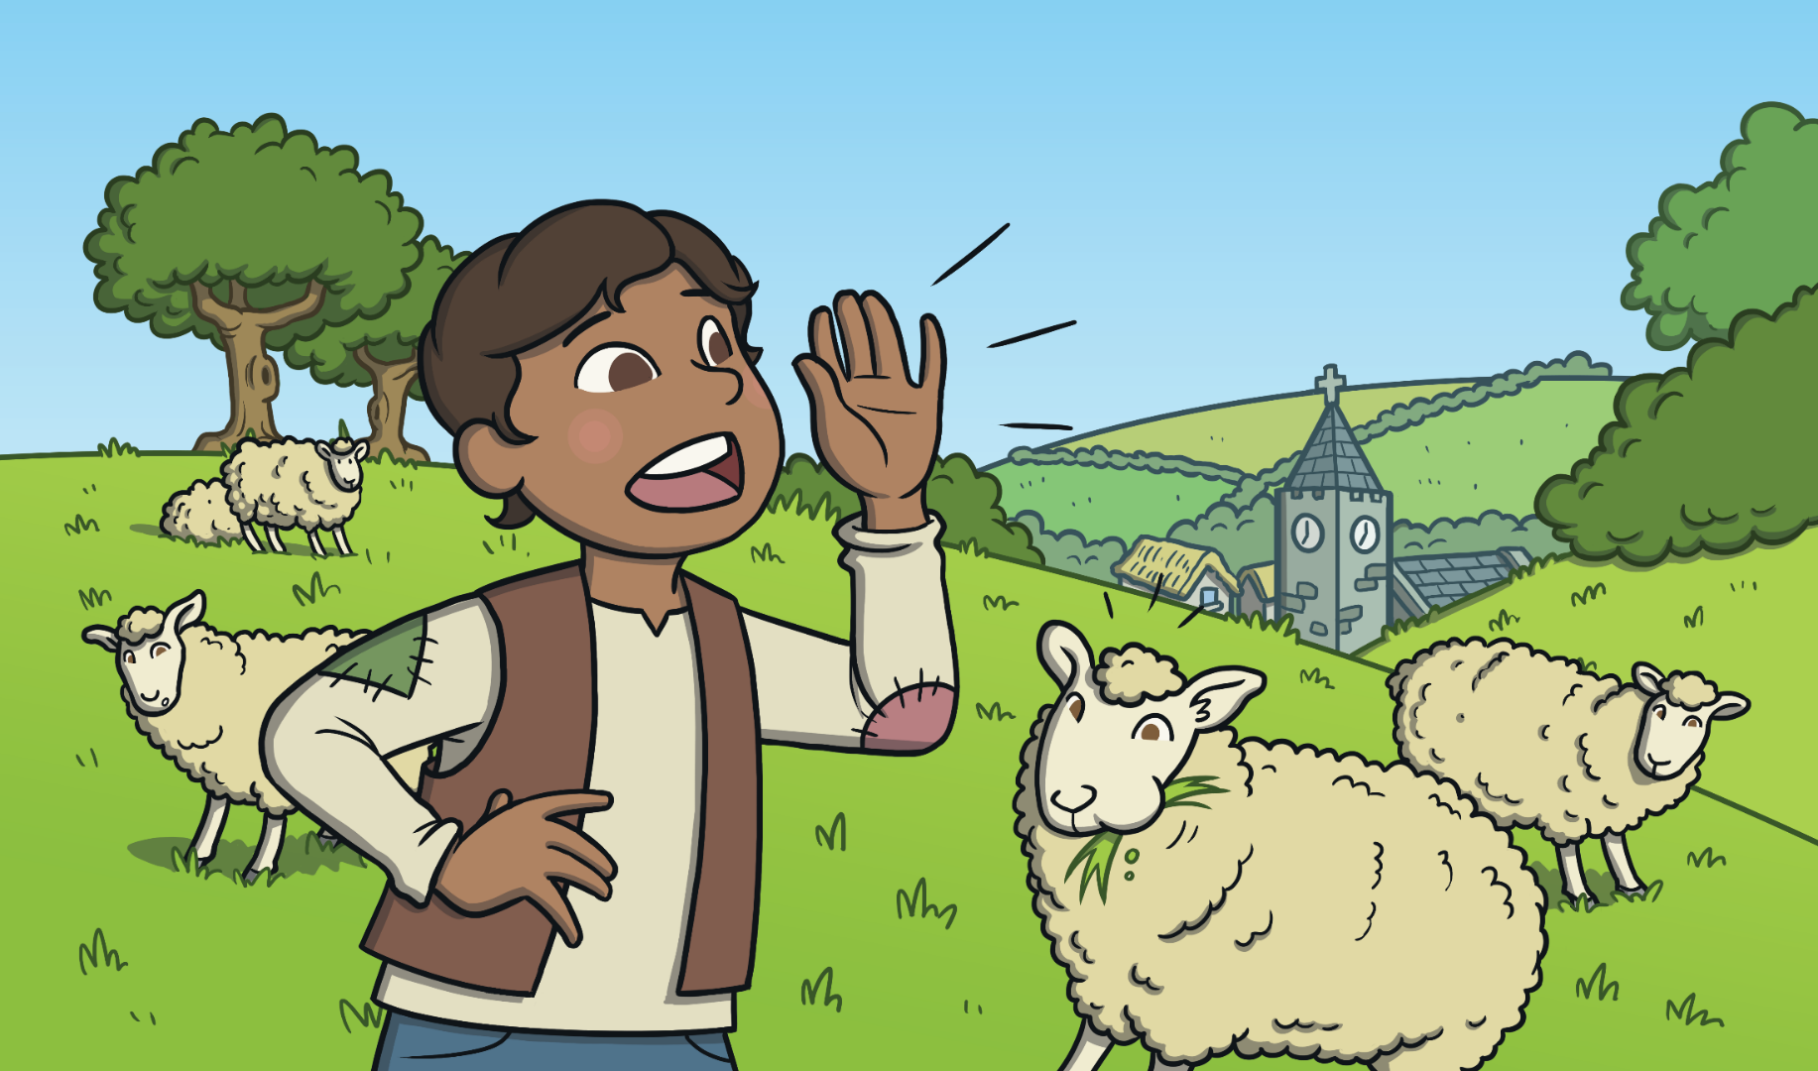
There was once a boy who looked after sheep. The boy was bored. One day, he played a trick on the villagers. The boy cried out that there was a wolf attacking his sheep, even though there wasn’t.

Slide 5
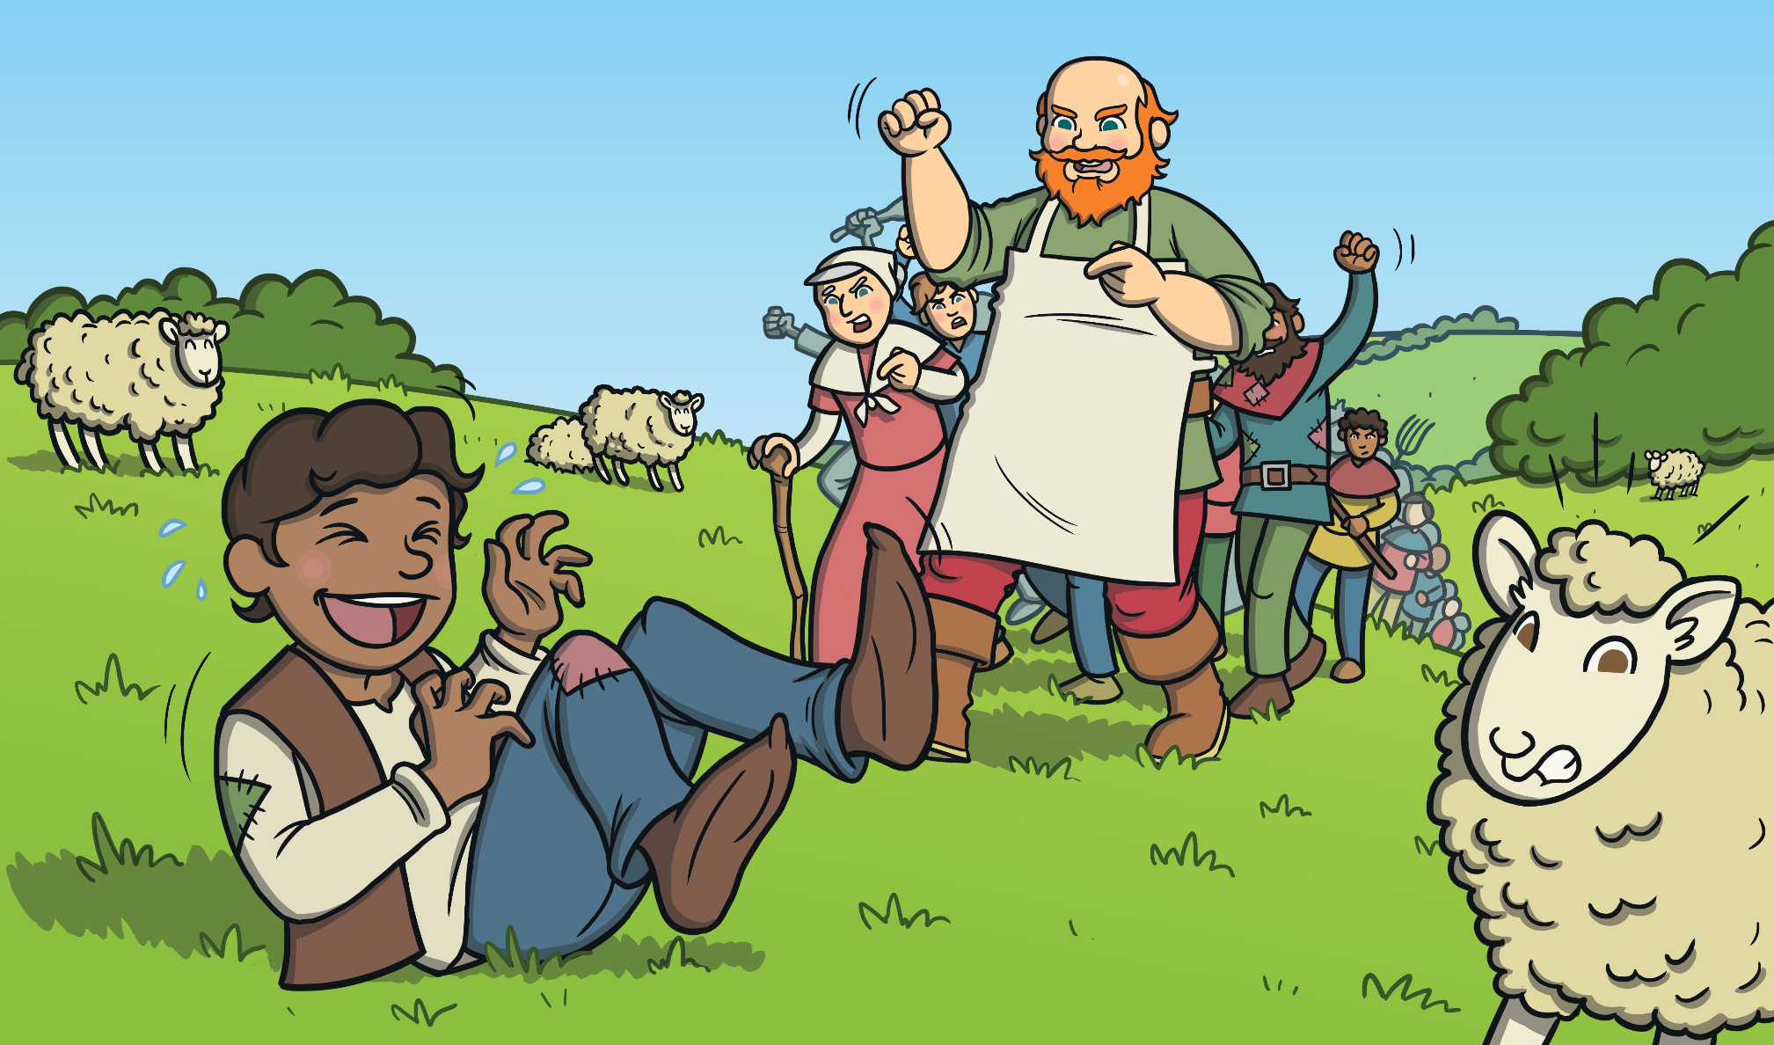
The villagers came up the hill to save the sheep. When they got there, there was no wolf. The boy laughed at them. “You must not tell lies!” said the villagers. They went back to the village.

Slide 6
Soon the boy was bored again. He shouted, “Wolf! Wolf!” The villagers rushed up the hill to save the sheep. When they got there, there was no wolf again. The boy laughed at them again.

Slide 7
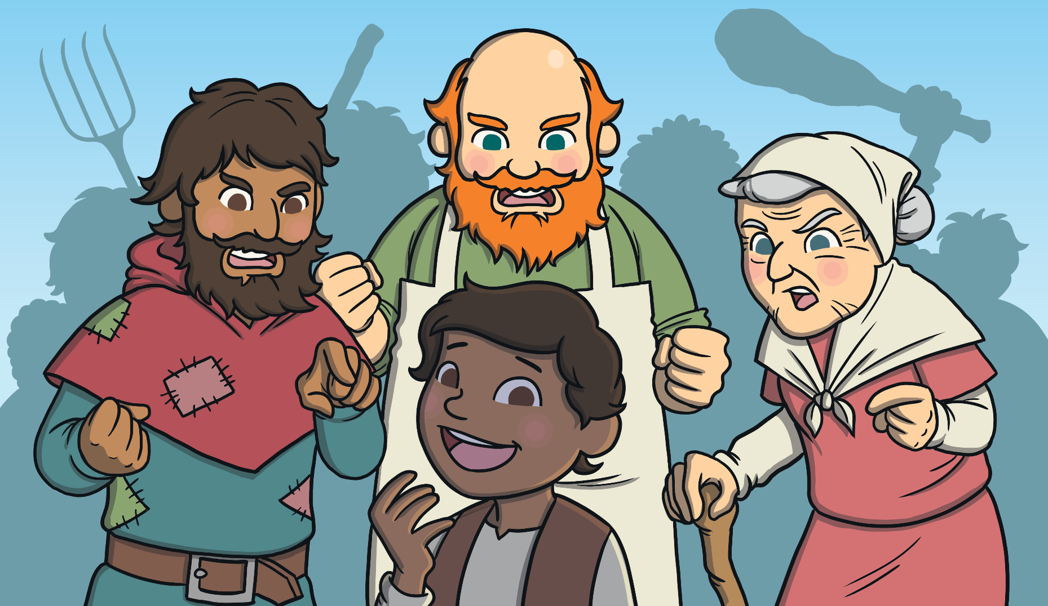
“You must not tell lies!” shouted the villagers. They went back down to
the village.

Slide 8
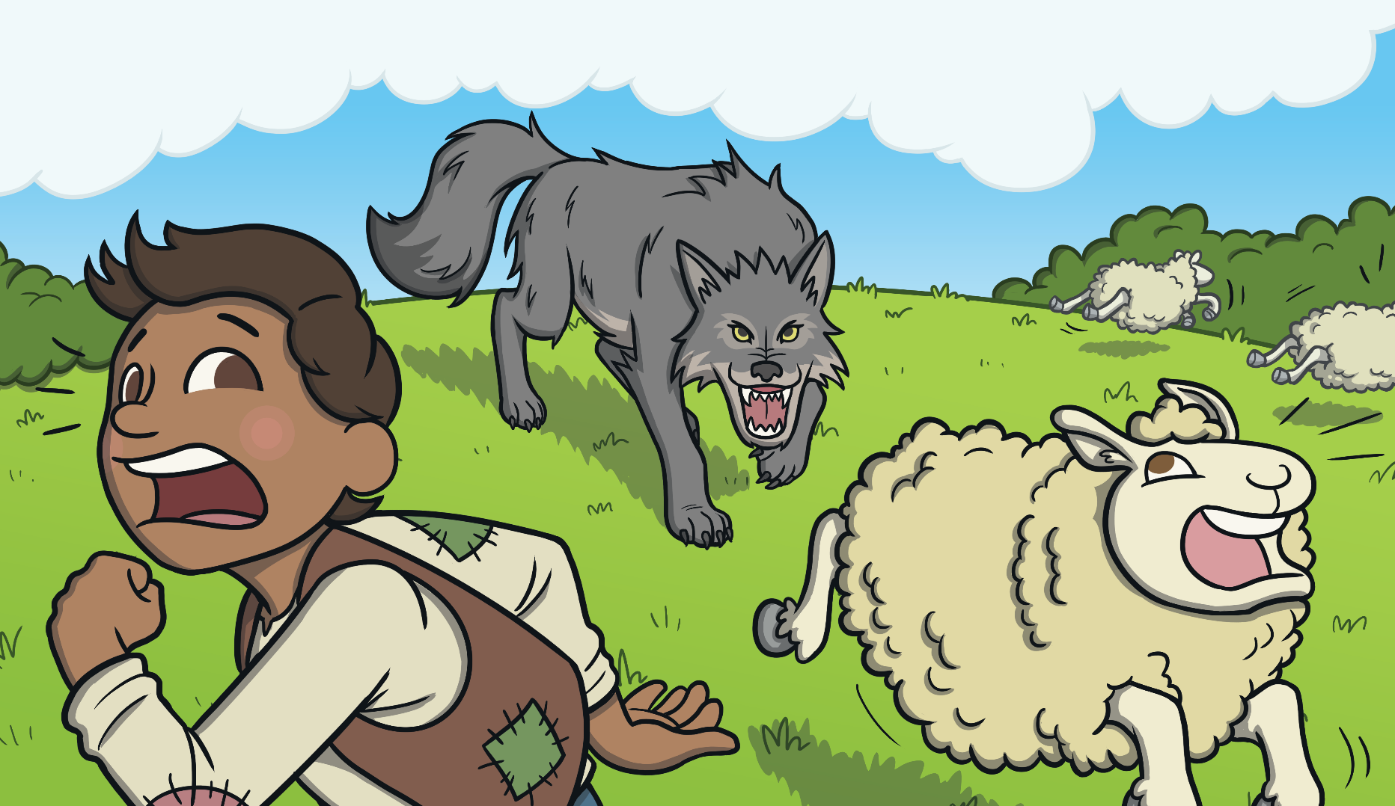
Later that day, a wolf did come into the field. The boy shouted and shouted, “Wolf! Wolf!” This time no one came to help, and the wolf ate
all of the sheep.

Slide 9
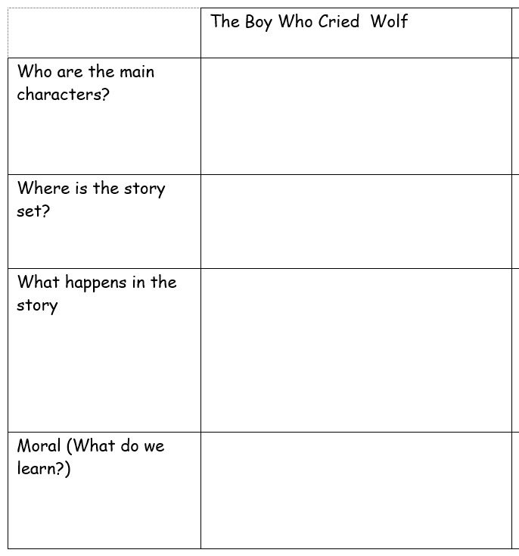
Can we fill in the table for The Boy Who Cried Wolf all together?
Notes:
Comparison table

Slide 10
Your task:
You will have a copy of The Ant and The Grasshopper and The Boy Who Cried Wolf. You are going to complete the table for both stories to help you compare.
Then, answer the questions at the bottom of your sheet in full sentences.
YR3 will need to work with a partner to discuss why fables are good at teaching us morals before answering your final question.

Slide 11
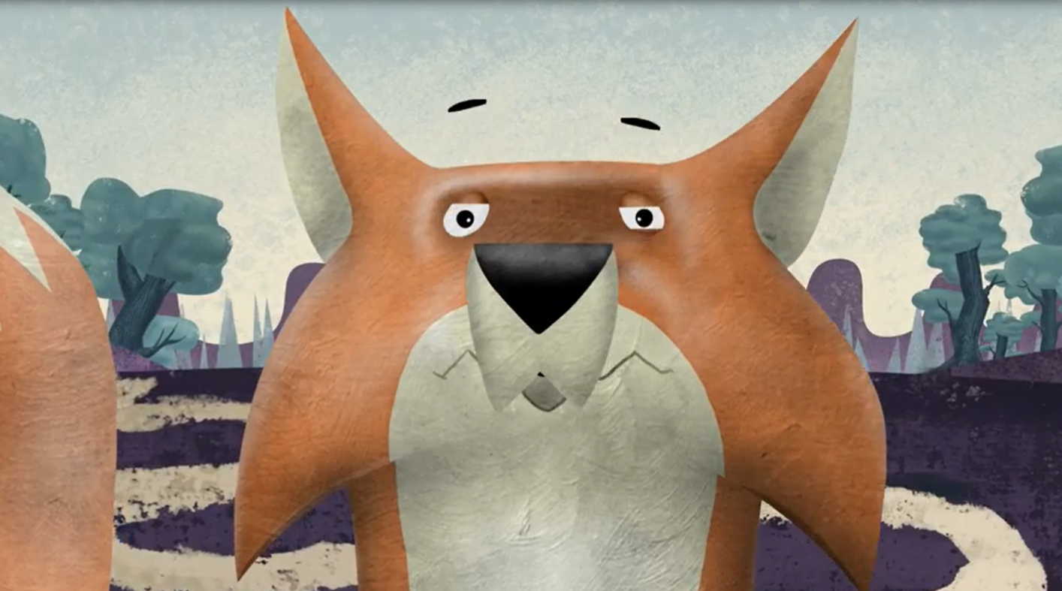
Plenary: What’s the moral?
Notes:
https://youtu.be/o-M8rKiq35s

