Slide 1
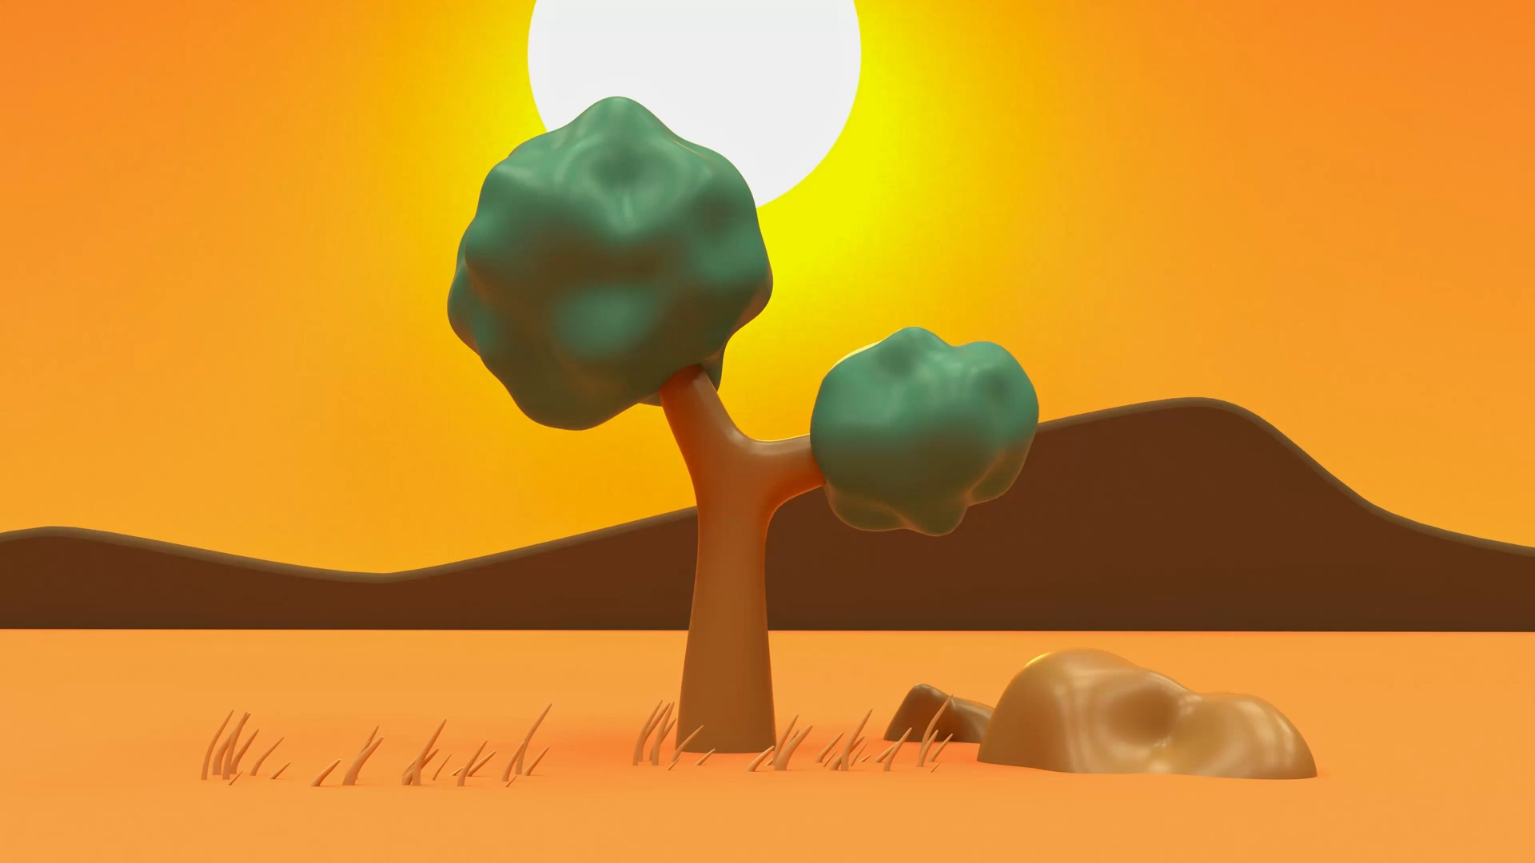
Aesop’s Fables
Lesson 1

Slide 2
LO: To understand what a fable is.
I understand what a moral is.
I can list key features of a fable.
I can annotate a fable to demonstrate the key features.

Slide 3
What is a story?
Notes:
Starter: With a partner – What is a story? Write ideas down on IWB. Is it easy to define what a story is? Explain this is because there are different genres.

Slide 4
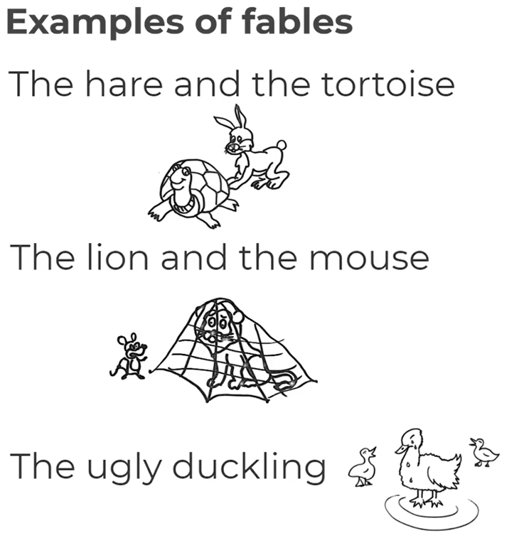
What is a fable?
Fables tell us a story and teach us a lesson at the same time.
A fable is a story that features animals, plants, or forces of nature that are given human qualities. A fable always ends with a moral. This is the lesson that you should learn from reading the story. There is normally something that goes wrong in the story to teach us this lesson.
Notes:
Explain that we are starting a unit on a type of story called a fable. What is a fable? Explain that it is a fictional narrative which teaches a moral lesson. What is a moral? A moral is a lesson that you learn, usually from having a negative outcome from doing the wrong thing.

Slide 5
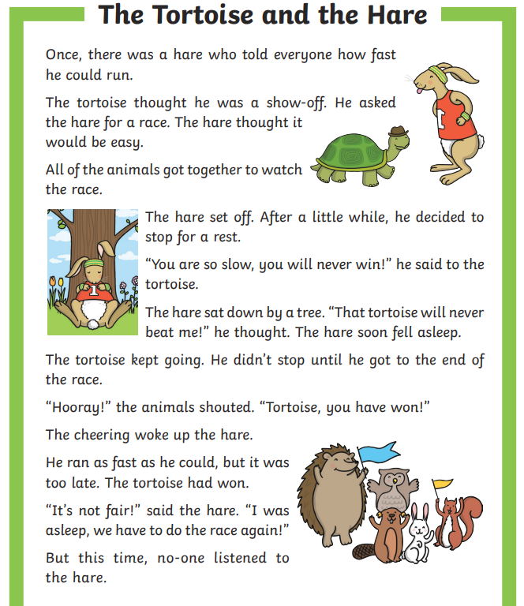
Task 1:
In mixed ability pairs, read through fable of ‘The Tortoise and The Hare.’
What do you notice about the story? Can they think of any key features? Who are the main characters? What is the plot of the story? What happens in the end?

Slide 6
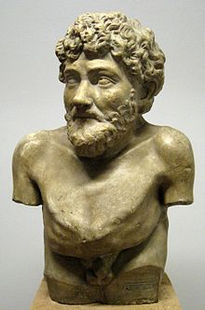
Aesop
Aesop (c. 620–564 BCE) was a Greek storyteller credited with a number of fables now collectively known as Aesop's Fables.
Although his existence remains unclear and no writings by him survive, numerous tales credited to him were gathered across the centuries and in many languages in a storytelling tradition that continues to this day. Many of the tales associated with him are characterized by animal characters with human characteristics.

Slide 7
Key features
The characters are usually animals.
Third person narrator – they usually have a non-participant narrator who tells us what happens to the characters in a place and time indeterminate (we don’t know where or when).
Very simple structure. Every fable begins with a situation or problem where one or more main characters are involved.
Fables are often very short stories.
Human themes – fables with animals often have problems that humans would have e.g. being unkind, jealousy, lying.

Slide 8
Task 2:
Now let’s see if we can find these features in the story using post it notes. Can you work out what the moral of the story is?
EXT: Can you complete the comprehension questions for the story?

Slide 9
Plenary
Verbally with a partner before sharing ideas with the class - how are fables different to ‘normal’ stories? How are they the same?

