Slide 1
Exciting Writing Edit

Slide 2

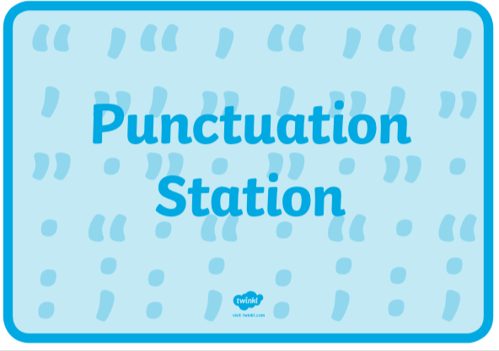



Year 2 – capital letters, full stops, exclamation marks, question marks.
Year 3 – as above and commas for a list, apostrophes for contracted words and possession.

Slide 3
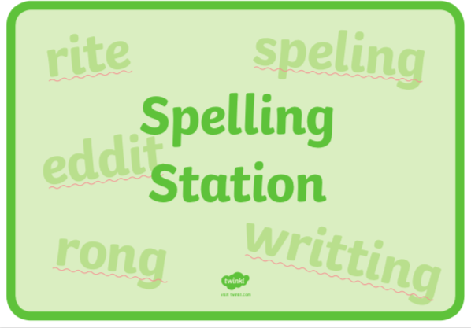
Make sure that all of the high frequency words you know are spelt correctly.
What about the words that were on our word bank we created?

Slide 4
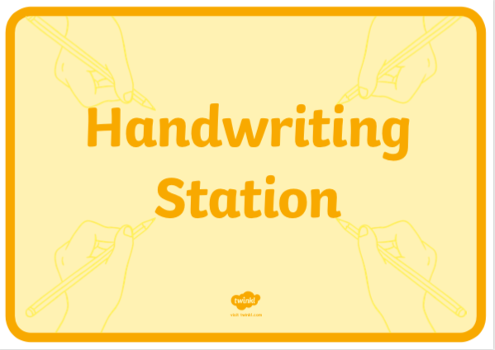
Take a few minutes to check your handwriting.
If you are joining your handwriting, is it neat?
Are all your letters formed correctly?
Are they sitting in the right place on or under the line?

Slide 5

Think about some of the words you have used – could you improve any?
If you have used an adjective in a phrase, could you change it to be a more powerful one.
You could check whether you could improve the quality of some of your words using a dictionary or thesaurus.

Slide 6
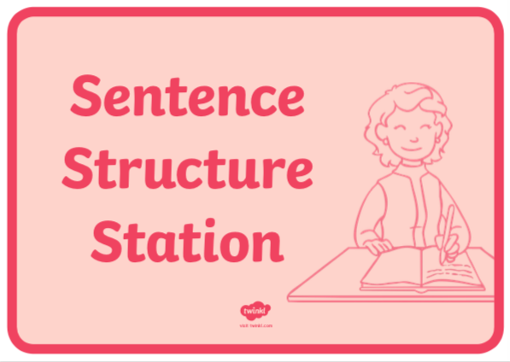
Have you included some statements and exclamations?
Have you used any conjunctions?
Have you used any prepositions year 3?
Is it written in the correct tense?

