Slide 1
LO: To recognise and use the relative clause.
Must- be able to identify the relative clause.
Should- begin with a relative pronoun.
Could- separate the relative clause using commas, brackets or dashes.
Even better if- I can write using relative clause independently.

Slide 2
Relative clauses are a speciﬁc type of subordinate clause. They help to add more information to sentences.
A relative clause directly links to the noun which you are describing or modifying – it is relative (related) to it.
A relative clause starts with a relative pronoun: who, which, where, whom, that, whose.
When you remove the relative clause, the original structure still makes sense.
Gemma, who is my younger sister, sat with my parents on the plane.
The sentence would still make sense without a relative clause and can still be punctuated using a pair of commas, dashes or brackets.
https://www.bbc.co.uk/bitesize/topics/zwwp8mn/articles/zkcd7sg

Slide 3
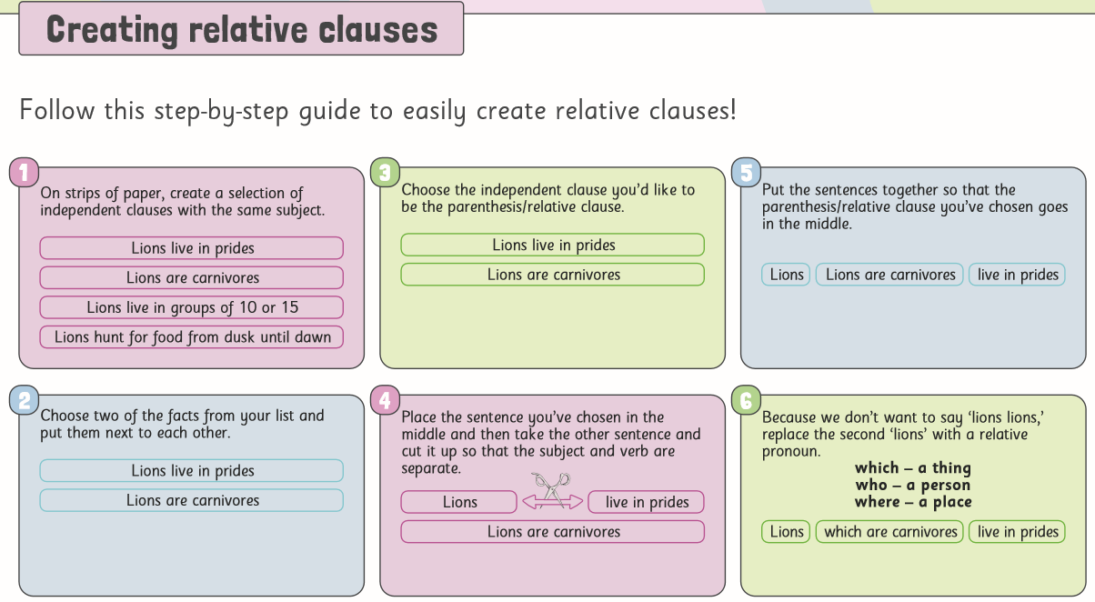

Slide 4
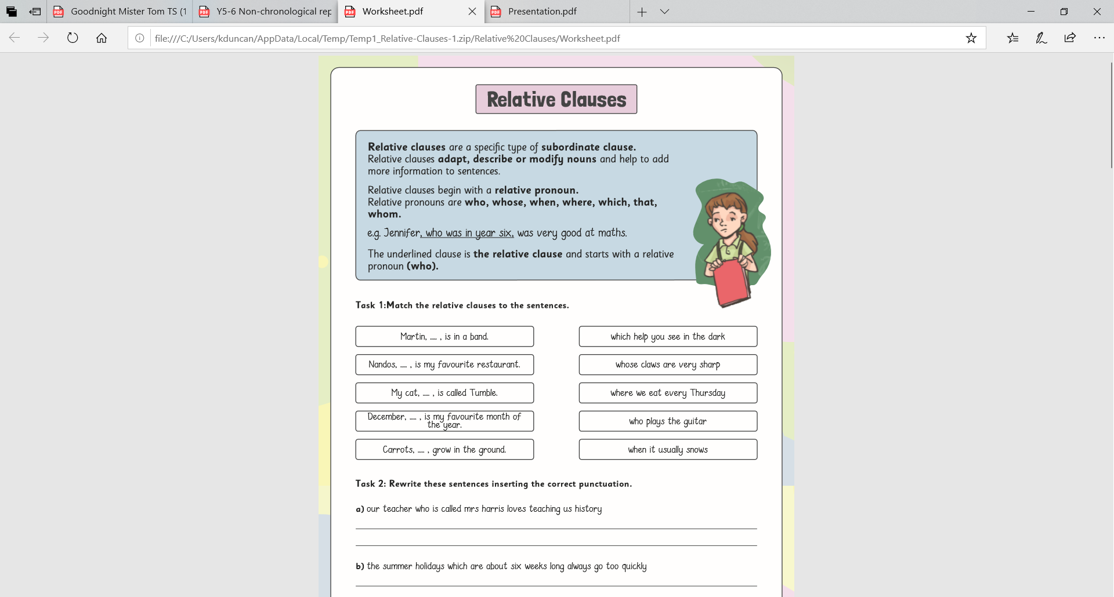
Task 1: Complete the relative clauses activity sheet!

Slide 5
Task 2: Expand these independent clauses using relative clauses, (Don’t forget who, whose, that, which, when, where!)
Willie is a talented artist.
Mr Tom takes care of the graveyard.
Sammie barked excitedly.
Zach danced beautifully.
The Anderson shelter was flooded.

Slide 6
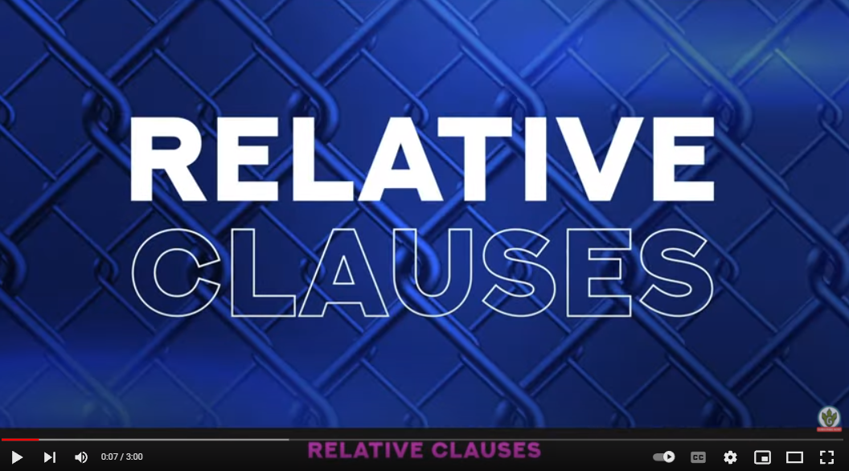
Plenary- Sing the relative clauses song!
https://www.youtube.com/watch?v=H7UI6Q-0M4k

