Slide 1
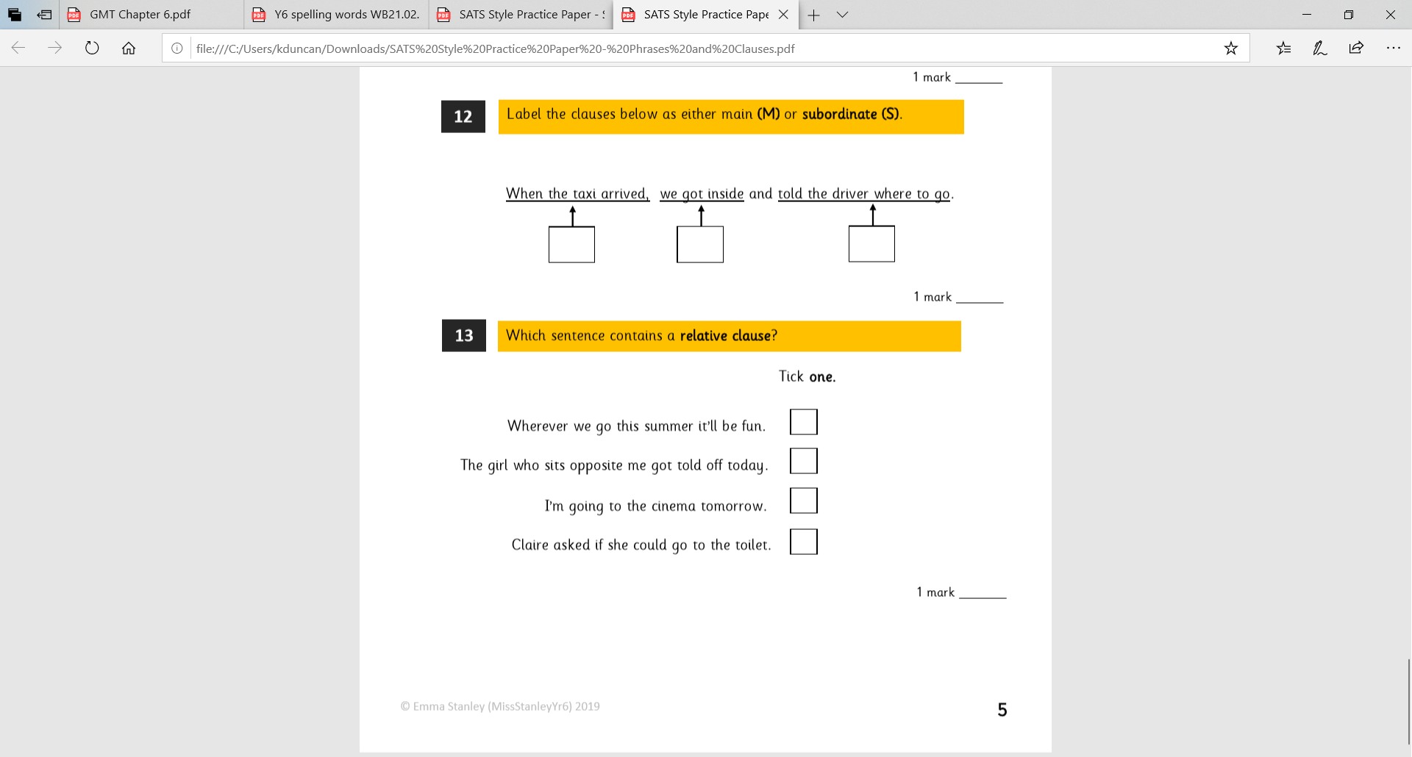
LO: To plan instructions for an air raid shelter.
Must: work with a partner to rehearse instructional language.
Should: plan my writing using imperative verbs.
Could: use ordering language to explain steps.
Even better if: add specific details.

Slide 2
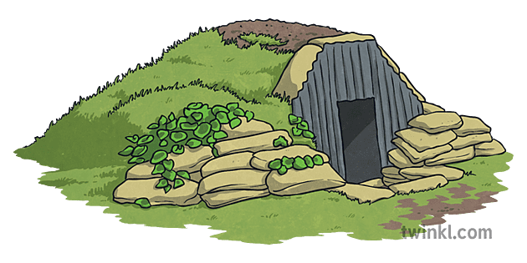
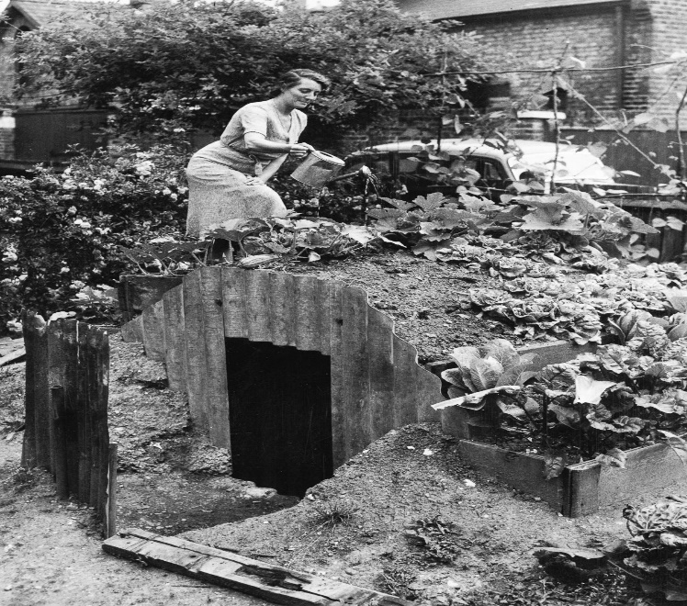
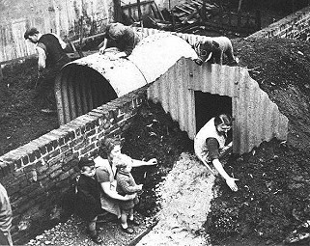
First, listen up to the end of chapter 6.
In the last two chapters, Tom and William have been building a type of air-raid shelter. These types of shelters were called Anderson shelters.
Why might people choose to construct these near their homes?

Slide 3
Your task over the next two lessons is to plan and write a set of instructions for constructing an Anderson shelter.
Step 1- use the following resources to learn about Anderson Shelters.
http://www.primaryhomeworkhelp.co.uk/war/shelters.htm
https://www.iwm.org.uk/collections/item/object/1060013384
https://www.andersonshelters.org.uk/index.html
https://www.andersonshelters.org.uk/library/anderson_shelter_construction_instructions.pdf
https://historyforkids.org/anderson-shelter-facts-and-information/

Slide 4

What are the features of instructional writing?

Slide 5
Working with your partner, take turns practising your instructions out loud.
You can use your whiteboards to note down your ideas and improve them. Try putting them in time order, and using time conjunctions to add them together.
After 5 minutes I will be choosing a few students to read out their ideas. Listen carefully and be ready to share ideas of how to make these even clearer.

Slide 6
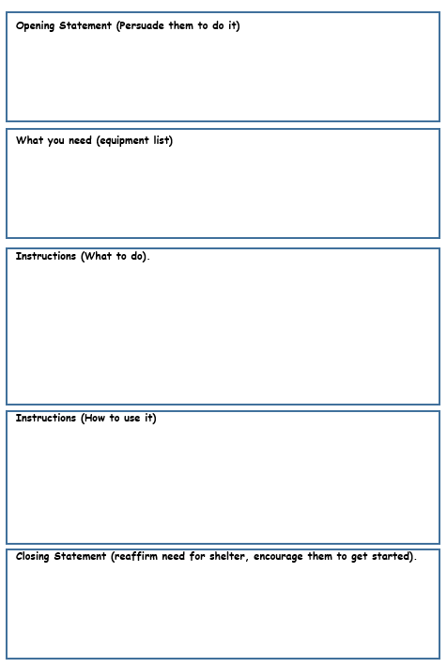
Use the planning sheet to plan your main ideas for each section.
You will write your full version next lesson.

