Slide 1
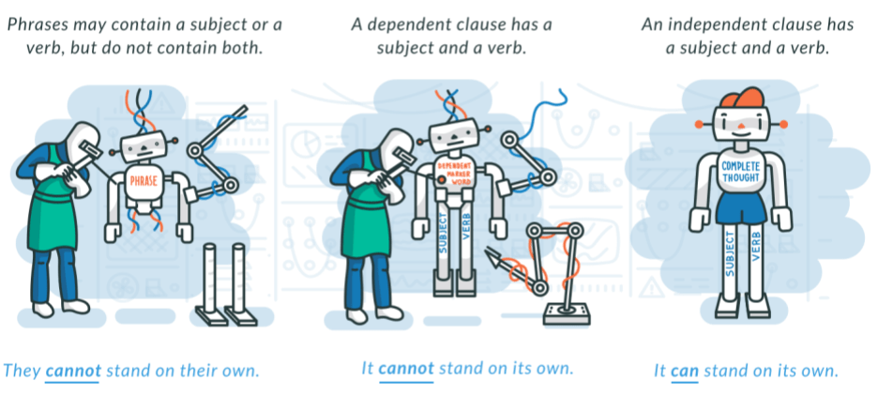
LO: To identify the subject and verb of a sentence.
Must- I can explain what verbs are.
Should- I can identify the subject of a sentence.
Could- I can use verbs and subjects to compose my own sentences.
Even better if- I can experiment with sentence structure.

Slide 2
Discuss with your partner: What is a sentence?
A sentence is when you have a capital letter at the beginning and a full stop at the end.
A sentence contains only one idea or thought.
A sentence contains a subject and a verb.

Slide 3
Answer- A sentence contains a subject and a verb.
Identify the verbs in these sentences.
Billy began his homework. Cats are furry. Delilah went home.
The driver turned left. Diego was bored.
You can think to verbs as ‘doing’ or ‘being’ words. Sort these into things you are, or things you do.
cry was listened went need am wrote is blame are like am took.

Slide 4
Now we can talk about subjects. A subject is a noun that does or is something.
E.g. Mr Tom was grumpy. Willie likes art. Cows are herbivores.
Try to identify the subject of these sentences.
the cottage looked neat six starving evacuees glared at the teacher
a flock of sheep escaped fear gripped Willie’s soul
If you have both a subject and a verb, and you have completed your idea, this is called an independent clause. You can add a full stop and move on!

Slide 5
Task A. On your whiteboard, come up with your own sentences. Swap with your partner and identify the subject and verb.
https://www.youtube.com/watch?v=ErwKUGfBzhg
Can you extend your subject with further information?
(This is known as a noun phrase).
Can you extend your verb with further information?
(This is known as an adverbial phrase).
Can you change the order of the verb and noun? What is the effect?

Slide 6
Example sentences.
Tom opened the door.
Tom the grumpy old hermit opened the door.
Tom opened the door with a violent jerk.

Slide 7
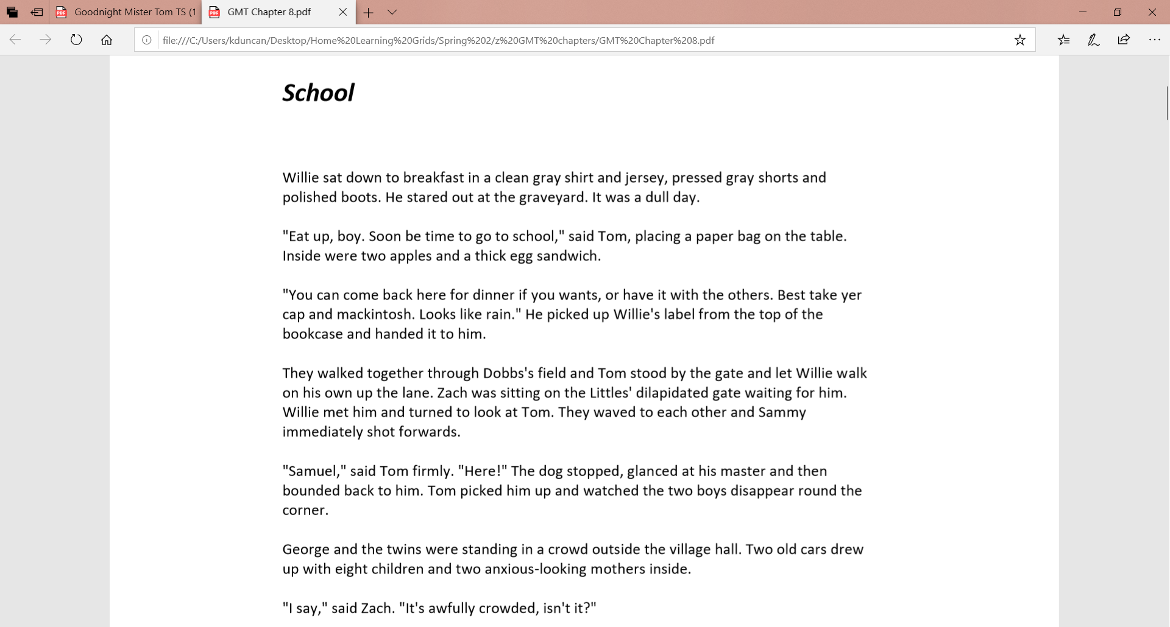
Task B. Using your highlighters, identify the subject and verb in each sentence of a passage of Goodnight Mr Tom.

Slide 8
Plenary. Just for fun, can you identify the subject and verb from each sentence of ‘The Jabberwocky’ by Lewis Carroll?
“Beware the Jabberwock, my son!
The jaws that bite, the claws that catch!
Beware the Jubjub bird, and shun
the frumious Bandersnatch!”
’Twas brillig, and the slithy toves
Did gyre and gimble in the wabe:
All mimsy were the borogoves,
And the mome raths outgrabe.

