Slide 1
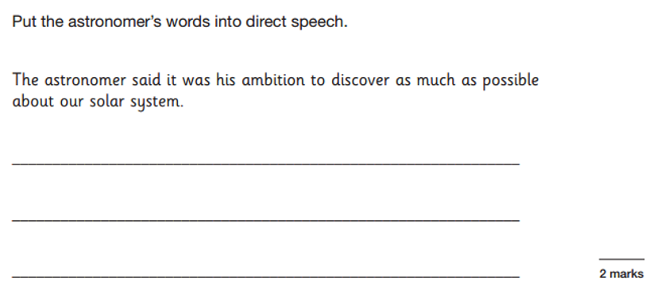
L.O: To use dialogue to convey information and move the story on. 19.01.22
P | Success Criteria | T
 | Must: I can correctly use inverted commas (speech marks).
 | Should: I can use correct punctuation to show what is being spoken.
 | Could: I can combine dialogue with action and description.
 | Even better if… I can use dialogue to progress the scene.

Slide 2
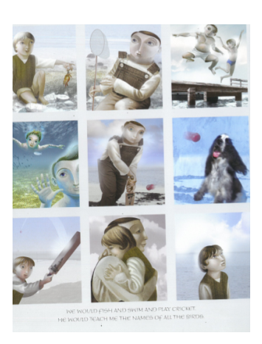
Task 1- on your mini WB, write a sentence that the father might have said to the son using direct speech. What do we need to include to be successful?

Slide 3

Why might an author choose to use dialogue in their narrative?
To move the plot forward.
Give information to the reader about the story.
To show the character’s thoughts and feelings.
To make sure your dialogue is effective, make sure you mix it in with action and descriptive prose.
Would you like to read a story that only contains direct speech?

Slide 4
In this lesson, we will be imagining a scene before the father leaves for the war.
In small groups, each of you will take on the role of one the characters, such as the mother, father or son.
Imagine what each person might say to each other before they leave. Also consider how people spoke in 1914- they spoke in a more formal manner, such as using fewer contractions.
People often behaved differently, as people tried to not show emotions and keep a ‘stiff upper lip’ and children were often expected to keep quiet unless spoken to by an adult.

Slide 5
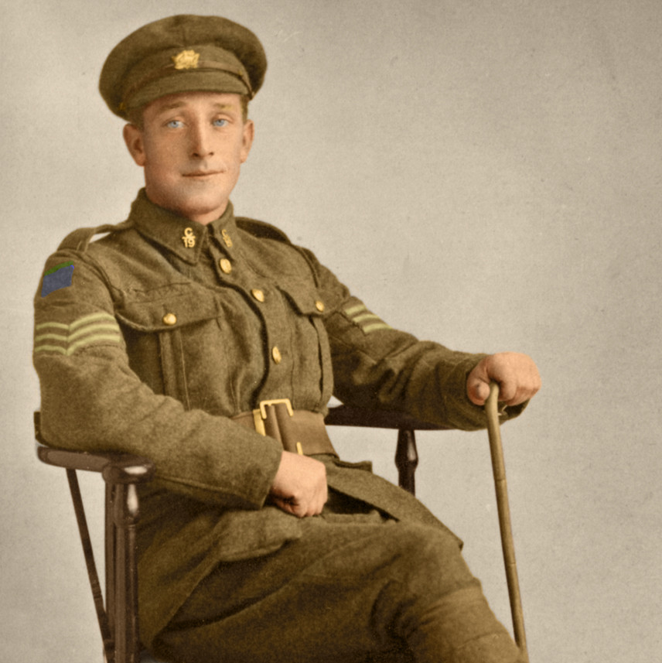
With your talk partner, suggest some sentences to continue the scene.
“Sit down, John,” my father said as he straightened his heavy khaki tunic. “What I am going to tell you is very important. While I am gone, you shall be the man of the house. It will be your responsibility to look after your mother.”

Slide 6
Written task- use the dialogue you came up with in role to write a short scene using speech.
Must/Should: Use correct punctuation to write direct speech, particularly inverted commas.
Could: Use a mixture of dialogue with action and description.
Even better if: Use dialogue to progress the scene.
This could be between the father and son before he leaves for the war, or between the mother and son after he is gone.

