Slide 1
L.O: To write a diary entry in role. 18.01.22
P | Success Criteria | T
 | Must: I can write using a character’s viewpoint.
 | Should: I can include description of the setting.
 | Could: I can include descriptions of the character’s emotions (show don’t tell).
 | Even better if… I use formal language suitable for the time period.

Slide 2
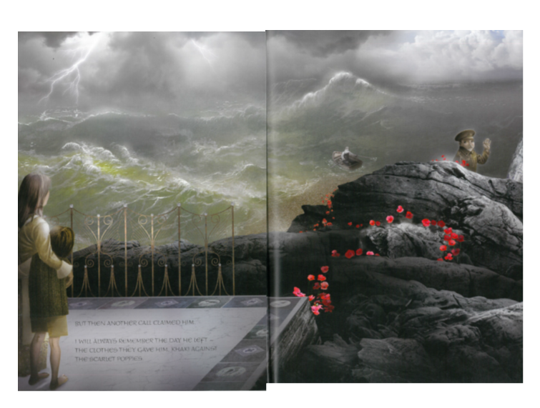
In a well-written story, all of the characters will have a different point of view. What do you imagine each of these characters might be thinking about at this moment?
Shared experience: Everyone to close your eyes and imagine what it might be like to be in this scene. What would you be able to see, hear, feel?

Slide 3
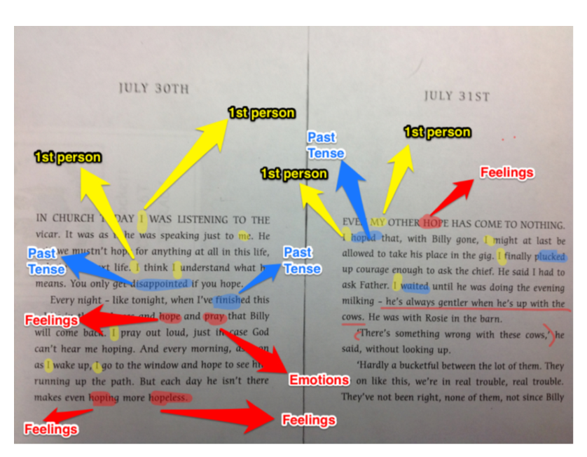
What do we know about the features of a diary entry?

Slide 4
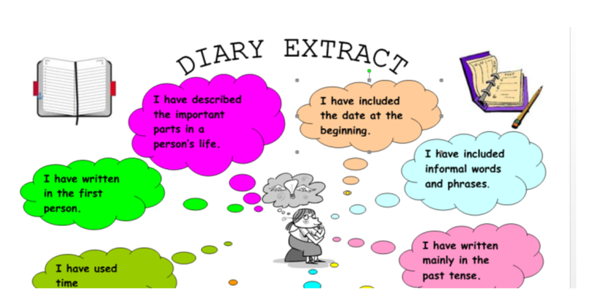

Slide 5
Dear Diary,
What a dreadful day.
This morning, just after breakfast, Mr Collins came. How he managed to guide that small rowing boat past the rocks I shall never know but he did, sadly. I know it's wrong, but I was wishing the gigantic waves would just swallow him up so
that my beloved Father would not be taken from us.
Breakfast had been such a sad affair: everyone was trying to be brave but we have all seen the headlines...

Slide 6
Plenary
Consider the point of view of the boatman.
Do you think he knows the family?
What does he know about the war?
What might he say to reassure the mother and son?

