Slide 1
LO: To use my 5 senses to create a word bank about the sea using my 5 senses.
Self- Assessment | Success Criteria | Teacher Assessment
 | Must: I can use music and visual images to help me to create a word bank about the sea.
 | Should: I can use my 5 senses to explore different images to create a word bank of exciting words and phrases about the sea.
 | Could: I can use my 5 senses to create word banks of noun phrases and similes about the sea and can also include examples of alliteration and onomatopoeic words.
 | Even better if… I can use my 5 senses to create word banks of noun phrases and similes about the sea and can also include examples of alliteration and onomatopoeic words.
Spag Starter-Noun phrases.
Noun phrases describe a noun by using which kind of words?
The ancient, grey-muzzled hunting hound wagged his tail.
A ________________________________ parrot landed on the palm tree.
Jenny’s _______________________________________________ diary was her most precious possession.

Slide 2

https://www.youtube.com/watch?v=a3MiETaBSnc
First, listen quietly to this piece of music by Mendelssohn.
Think about the impressions, ideas and images you got from the music, and spend a few minutes putting these in a mind map in your book.

Slide 3
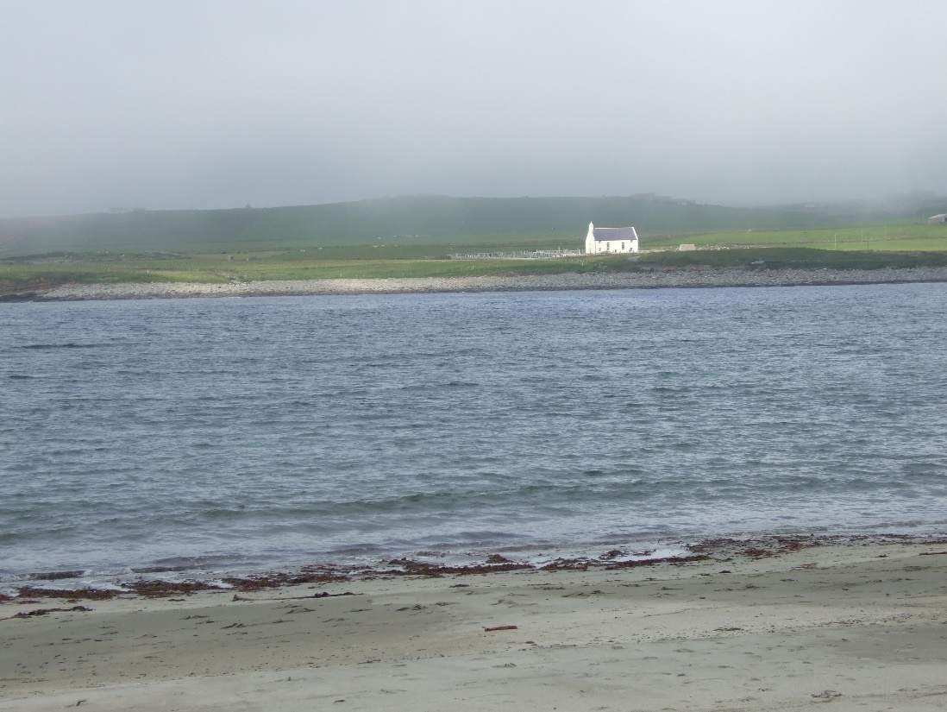
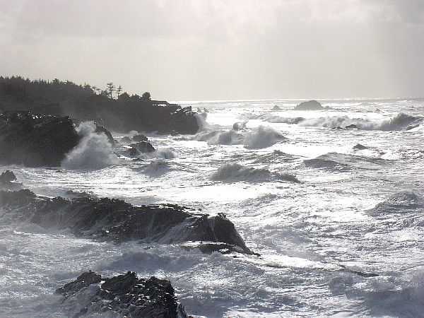
On your table, use the pictures given to discuss how you would describe the sea in each image.

Slide 4
Task: To create a word bank of vocabulary about the sea.
Create a word bank of powerful vocabulary, based on your 5 senses.
Use your imagination to come up with words and phrases to describe how the sea looks, feels, moves or sounds.
See | Hear | Touch | Smell | Taste
Extend your thinking: Underline any words in your bank which use onomatopoeia. Begin to test out some of your vocabulary by writing descriptive sentences- challenge yourself to add phrases using alliteration.

Slide 5
Plenary-
Volunteers will read out some of their best words.
Make sure you are listening carefully to magpie some excellent ideas you might not have yet.

