Slide 2
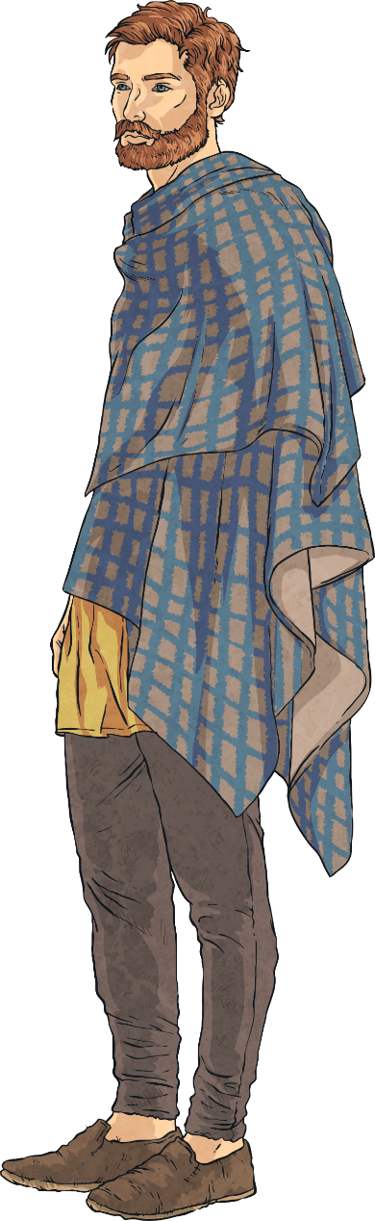
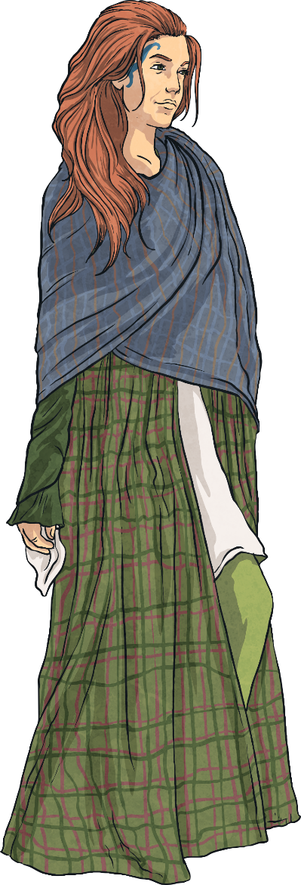

Who was Boudicca?
Boudicca was the wife of Prasutagus, the ruler of a Celtic tribe called the Iceni.
The Iceni lived in a region of Britain that is now called East Anglia.

Slide 3
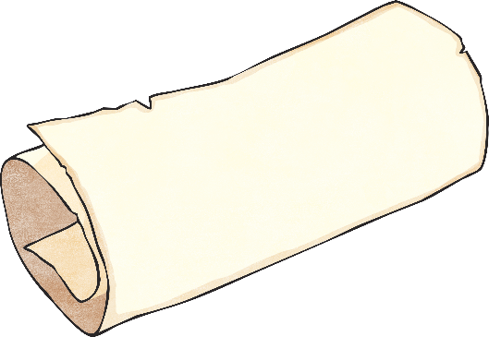
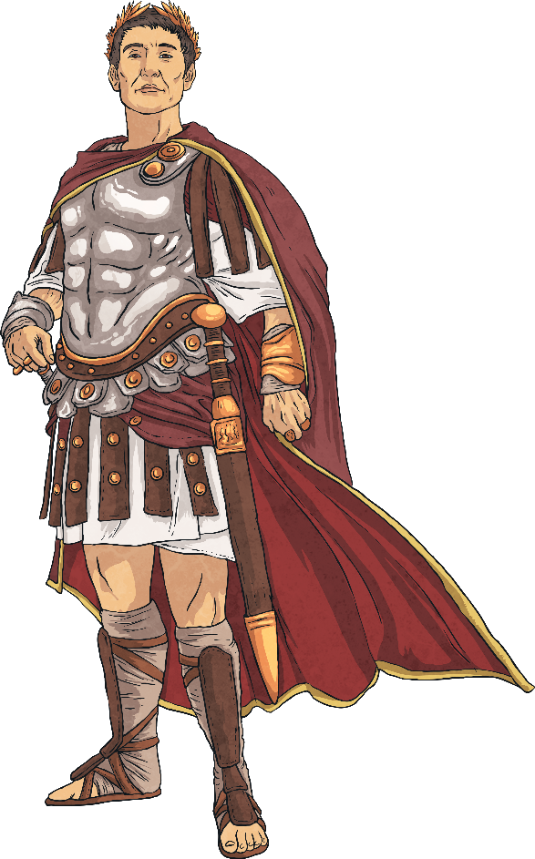
Prasutagus and the Romans Agreement
When Romans settled in the South of England in 43 AD they made an agreement with Prasutagas so that he would be able to continue as ruler of the Iceni.
When Prasutagas died, the Romans turned on the Iceni.
They stole from the Iceni tribesmen, made people slaves and they had Boudicca whipped.

Slide 4
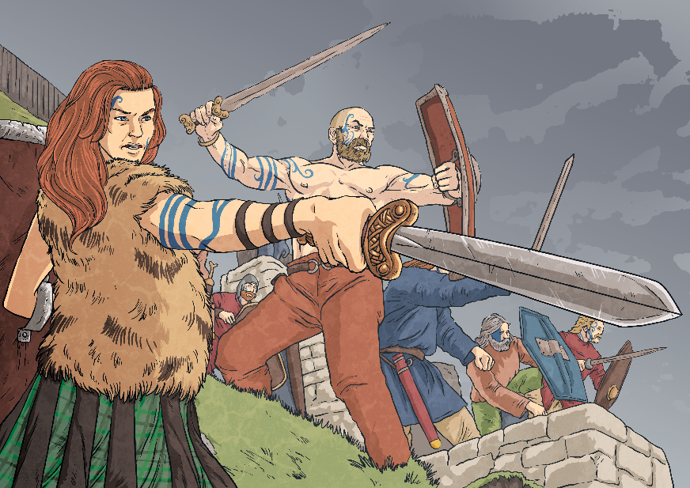
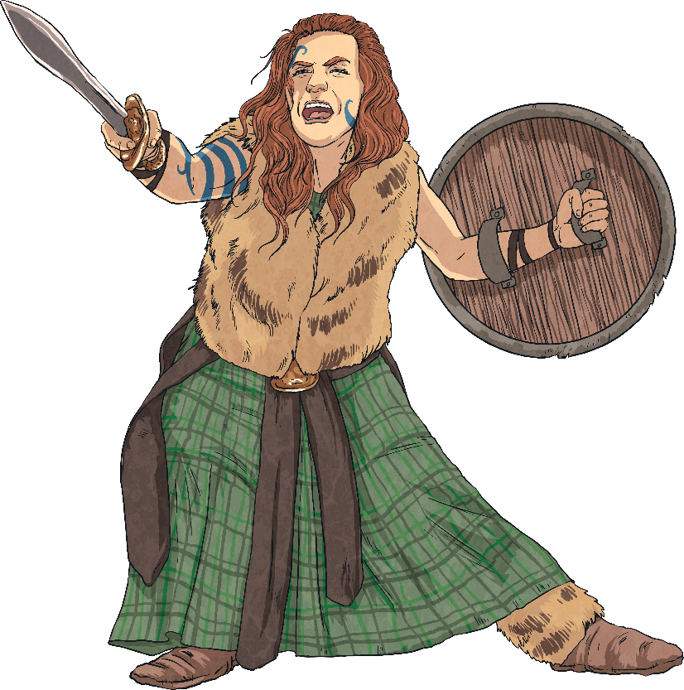
The Rebellion
In about 60 AD, the Roman governor was sent to North Wales to lead an army.
While he was away Boudicca led an attack against the tribe’s Roman rulers with several other tribes.
Her army was called the Britons.
They managed to destroy Camulodunum (Colchester), the capital of Roman Britain and defeated the Roman IX legion.

Slide 5
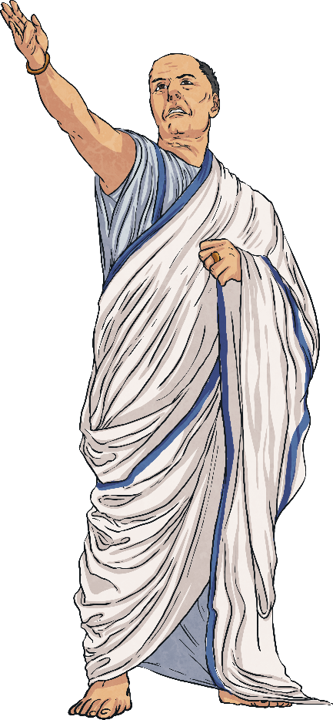
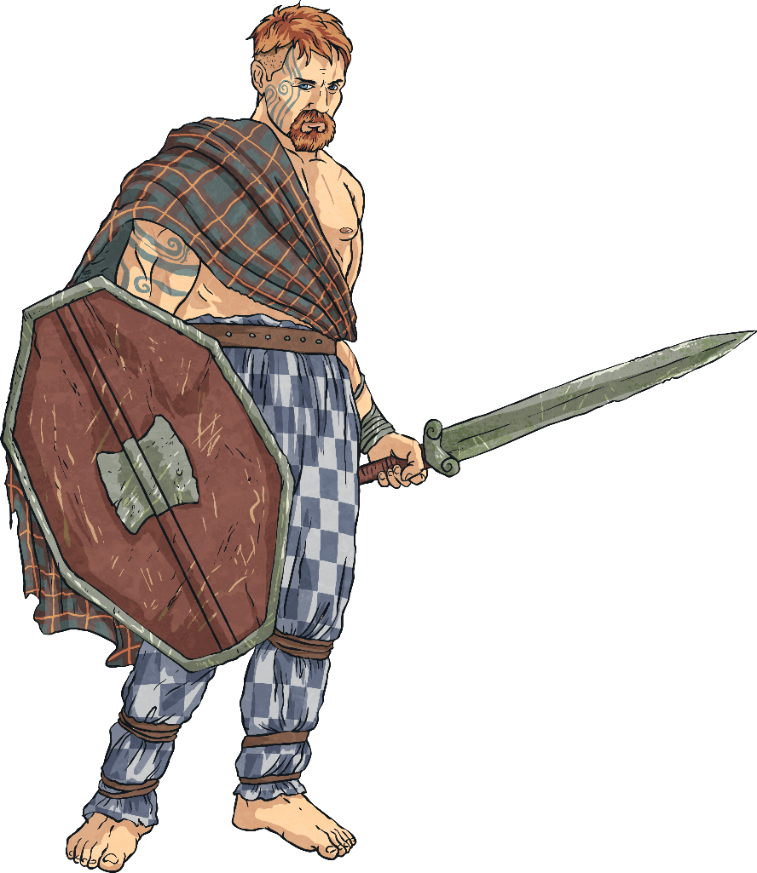
Attack on Londinium
Hearing the news, the Roman governor rushed back from Wales.
He tried to evacuate Londinium (London) as he guessed this would be the Britons next target.
Boudicca and her army destroyed Londinium and
Verulamium (St Albans).
People believe that over 70,000 people were killed in the attacks by the Britons.

Slide 6
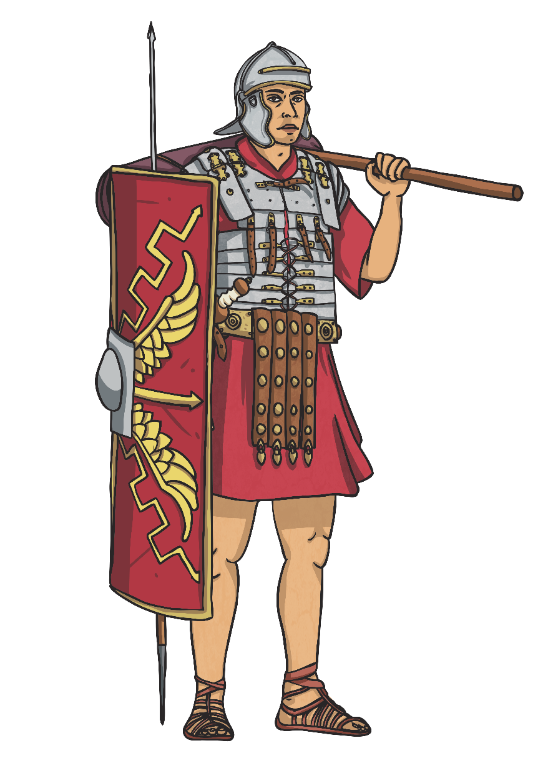


Defeat
The Roman army regrouped in the Midlands and finally defeated the Britons in the battle of Watling Street.
No one knows what really happened to Boudicca. Some say she killed herself when she knew the Romans had defeated her, others say she fell ill and died.

Slide 7


The Legend
“I was whipped by the Romans when they tried to take our lands and now I am fighting for my freedom. Think how many of us are fighting and why. We must win this battle or die. Let the men live as slaves if they want. I will not.”
-Boudicca’s last speech, as recorded by Dio Cassius
Boudicca is a heroine because she achieved a lot and fought for her country, for her people and for herself. Although she lost the final battle, she never let the Romans conquer her.

