Slide 1
LO: to write a newspaper article.

Slide 2

title
headline
photo
caption
Features of a newspaper article
article
Notes:
Recap

Slide 3
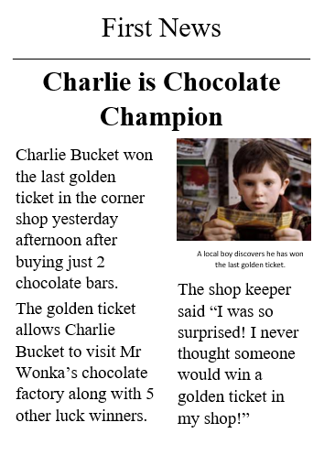

title
headline
photo
caption
What makes this a good news report?
article

Slide 4

Your task:
Write your own happy new article.
Top tips:
use your previous work on headlines amnd the 5Ws.
Start with a sentence using the 5 Ws.
Challenge:Include something someone has said. Ie an eye witness account.

