Slide 1
Warm up
Choose a conjunction to join the two sentences together.
Sam is really excited. It is his birthday tomorrow.

Slide 2

LO: to write a correctly punctuated question.
Must: write a simple question which I can read back.
Should: punctuate a question with a capital letter and question mark.
Could: convert a fact into a question.

Slide 3
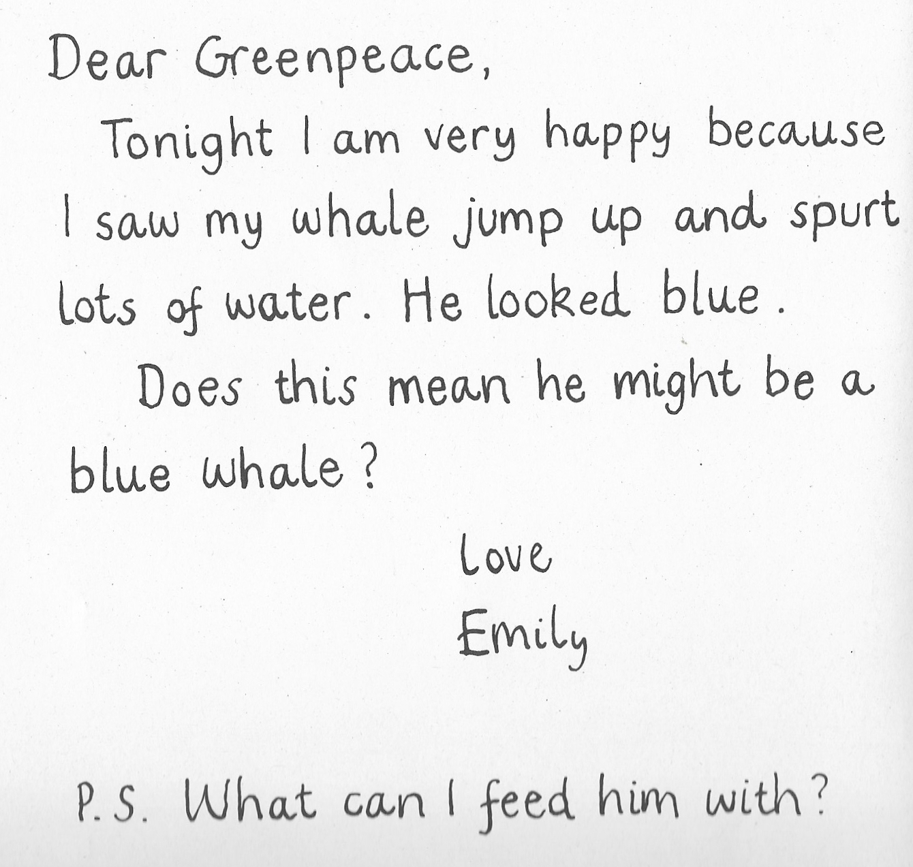

Slide 4
Which sentence is the question? Is there any missing punctuation?
A blue whale lives in salt water
Does a blue whale live in salt water

Slide 5
Question marks:
?

Slide 6
How can we convert this statement into a question?
Blue whales eat krill.
What do blue whales eat?

Slide 7
Your task- Reception/ year 1 something easier:
Record at least one question about whales. Remember to use a question mark.
?

Slide 8
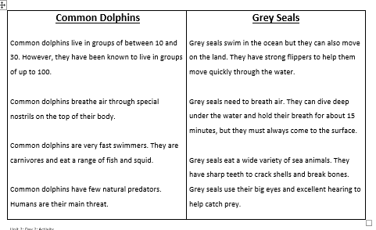
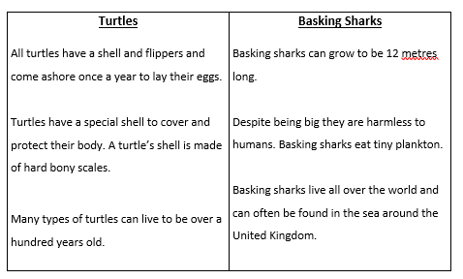
Your task- Year 1:
Select one of the fact sheets about sea animals. Then record each fact as a question. Remember to use a question mark.

Slide 9

Extension:
Explore and select a fact book about sea animals from the school library.
Record 5 facts in your book about your chosen animal.
Then convert each fact into a question and record in your book with the correct punctuation.

