Slide 1

Warm up
Write the upper and lowercase letters on your whiteboard. Watch your letter formation!

Slide 2

LO: to compose a simple letter.
Must: compose a sentence orally before writing it.
Should: use some features of a letter (dear/from).
Could: write a question in your letter.

Slide 3
Reread Greenpeace, stop at p16.
Recap the tone of each of the letters- formal? Informal?
How do the letters begin and end?

Slide 4
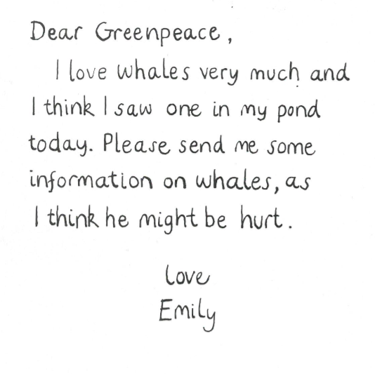
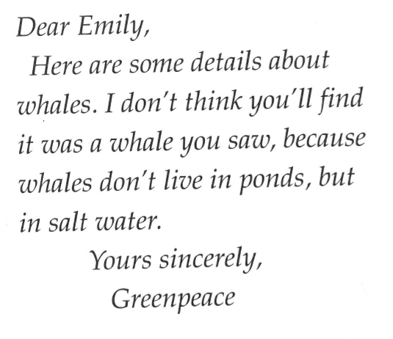
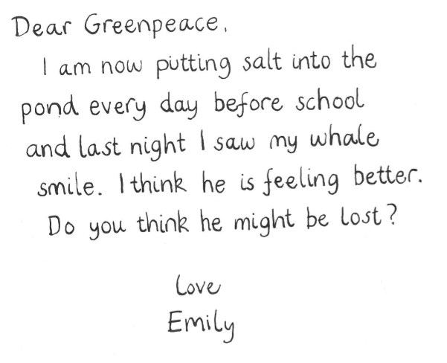

Slide 5
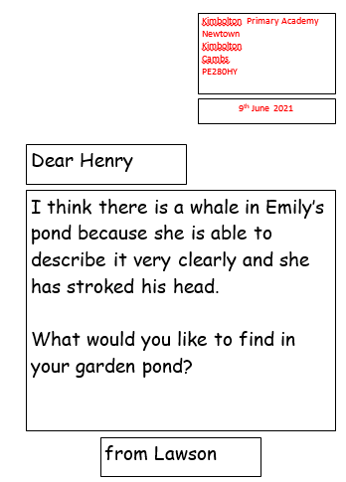
Write a letter to a friend telling them about the whale in Emily’s pond. Do you think it’s real? Can you ask your friend a question?
Let’s write one together as a class on the whiteboard.
In the example:
Address
Date
Dear/from
Uses because
Asks a question

Slide 6
Your task:
Write a letter to a friend telling them your thoughts about Emily’s whale.
Remember to include:
Address
Date
Dear/from
Challenge:
Use ‘because’
Ask a question

Slide 7
Plenary
Read your letter to the person you are sending it to. Does it make sense?

