Slide 1
LO: to write a headline.

Slide 2
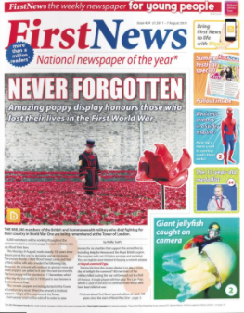
title
headline
photo
caption
Features of a newspaper article
article
Notes:
Recap

Slide 3
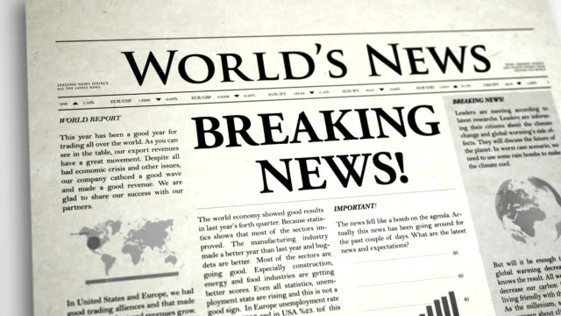
Headlines are:
Short and snappy- keep it short!
Include the main point of the story.
Can use alliteration- words that start with the same letter.

Slide 4
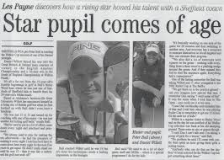
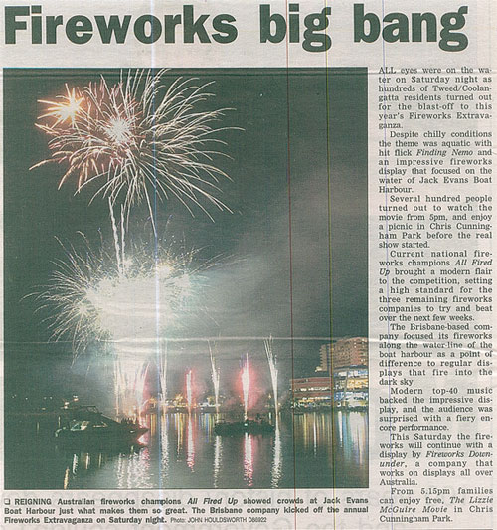

Slide 5
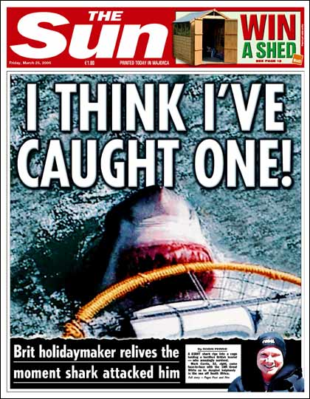

What is a headline?
What could this be headline be about?

Slide 6
What makes a good headline?
Discuss between you…

Slide 7
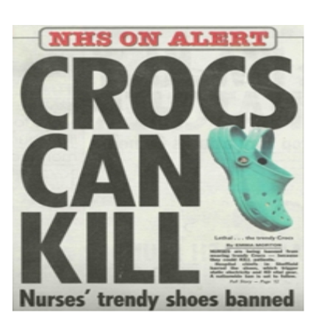
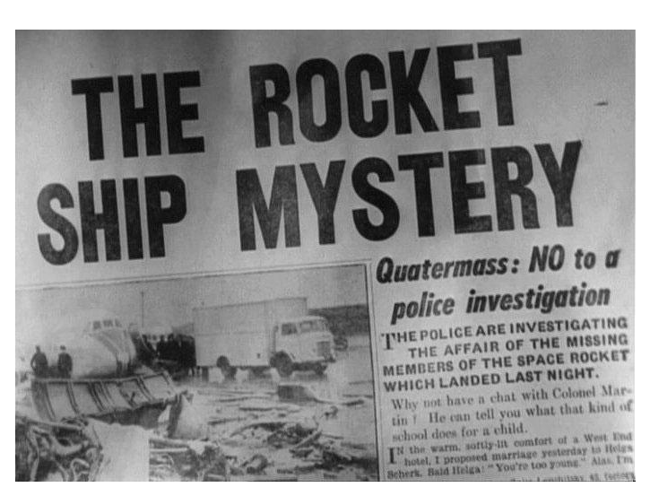
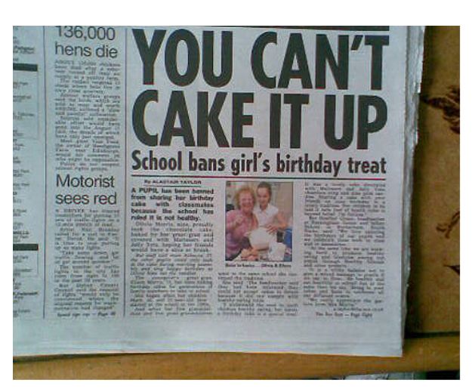
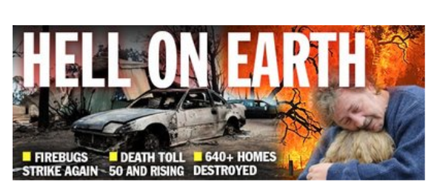

Slide 8
Headlines should be…
Short
To the point.
Eye-Catching
BIG
Bold
Interesting

Slide 9
Alliteration
Often using the same letter sound at the start of your words can create an interesting effect.
Examples…
Sending up the stars and stripes.
Greedy girl gobbles gruel.
Big bad bear bites boy.

Slide 10
Now your turn…
With your learning partner! Choose one of these pictures and create a headline.
Try to use alliteration with one of your headlines.

Slide 11
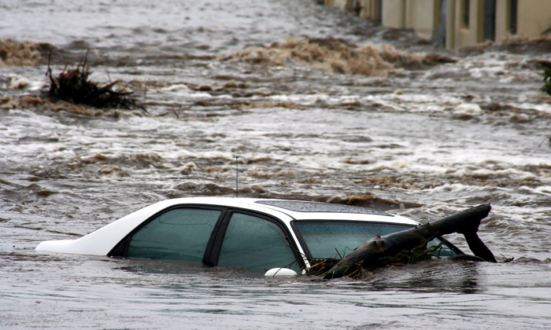
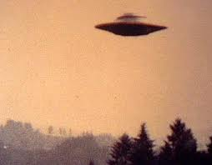
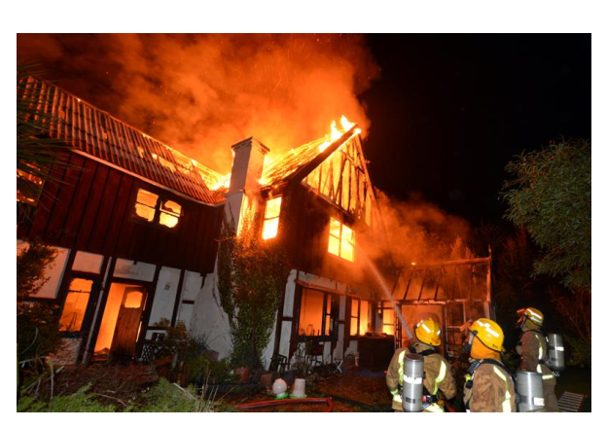
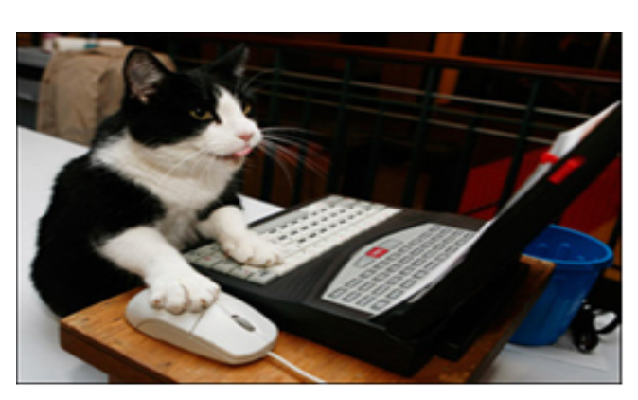

Slide 12
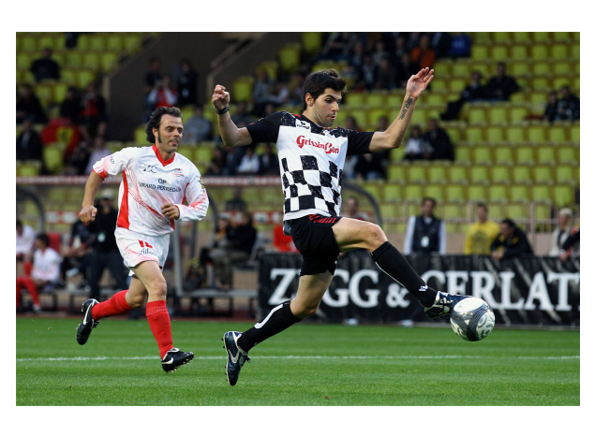
You have 5 seconds!

Slide 13
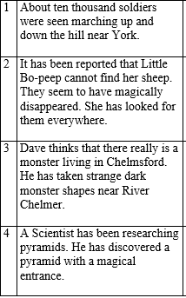

Dave thinks that there really is a monster living in Chelmsford. He has seen strange dark monster shapes near the River Chelmer.
Notes:
Match the headline to the story.

Slide 14

Your task:
Reception: write one headline in your book. Eg about sports day.
Record at least 3 headlines in your book for some happy news. Eg sports day, whale rescue, forest school.
Challenge: can you use alliteration?

