Slide 1
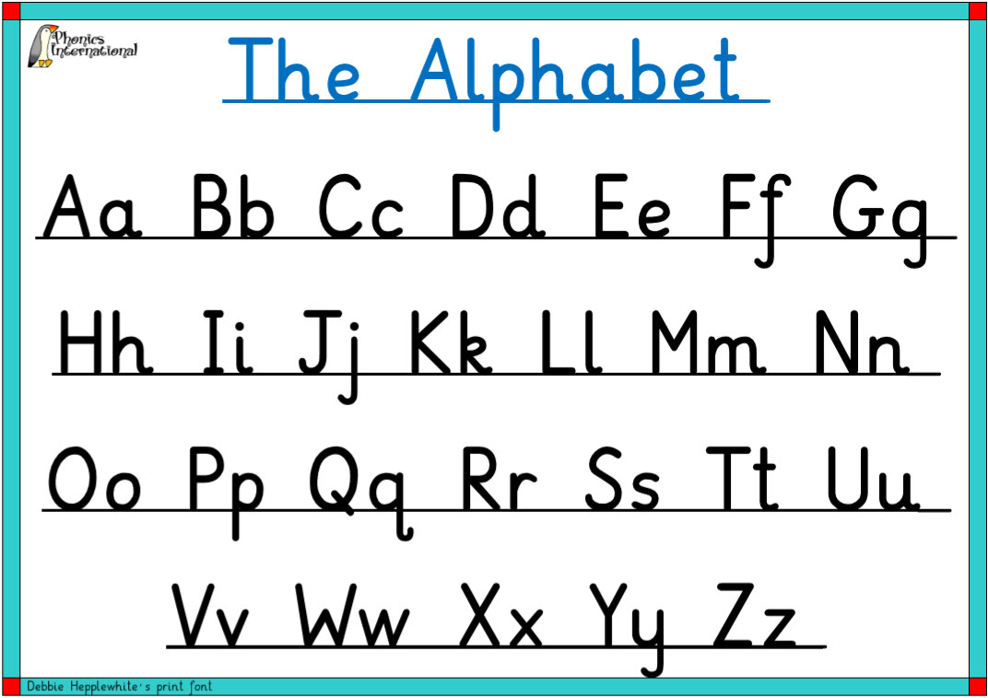
Warm up
Write the upper and lowercase letters on your whiteboard. Watch your letter formation!

Slide 2

LO: to articulate and justify answers and opinions.
LO: to read aloud accurately.
LO: to participate in discussion about what is read to them.
Must: read aloud confidently.
Should: contribute to a discussion, sharing own ideas.
Could: identify and explain the purpose of a letter.

Slide 3
Who are Greenpeace?
Greenpeace are an organisation of people who help and encourage people to look after the planet.

Slide 4
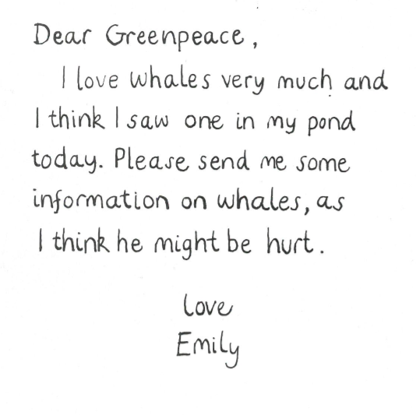
Letter 1
Is the letter formal or informal? What’s the purpose? What’s the same and what’s different between Emily’s letters and the letters from Greenpeace?

Slide 5
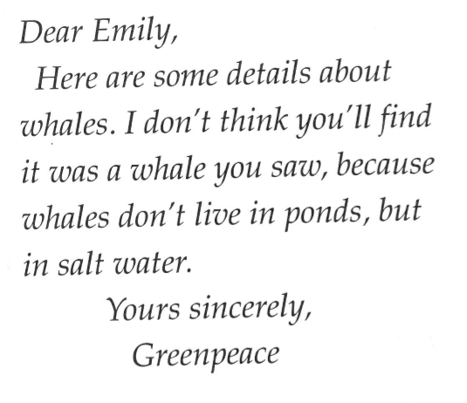
Letter 2
Is the letter formal or informal? What’s the purpose? What’s the same and what’s different between Emily’s letters and the letters from Greenpeace?

Slide 6
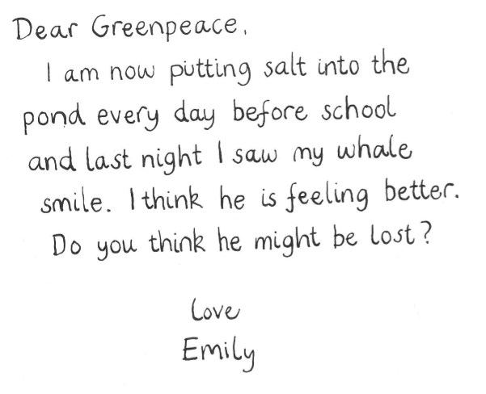
Letter 3
Is the letter formal or informal? What’s the purpose? What’s the same and what’s different between Emily’s letters and the letters from Greenpeace?

Slide 7
Your task:
Work with a partner to explore the first 6 letters from Dear Greenpeace.
Read each letter out loud. What is the purpose of each letter?

Slide 8
Plenary
Read the rest of Dear Greenpeace. What is the purpose of the rest of the letters?
Do you think Emily will persuade Greenpeace that there is a whale in her pond?

