Slide 1

LO: to identify the features of a newspaper report.
Notes:
Good morning everyone and welcome to our lesson today. We are going to continue our poetry unit and today with a little bit of grammar. Our learning objective is to identify nouns and verbs.

Slide 2
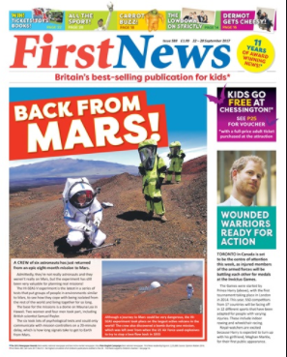
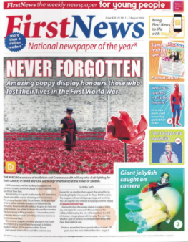
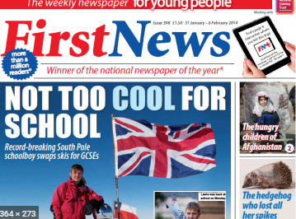
Lots of people find out about the news on the internet, television, radio or on their smart phones but many people still buy a newspaper everyday.
Notes:
Newspapers share information about big events. They can share good and bad news. Good news is my favourite kind of news.
When we write our own newspaper reports we are going to be writing about some good news linking to the story of Charlie and the Chocolate Factory. What good news might we share? I’ll leave you to have a think about that and we will come back to it in a later lesson.
News paper reports share information but they have lots of common features. We’re going to find out about these features today.

Slide 3
title
headline
photo
caption
Features of a newspaper article
article
Notes:
Explain each of the features

Slide 4
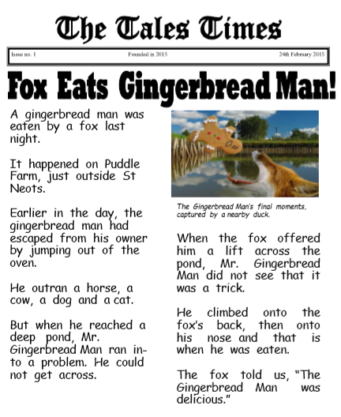
title
headline
photo
caption
Can you spot the features in this newspaper article?
article
Notes:
Let’s read this newspaper article together.
Newspapers are full of facts and opinions. They make use of the 5 Ws to give their reader all the information they need.

Slide 5

Your task:
Explore the newspapers and newspaper article with your group.
What are the features of a newspaper? Can you spot them?
Record some newspaper article ideas for our happy news newspaper.

