Slide 1
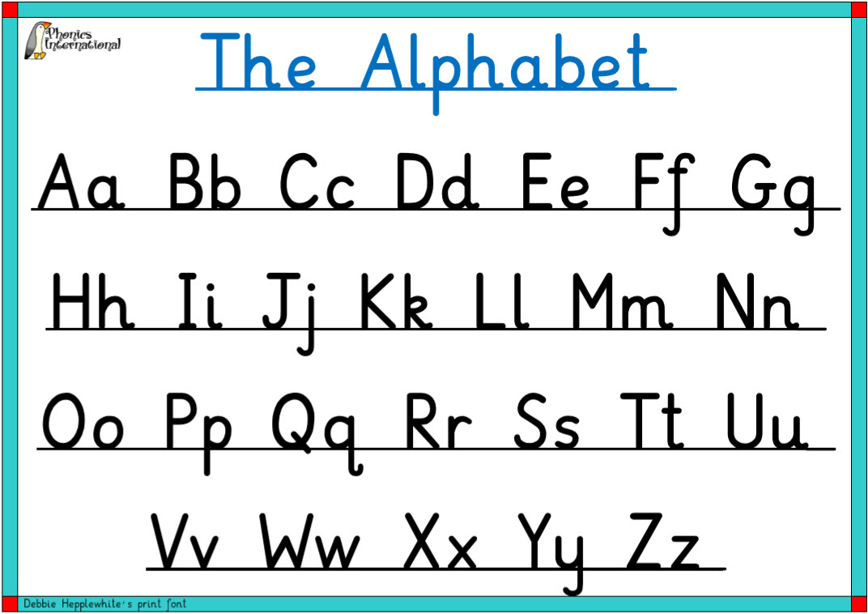
Warm up
Sing the alphabet.
Challenge: what letter is missing?

Slide 2

LO: to listen and respond.
LO: to link what they read and hear to own experiences.
Must: identify some key features of letters.
Should: listen to and discuss your ideas about letters.
Could: sort letters into form and informal.

Slide 3
I want to send a message to a friend. What types of messages are there?
What types of letters have you sent and received?

Slide 4
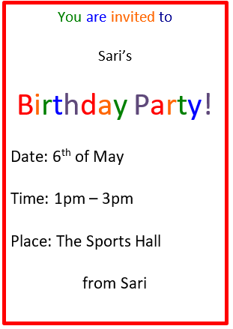
What kind of letter is this? What features does it have? Who sent it? Who received it?

Slide 5
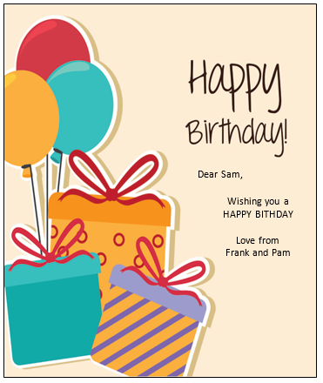
What kind of letter is this? What features does it have? Who sent it? Who received it?

Slide 6
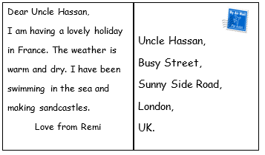
What kind of letter is this? What features does it have? Who sent it? Who received it?

Slide 7
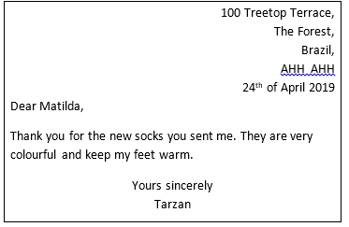
What kind of letter is this? What features does it have? Who sent it? Who received it?

Slide 8
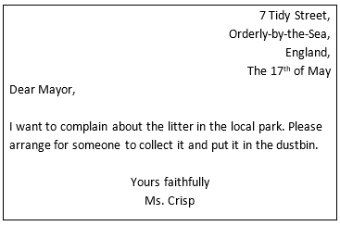
What kind of letter is this? What features does it have? Who sent it? Who received it?

Slide 9
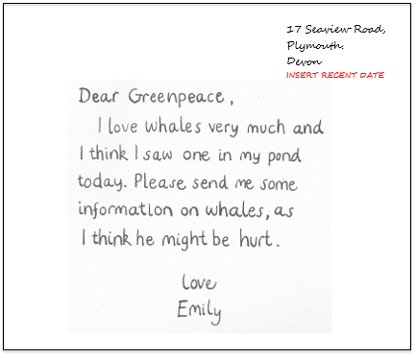
What kind of letter is this? What features does it have? Who sent it? Who received it?

Slide 10
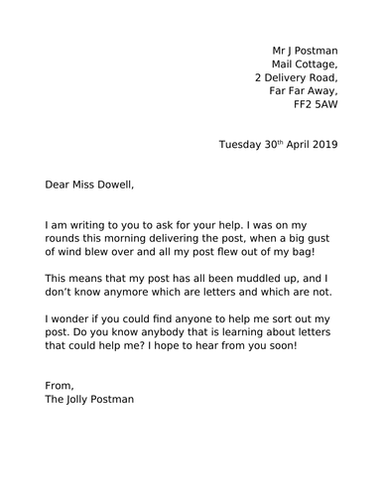
What kind of letter is this? What features does it have? Who sent it? Who received it?

Slide 11
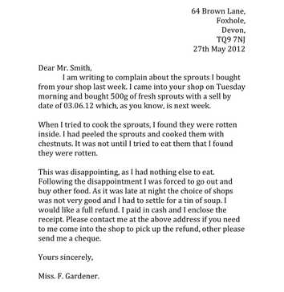
What kind of letter is this? What features does it have? Who sent it? Who received it?

Slide 12
Task:
formal
informal
Sort the letter samples into those that are formal and those that are informal.

Slide 13
Independent tasks:
In small groups discuss the collection of letters. Use these questions to guide your discussion. Try to answer in full sentences.
What are the features of the letter?
Who is the letter to?
Who is the letter from?
Why was the letter sent?
The letter was sent because…..

Slide 14
Challenge 1:
In your group, sort the letters into those that are formal and those that are informal.
formal
informal

Slide 15

Extension:
Write a list of the key features of a letter. Discuss this with your group and record your ideas on a whiteboard.

Slide 16
Plenary
Model writing a short letter to a friend.

