Slide 1
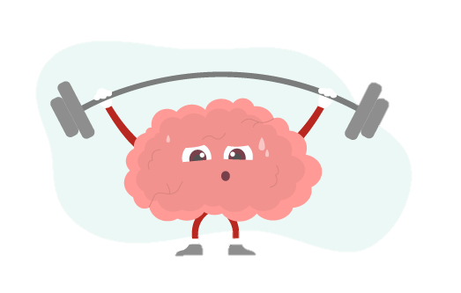
LO:To create a self-portrait inspired by growth mind set.

Slide 2
What is a growth mindset?

Slide 3
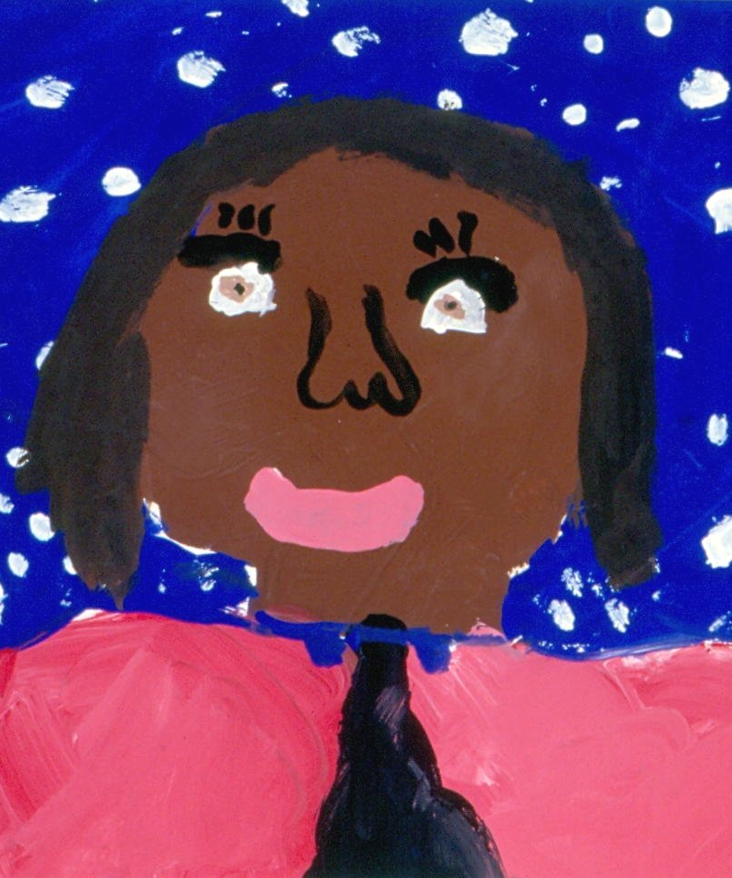
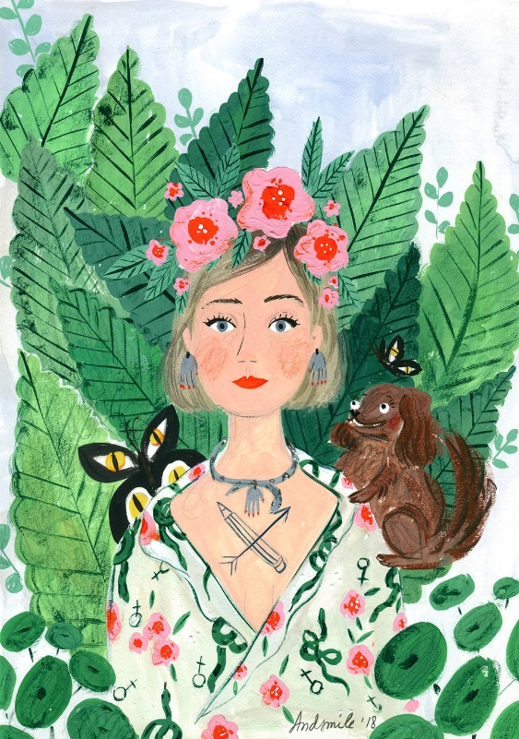
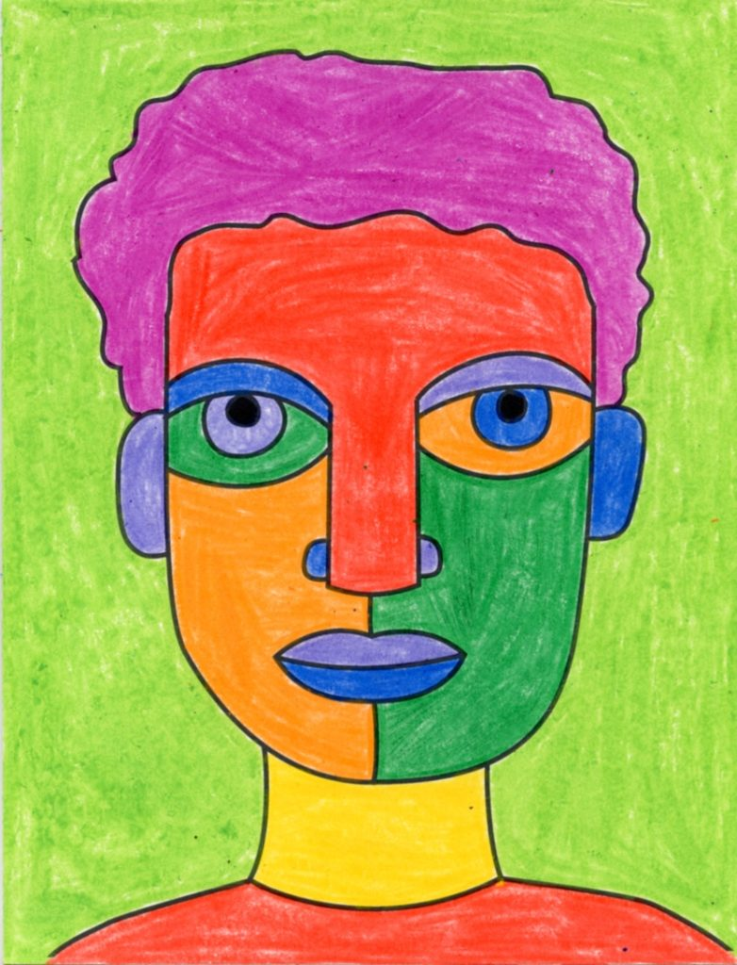
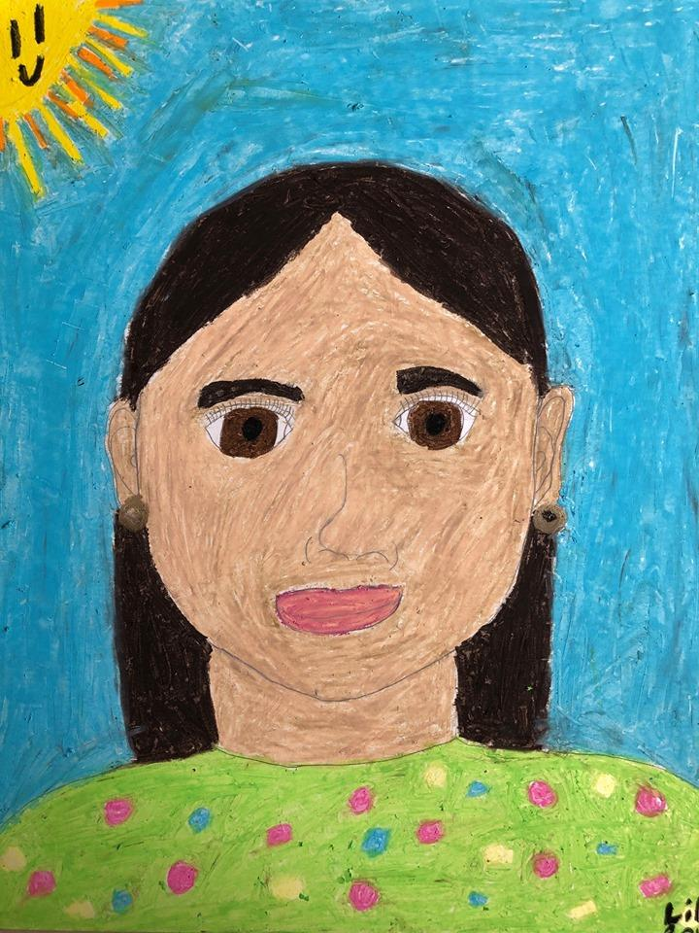
What is a self portrait?
A self portrait is a drawing of yourself.
Today we are making a portrait of ourselves to inspire us when we have a fixed mindset.

Slide 4
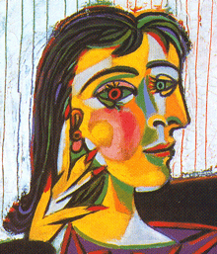
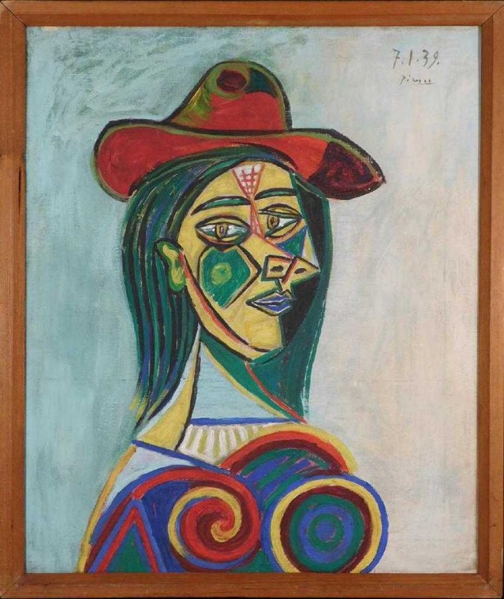
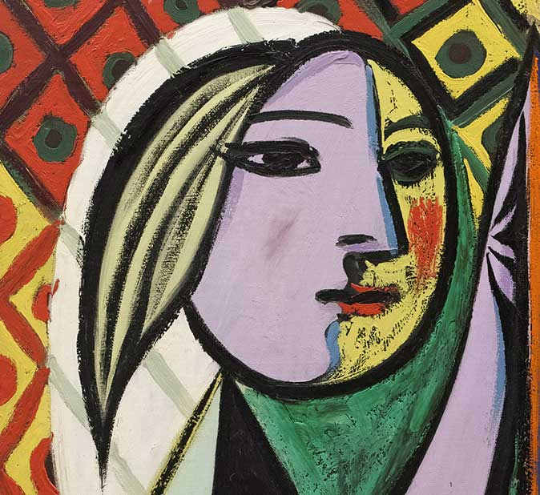
Picasso
Picasso is an artist who painted portraits, what do you think of them?
Picasso had a growth mindset, when he started people didn’t like his work but he still continued to paint them. Now he is one of the most regarded artists in the world.

Slide 5
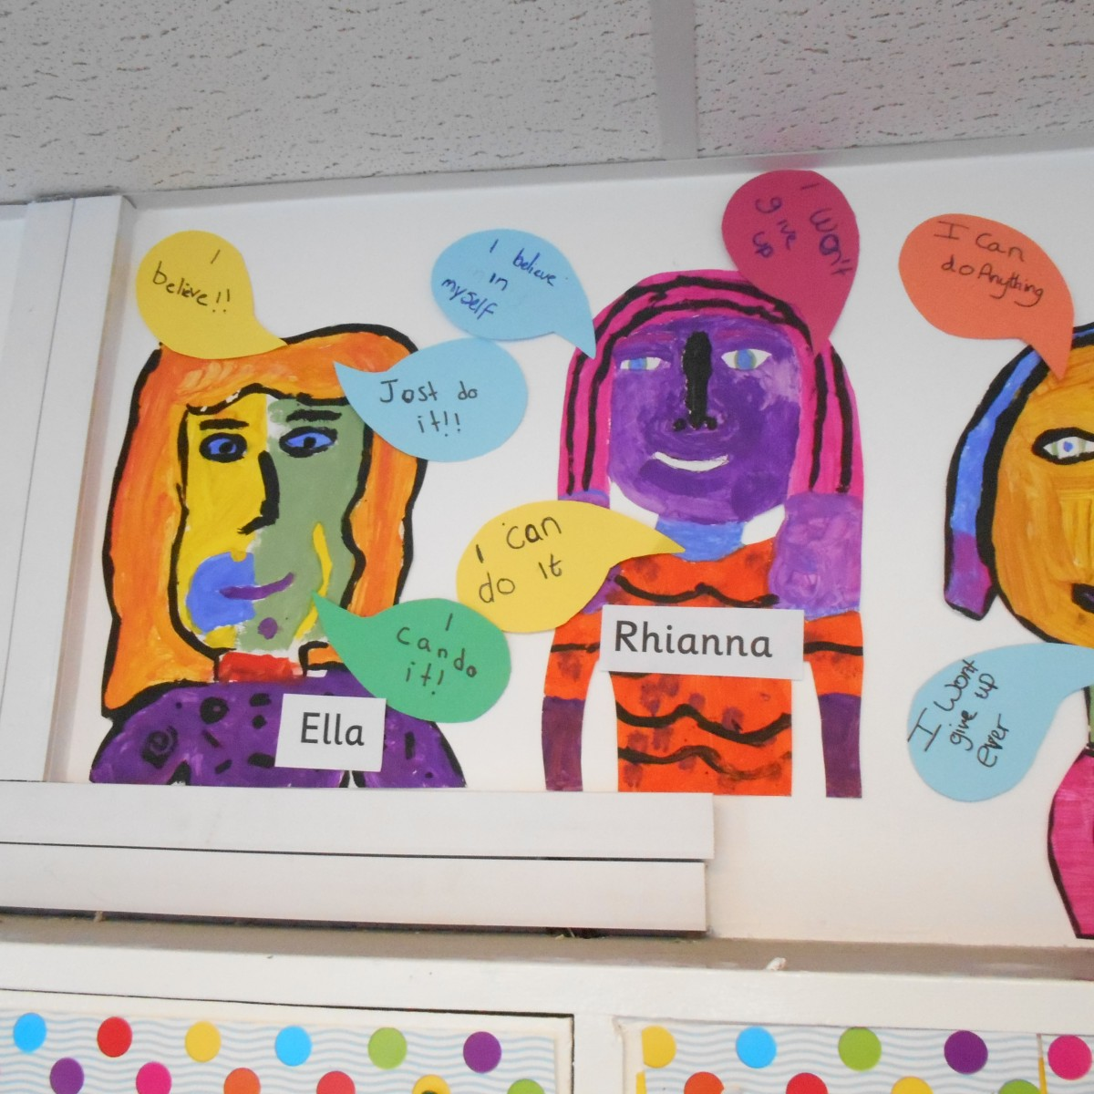
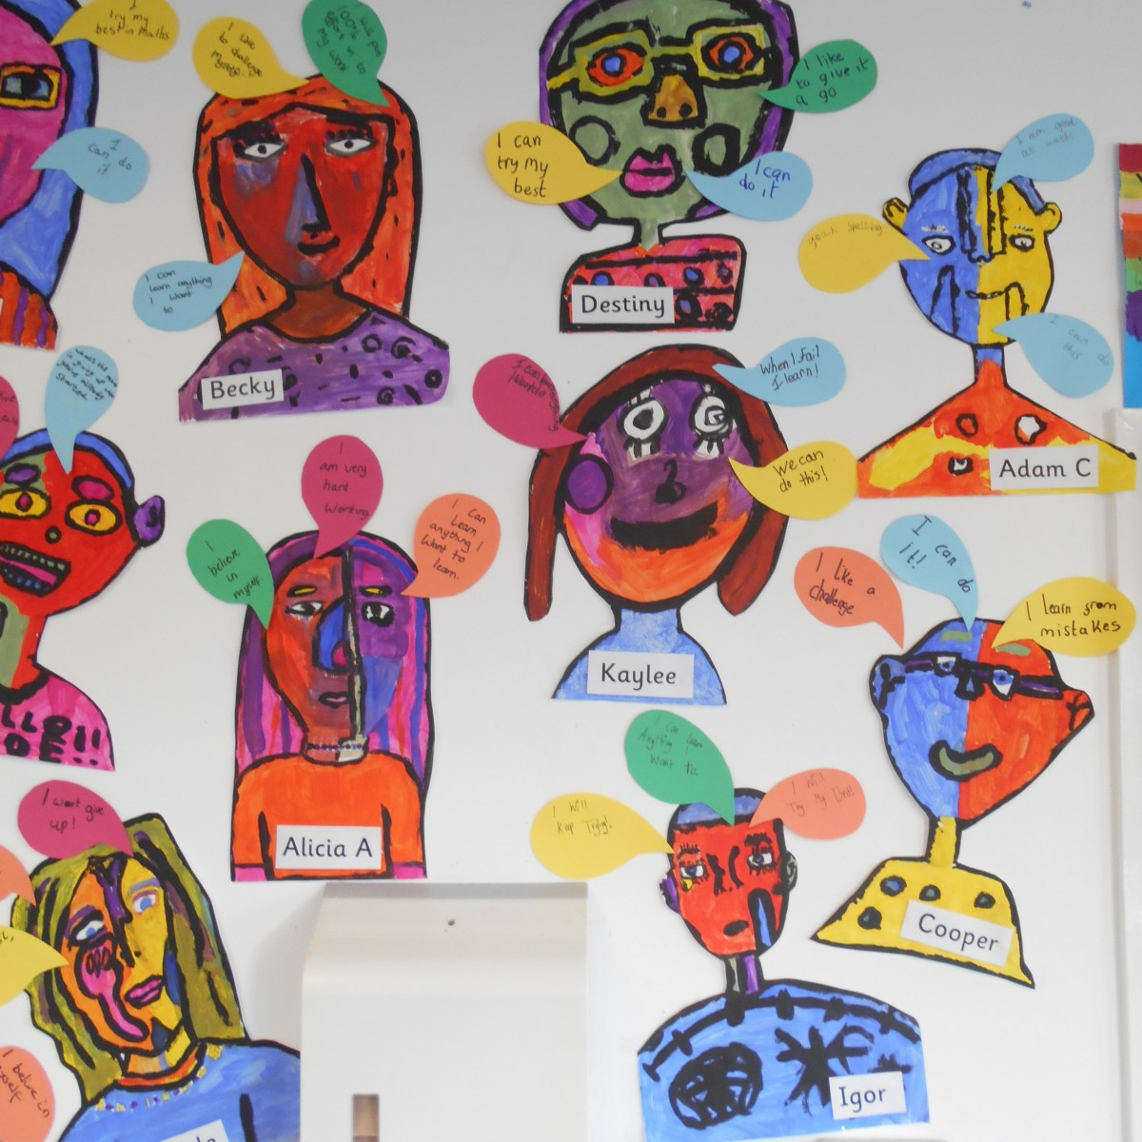
Today we are going to be artists and make Picasso inspired portraits with speech bubbles with growth mindset mottos!

Slide 6
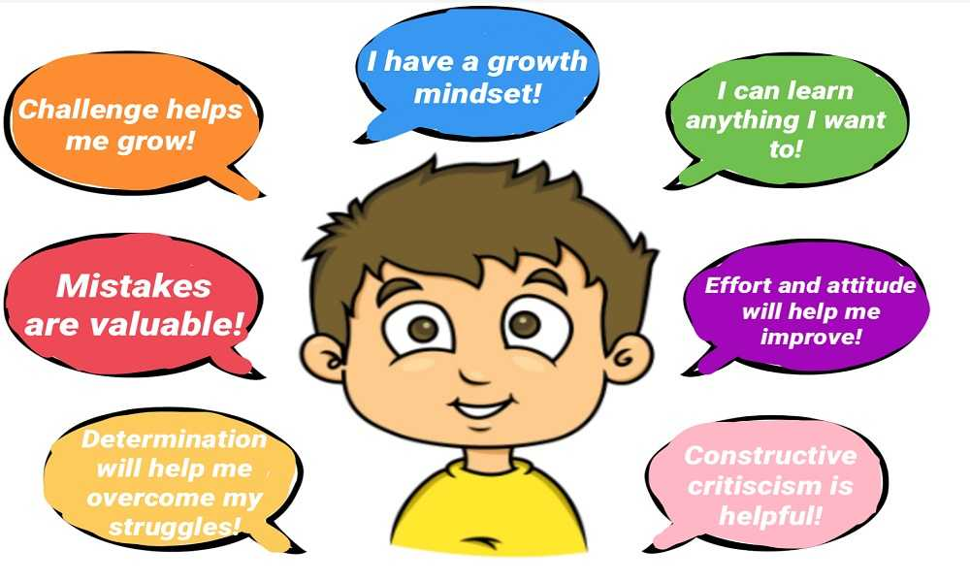
What things could we say to each other when we have a fixed mindset?

Slide 7
Task:
Create a self portrait (like the ones on the left), you can use paint or oil pastels but use bright colours!
You can also use black to define the outline.
Then create a speech bubble to add with a something to say to yourself when you have a fixed mindset.

